Slide 1

Malawi NTD Scorecard
Management Tool
June 2021

Slide 2

Specific Objectives
General Objective
Operationalize Zambia’s NTD scorecard management tool at national level
1. Understand what a scorecard is and how to use it for action.
2. Understand scorecard indicators and thresholds.
3. Identify routine management mechanisms into which the tool will be integrated.
4. Learn how to access and use the online scorecard web platform.
5. Analysis of the NTD scorecard Q4/2020.

Slide 3


Proposed Agenda for Malawi NTD Scorecard Indicator Review and ToTs (7 to 11 June 2021)
Date | Activity | Participants | Presenter
Monday 7th June 2021 | Preparatory meeting with 5 NTD programmes at MoH Departure from Lilongwe to Salima | ALMA and NTD Programmes | ALMA & NTDs
Tuesday 8th June 2021 | Introduction to the scorecard for accountability and action Update on the use of the NTD scorecard in Malawi Review of the NTD scorecard indicators Training on the web platform | ALMA, NTDs and partners | ALMA, NTDs and partners
Wednesday 9th June 2021 | Training of administrators Update of the scorecard | ALMA, NTDs and partners | ALMA, NTDs and partners
Thursday 10 June 2021 | Analysis of updated scorecard and action tracker exercise Training on the scorecard hub | ALMA, NTDs and partners | ALMA, NTDs and partners
Friday 11 June 2021 | Next steps as defined by NTD Programmes Partner session (expectations, support) | ALMA, NTDs and partners | ALMA, NTDs and partners

Slide 4
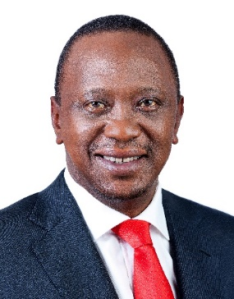
ALMA: An alliance of 55 Heads of State and Government in Africa
ALMA was launched as a collective, coordinated response
to complement efforts to rid Africa of malaria
  Provides a forum for Heads of State to review progress and address challenges in meeting the malaria targets
  Implements a continental monitoring and accountability system through the ALMA Scorecard for Accountability and Action to track results, identify bottlenecks, and facilitate action
  Supports countries with rollout of national scorecard management tools for malaria, RMNCAH, and NTDs, as well as for nutrition and community
  Identifies and shares lessons learned for effective implementation of national and regional programmes
  Maintains focus and collective attention on malaria within the AU, international community, UN and regional organizations
His Excellency Uhuru Kenyatta, President of the Republic of Kenya and current ALMA Chair
ALMA Scorecard for Accountability and Action

Slide 5
ALMA has assisted countries across Africa in the development and strengthening of national Malaria, RMNCAH, and NTD scorecards
  Between 2012 and 2021 ALMA has supported the development of:
    29 RMNCAH Scorecards
    40 malaria Scorecards
    6 NTD Scorecards
    1 country with Malaria-NTD integrated scorecard
    4 Community Scorecards
    2 Nutrition Scorecard (AFDB and TZ)
  Scorecards are updated quarterly and integrated into existing management and decision making processes
  ALMA has continuously supported the implementation and strengthening of country scorecards in order to:
    Strengthen the capacity to ensure sustained use of the tool
    Document best practices
    Provide additional support as needed
Countries with ALMA supported scorecards
Morocco
Tunisia
Objectives
  ALMA Heads of State and Government prioritize malaria control and elimination
  Malaria is maintained high on the political and policy agenda at national level in ALMA member countries & across the region
Sahrawi Arab
Democratic Republic
Algeria
Libya
Egypt
Mauritania
Niger
Senegal
Mali
Sudan
Eritrea
Djibouti
The Gambia
Burkina
Faso
Chad
Guinea-Bissau
Guinea
Benin
Sierra Leone
Côte
d'Ivoire
Togo
Nigeria
Central African
Republic
Ethiopia
Liberia
Ghana
Cameroon
South Sudan
Equatorial Guinea
EG
Uganda
Somalia
Gabon
Congo
Kenya
São Tomé
and Príncipe
DR Congo
R
Rwanda
Angola
B
Burundi
Community
Tanzania
Nutrition
Angola
Comoros
Malaria and RMNCAH
Zambia
Malawi
Mozambique
RMNCAH
Namibia
Zimbabwe
Madagascar
Botswana
Malaria
ESwatini
NTD
South Africa
No Scorecard
Lesotho

Slide 6
Introduction to Country Scorecards
June 2021

Slide 7
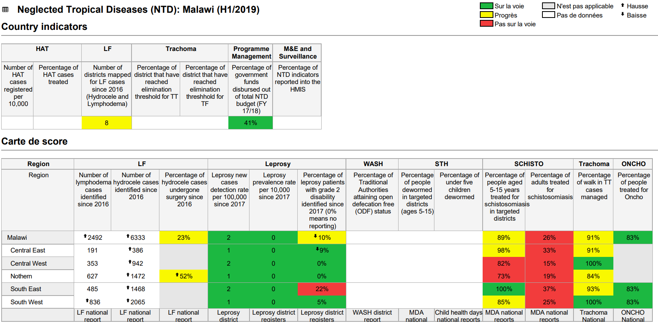
Scorecard Management Tools
A colour-coded management tool that helps Zambia track performance of priority indicators from their strategic plan.
Country-owned and managed.
Uses existing quarterly data from routine sources like DHIS2 and integrated into existing management processes.
Used for action, accountability and advocacy at national and subnational levels through data visualization and management functionalities

Slide 8
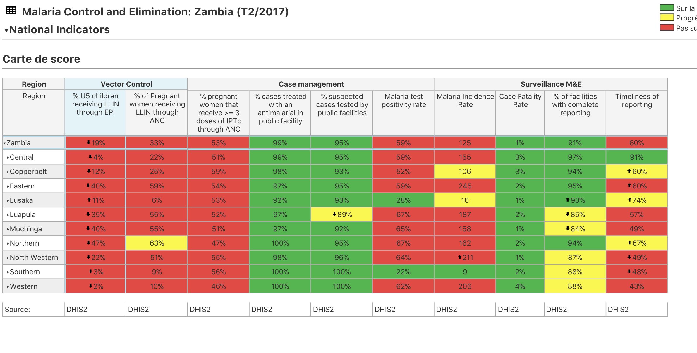
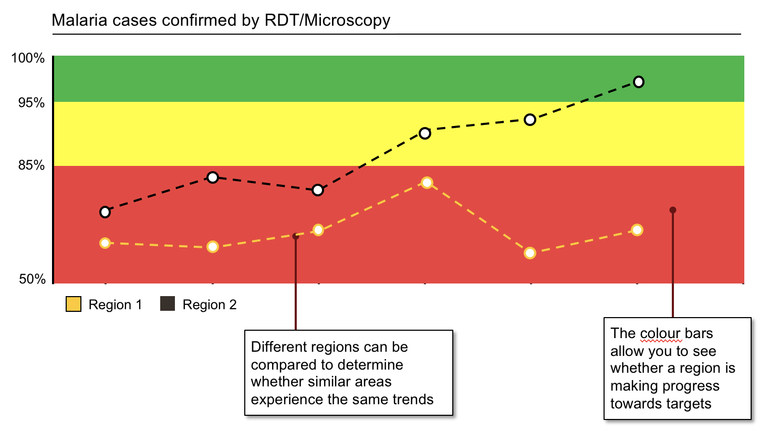
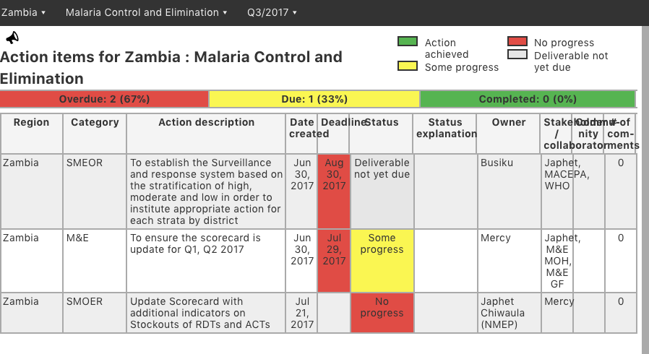
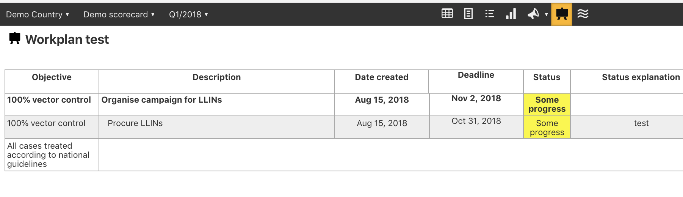

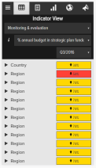
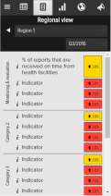
The online scorecard management tool (web platform) includes various data visualization and management functionalities
Scorecard
Action tracker
Charts & Graphs
Action tracker
Workplan manager
Mobile notifications
What It is
What it is
What it is
What it is
What it is
Quarterly performance of priority indicators at national, regional and district level. Some scorecards include facility level data
Charts, maps, and other data visualisation tools provide additional context by showing indicator performance over time
Used to assign actions with deadlines to action “owners”. It includes a progress field showing implementation status and an automated notification system
Tracks implementation of annual workplans, listing key milestones and the progress of action items with clear owners and timelines, and an automated notification system
An automated SMS notification system alerts action owners on outstanding actions and approaching deadlines
Only users with accounts can access scorecards and management tools at www.malariascorecard.org

Slide 9

Malawi Context
In October 2013 ALMA supported the development of Malawi’s RMNCAH scorecard as a management tool for action and accountability. In 2014, ALMA team returned to support MOH in identifying opportunities to strengthen the RMNCAH scorecard’s use.
In March 2017, the MOH, supported by UNICEF, hosted ALMA over a one-week period during which opportunities to revitalize and expand the use of the RMNCAH scorecard were identified and discussed.
In April 2018, ALMA supported the development of Malawi’s Community scorecards as a management tool for action and accountability
In November 2018 ALMA supported the development of the malaria scorecard. In September 2019,ALMA supported the revitalization of the malaria scorecard.
In April 2019, ALMA also supported the development of Malawi’s NTDs and Community scorecards as a management tool for action and accountability
In November 2019, ALMA supported Malawi malaria, RMNCAH and NTD scorecard decentralization where NTD Focal Points from 13 districts attended the workshop
The scorecards were developed with the team and leadership from the RMNCAH, Malaria, NTDs, Community Health and the in-country partners of these programes.
It was agreed that the scorecard management tool will:
      Strengthen existing decision-making processes
      Identify priority areas for action and;
      Track the implementation of key interventions

Slide 10
Scorecard indicator review
June 2021

Slide 11

Context and objectives
Context
Objectives
  The scorecards for NTD control and elimination will consist of national and sub-national indicators.
  Indicators should reflect national priorities and serve to motivate action and accountability.
  Indicators may change as the country moves towards elimination.
  Select a balanced list of strategic objectives and indicators of NTDs control and elimination
  ~ 10 national indicators
  20-25 sub-national indicators
  Define the numerators and denominators of the selected indicators.
  Determine the initial performance thresholds of selected national and sub-national indicators.

Slide 12
Selection of categories and indicators, pressure testing, and the establishment of priorities and data collection
1
2
3
4
Select appropriate categories
develop initial indicators list and prioritise
Select color thresholds
Populate the scorecard
  Select categories by considering priority areas across:
  National plans/strategies
  Causes of endemic NTDs in Malawi,….
  Levels of service delivery
  Community engagement and priorities
  Correctly and accurately label indicators
  Be clear on the units, numerators and denominators
  Use strategic plan targets to select the color thresholds
  Populate the scorecard with available data

Slide 13

  National scorecard management tools support Malaria, NTDs and RMNCAH programmes by:
    Providing an online management system to help countries track performance of key Malaria, NTDs and RMNCAH indicators and manage actions and workplans to improve performance
    Using existing national quarterly data to inform actions that address key emerging issues
    Used to facilitate action, accountability and advocacy at national, and sub-national levels through the action tracker and workplan functions

Slide 14

What are the national targets for NTD control and elimination and the corresponding indicators?
Strategic Objectives
Indicator
Strategic Priority 1: Strengthen government ownership, advocacy, coordination and partnerships
  Ex: Number of high level advocacy events on NTDs;
Strategic Priority 2: Enhance planning for results, resource mobilization and financial sustainability of national NTD programme
  % of planned NTD funds received.
Strategic Priority 3: Scale-up access to interventions, treatment and system capacity building
  Drug administration coverage;
  NTD data completeness and timeliness
Strategic Priority 4: Enhance NTD monitoring and evaluation, surveillance and operations research

Slide 15
Scorecard indicators will evolve as new data becomes available.
3
Wave
2
Wave
1
(Long term)
Wave
(short term)
  Prevalence of malaria among Pregnant women
(Today)
  % of leishmaniosis cases treated according to the standard treatment protocol
  Number of people treated for malaria at community level

Slide 16

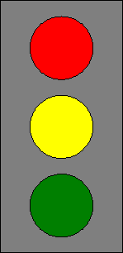
Each indicator will have thresholds set to indicate whether the performance is on track or Not
  Red
Not on the right track.
Thresholds are defined for each indicator in line with national control and/or elimination targets
Red-yellow threshold
  Yellow
Progress but extra effort required.
Yellow-green threshold
  Green
Target reached or on the right track.
The indicators also have "arrow thresholds", which determine the display of a high or low arrow indicating a substantial improvement or not.

Slide 17
How to revise indicators
Indicator selection and revision for the scorecard tool
It is advisable that scorecard categories, indicators and thresholds are revised within 1 to 2 years of scorecard rollout.
Considerations for indicator revision:
Add any new indicators that are priority, actionable and for which there are data available
Review indicators from wave 2 or 3 and put them in wave 1 if the data is now available
Consider removing wave 1 indicators that are no longer priority because the target has been achieved everywhere or consider increasing the targets.
Update thresholds to reflect new targets in strategic plan
Pressure test indicators to ensure they meet the SMART criteria

Slide 18
How to analyse a scorecard
June 2021

Slide 19
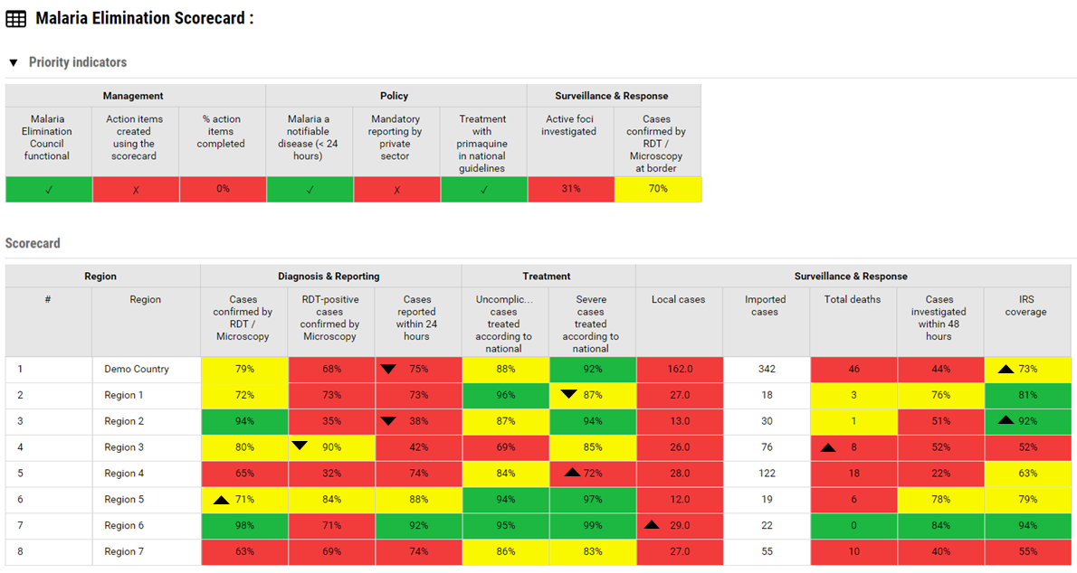
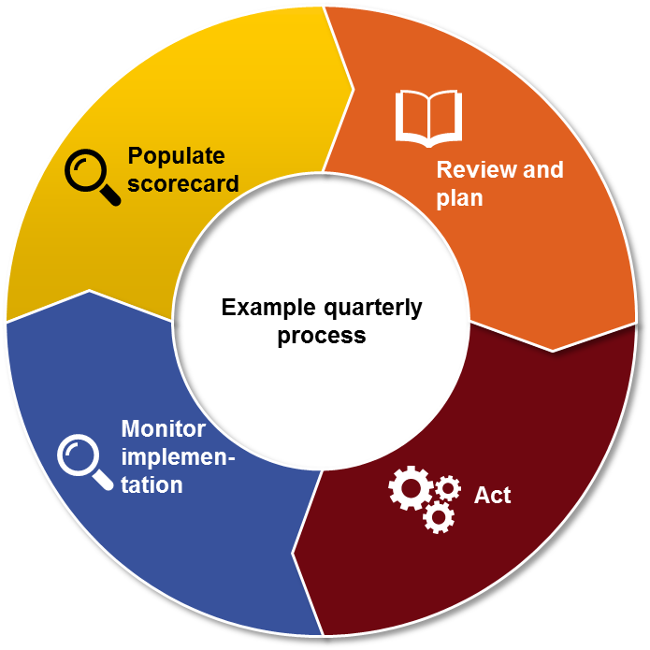
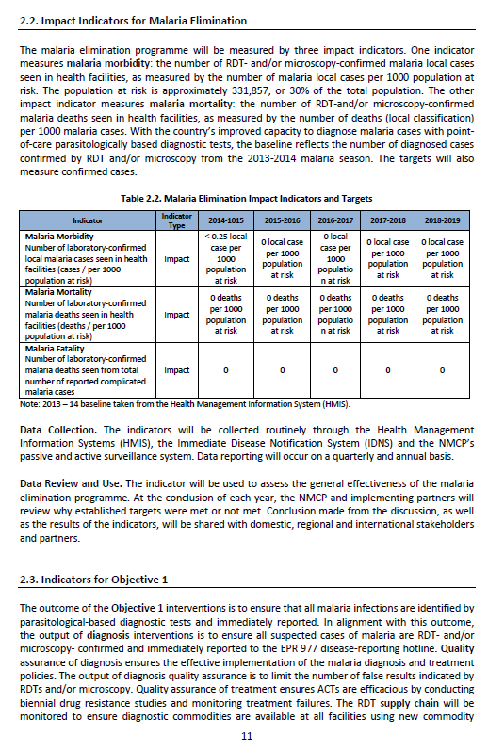
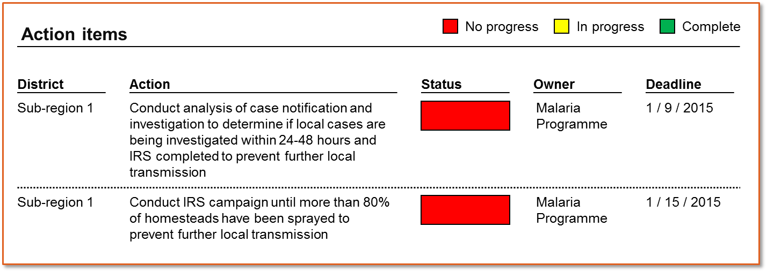

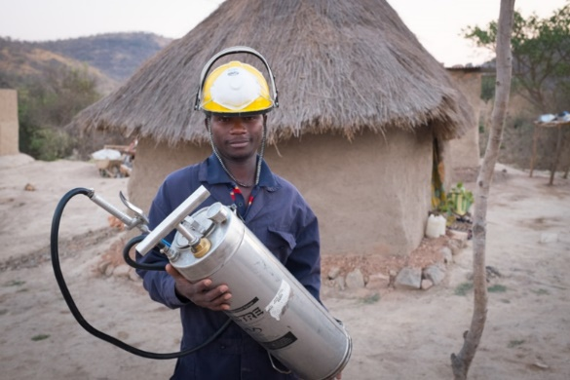
How does the scorecard process work?
1.
Data from existing sources are populated in the scorecard
3.
Existing management processes review the scorecard analysis and document recommended actions in the action tracker.
2.
Analysis
5. .
4.
Management and other existing accountability mechanisms monitor implementation of actions
Programmes and partners implement action items
Notes:
How does the Scorecard Process work?
As a management tool, the emphasis of scorecards should be on how the data is used for action.
Though the process varies depending on the country, many scorecards use the following process
Every quarter, scorecard administrators use data from existing sources like DHIS2 to produce the scorecard.
Technical teams at various levels analyze the scorecard, investigate the root causes of the bottlenecks and propose actions
The scorecard analysis and proposed actions are presented and validated during existing management meetings at all levels. These actions can be entered into the web platform’s action tracker.
Programmes and partners implement the action items; and
Management and other existing accountability mechanisms monitor implementation of actions
If the actions taken had the intended results of addressing the root cause of the issue identified in the scorecard, the data in subsequent scorecards should begin to show improvements.

Slide 20
2. Analyzing the scorecard to create actions…
1
Prioritise
2
Investigate
3
Act
Identify indicators requiring attention
Identify Provinces and Districts requiring attention
Evaluate whether performance is improving or getting worse
Gather information about root causes of the problem
Determine which factors contribute most to under-performance
Consider whether performance is likely to persist
Develop actions that address the root causes identified
Input action items into web platform and monitor
Notes:
Analyzing the scorecard to create actions is a three step process: prioritise, investigate, and create actions.
Prioritizing is an important first step because, in a world of limited time and resources, it is usually not possible to resolve of all the problems revealed by the scorecard in one quarter. For that reason, scorecard users usually identify 3-5 priorities to focus on every quarter. Prioritization involves identifying the indicators and locations requiring attention, then evaluating whether the performance is improving or getting worse. A Province or district with poor performance that is getting worse is usually prioritized.
After selecting a few priorities from the scorecard, it is important to investigate by gathering information about the root cause of the problem. It is helpful to determine which factors are contributing the most to the underperformance and whether the performance is likely to persist. Investigating the root cause of the problem often requires communicating with the people on the ground, where the under-perfomance is taking place.
Once the root causes of the problems are known, it is essential to develop actions that address the root causes of the bottleneck identified. Those actions, can then be input into the scorecard web platform which allows managers to monitor the implementation progress of actions. In the next slides, we will dive deeper into how to prioritize, investigate and act.

Slide 21

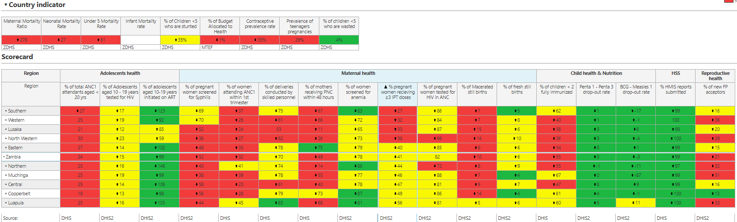
Three dimensions to each cell
3. How to prioritize using scorecard data…
Colour
Arrow
Data value
Notes:
So how can we use the scorecard to prioritize which problems to address?
Each cell on the scorecard has three dimensions to help guide your analysis: a colour, a data value, and sometimes an arrow.
The colour shows whether an indicator is performing well or poorly relative to the national target set by the country. If the indicator is showing red, it means the associated geographic Province is not meeting target. If it is green, it is meeting target, and if yellow, more progress is need to achieve the target. A grey cell means the indicator is not applicable for that geographic location for that period and a white cell means there is no data. An indicator that is performing green may be worth highlighting as a best practice that can be scaled up to other Provinces.
The data values on the scorecard come from various existing local routine data sources. Most scorecard indicators are configured in percentage format, whole number, or decimal, though it is possible to include other formats. In some cases, it is better for the value of an indicator to go up. For example, in the case of Vitamin A coverage, a higher percentage is good and a lower percentage is bad. For other indicators a lower number is considered to be good. For example, in the case of malaria incidence, a lower number is considered to be good.
In addition to the colour and data value, sometimes the scorecard will show an arrow. An arrow will only appear if the performance has changed compared to the previous scorecard or the previous year. For example, if the arrow threshold set by a country is 5%, then an arrow will only show if the percentage increases or decreases by 5 or more points. So if there were a decrease from 50% in Q1 2020 to 45% in Q2 2020, the scorecard in Q2 2020 would show a down arrow, signifying the number has gone down. It is important to note that a green colour indicator with a down arrow may also highlight a priority, since it means the gains are not being sustained and the green may turn to yellow or red eventually.
The colour, the arrow and data value can help to guide the scorecard analysis and prioritization. A red with an arrow showing that the performance is bad and getting worse, is a very high priority.

Slide 22
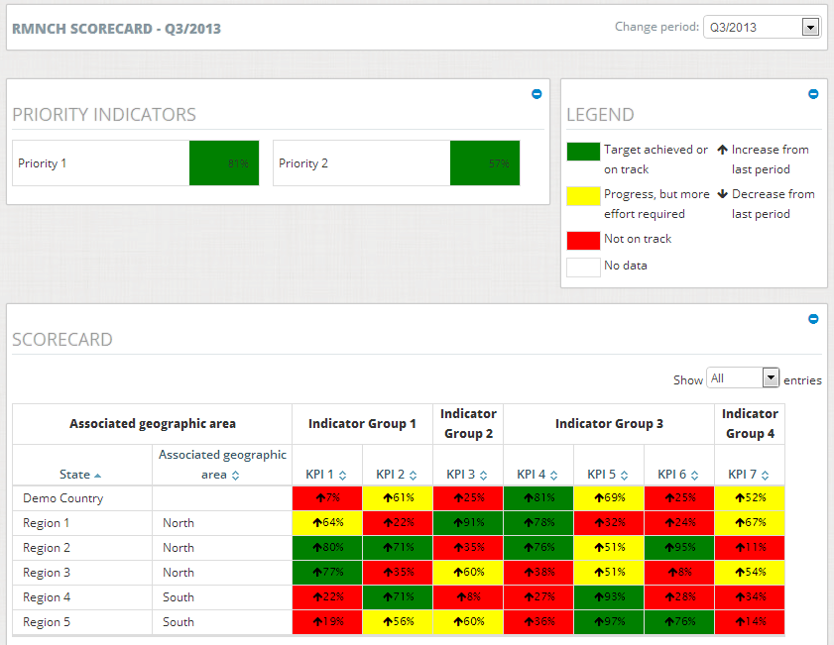
Three analyses help identify and prioritise specific Provinces and indicators for potential intervention
  BY ARROWS: Arrow indicates a change in performance relative to the previous scorecard or year, and may highlight the need for action
  BY INDICATOR: Low performance of a given indicator across most Provinces highlights systemic bottleneck to achieving objectives
  BY GEOGRAPHIC AREA: Low performing indicators in each Province highlight areas of focus for action items
Notes:
In addition to the arrows, which may highlight a need for action, it is also helpful to analyse multiple cells at a time across rows and columns to identify systemic issues.
For example, it is possible to analyze columns to see if there is a systemic issue with an indicator. If an indicator is showing red in many geographic locations, this likely means there is a systemic bottleneck making it difficult to achieve the targets for that indicator. Systemic issues often require a broader high-level solution.
It is also possible to analyse across rows, which represent geographic locations. If there are multiple reds across a row, this means there is systemic issue with a geographic location which requires intervention.

Slide 23
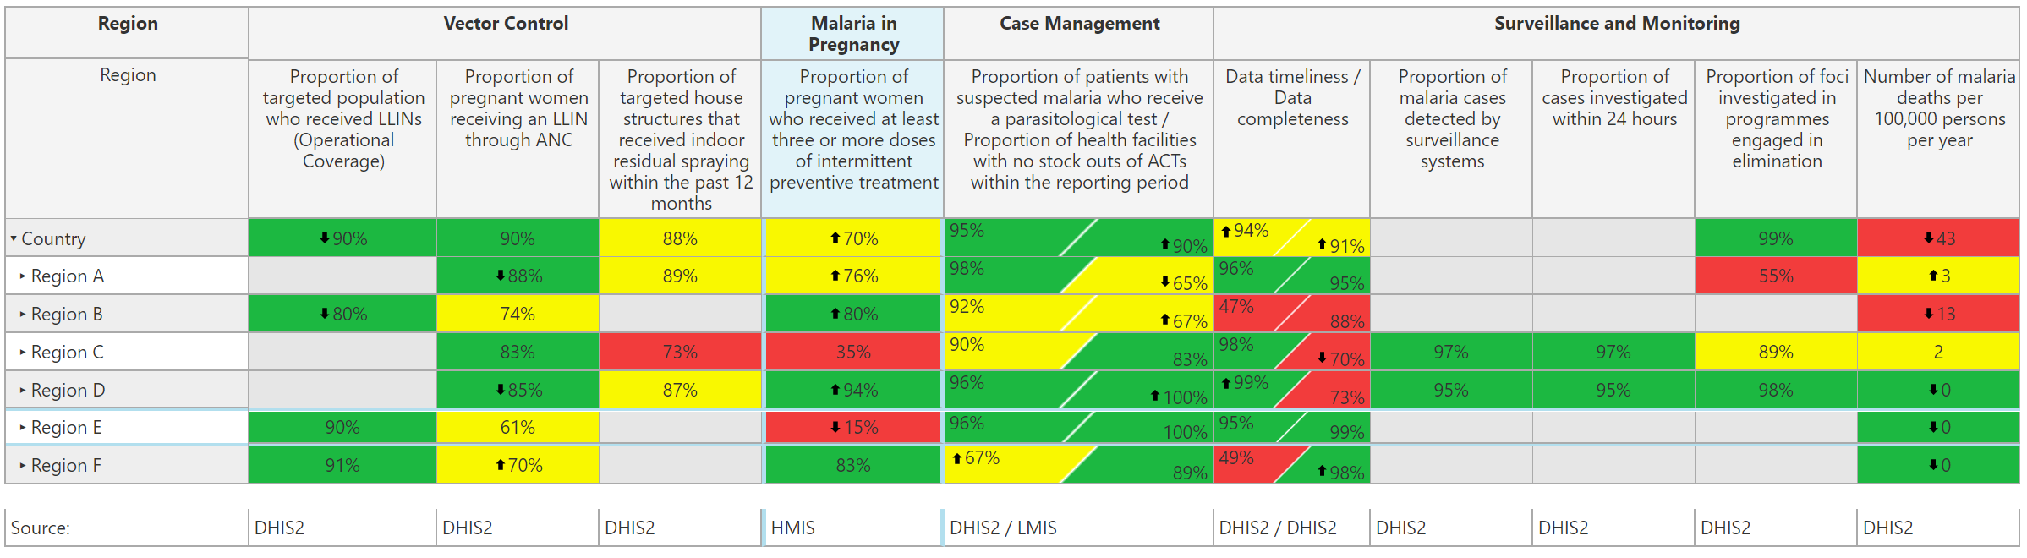
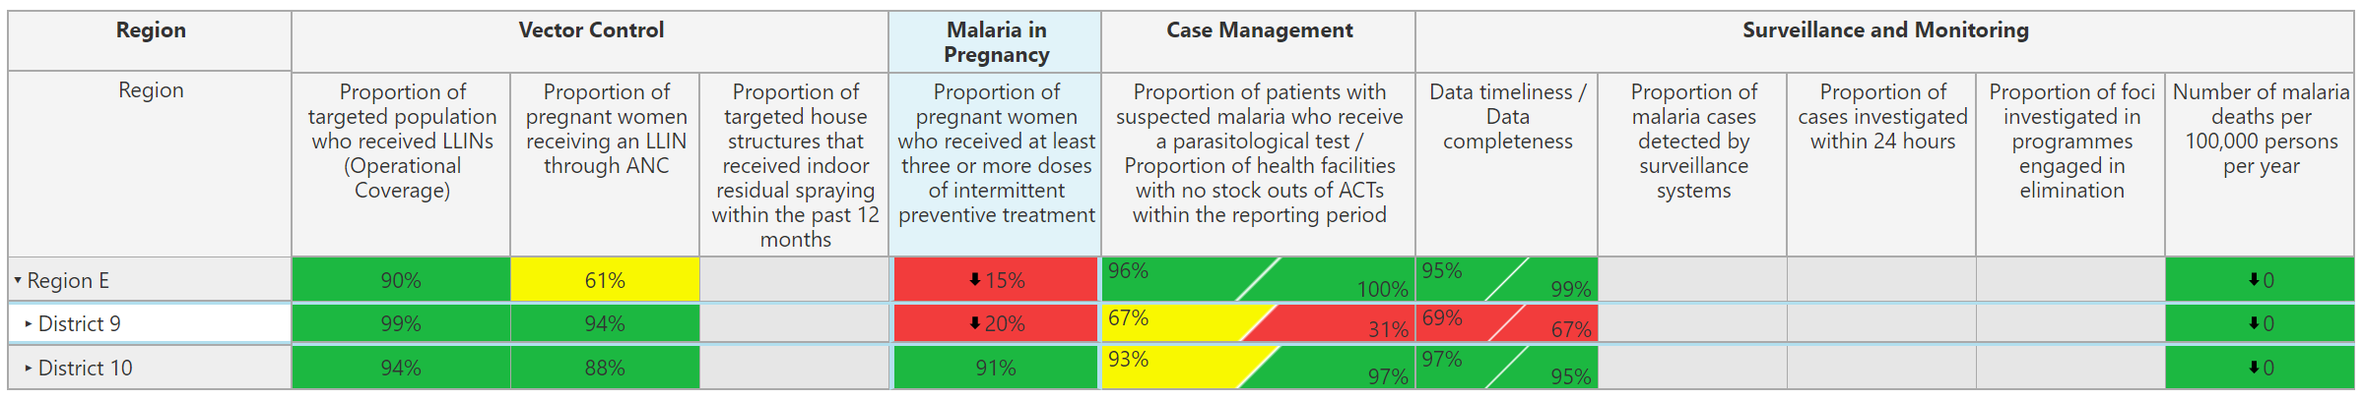
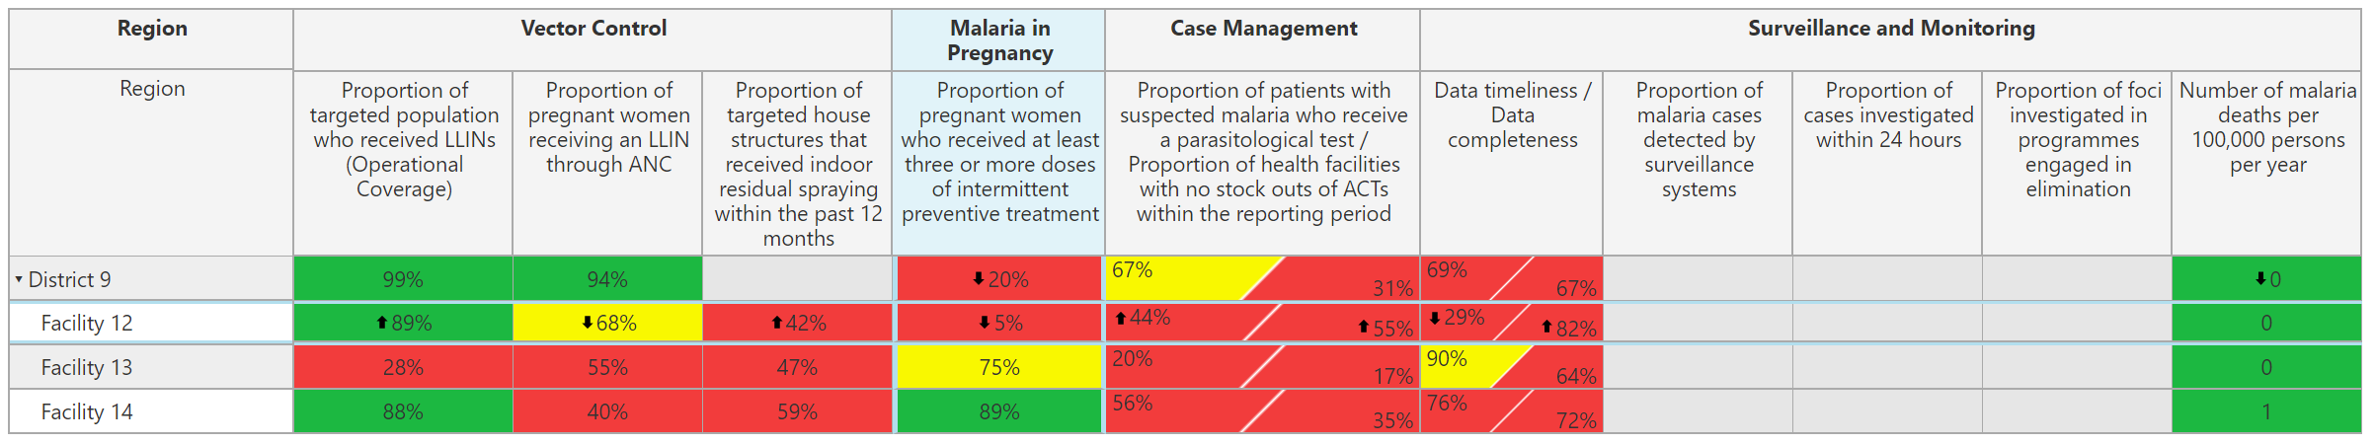
When you identify a problem, open Province to see the performance of the Districts…
“Drill down” by clicking on the arrow next to the name of the Province
Open Province to see which Districts are contributing to the under performance
Open District to see which health facilities are contributing to the under performance
This will help you “find” where the problem is
Open Districts to see the performance of health facilities
Notes:
The scorecard web platform allows users to open sub-Provinces to see the performance of the lower levels, allowing for a more targeted analysis showing where the problem is.
Opening sub-Provinces, or drilling down as it is called, is an important strategy for finding which geographic locations are contributing the most to underperformance.
Take the example in front of you. In the case of the indicator for “Proportion of pregnant women who received at least three or more doses of IPT”, it is clear that Province E is the priority. That indicator in Province E is showing red, at 15%, with a down arrow. It is a bad situation getting worse.
However, to understand the situation better, it is important to open Province E to see how it’s Districts are performing. To see the Districts, in the online web platform, click on the arrow next to the name of the subProvince. In this example, clicking on the arrow next to Province E, will displays two Districts. However, only one of those Districts, “District 9”, is showing poor performance, at 20% with a down arrow. This means it is district 9 that is contributing the most to the underperformance in Province E and District 9 is where the programme should focus its efforts.
Some country scorecards even go down to facility level. In this example, upon opening District 9, it is possible to see that it is actually facility 12 that is mostly contributing to the underperformance. In this way, it is possible to do targeted analysis to create targeted solutions.

Slide 24
How to use the scorecard data for action
June 2021

Slide 25
After identifying the problems, investigate deeper to gain an understanding of the situation
Questions to consider
Questions to consider
Example questions
1. Does this need a solution?
  Is this an anomaly? Or is performance likely to remain the same or even worsen?
2. What are the root causes?
  What are the root causes of the poor performance?
  Are there any causes that are specific to this geographic location that is contributing to the underperformance?
  Which causes can be managed or controlled?
3. What interventions exist?
  What interventions are in place or have been tried?
  What interventions have been successful? Which have been unsuccessful?
  Are there lessons learned from neighbors that can be adopted or scaled up?
  Can the community play a role in solving the issue?
Notes:
While the colour-coded scorecard data provides a good starting point for finding the problem, it is important to investigate deeper to understand the situation. Key questions to consider may include:
Does this need a solution? It is important to understand whether the scorecard data truly represents a problem requiring a solution or if it is simply an anomaly or even a data quality issue. Ask yourself, is the performance likely to get worse? If yes, then it is important to take action.
What are the root causes of the problem? Creating an action that will solve the problem requires understanding the root cause of the poor performance. Are there any factors specific to this geographic location that are contributing to the underperformance? Which root causes can be managed or controlled? And finally….
What interventions exist? What interventions are in place and have been tried? Have any been successful? Have any been unsuccessful? Are there lessons learned and success stories from neighbors that can be adopted or scaled up? And can the local community play a role in solving the issue?
The answers to these questions can help to guide the actions required to address the issues identified by the scorecard.

Slide 26


Formulate actions that are easy to understand, and adhere to 4 guiding principles
Actions should look like this…
…and not like this
Specific and practical
  Install 3 new computers with LMIS software in each Provincial medical store
  Improve quality of LMIS data
Owner is capable of implementation
  The NMEP manager write a letter, signed by the Minister of Health, to the CCM to secure funding for 5 million LLINs for national campaign through the Global Fund (owner = Malaria Programme Manager)
  The District should ensure LLIN coverage is maintained (owner = District?)
Actions have clear owners in country
  Director of Maternal & Child Health to establish a regular forum to engage partners, mobilise funds and improve funding allocation
  Increase total donor contribution to RMNCAH Sector
Progress can be tracked effectively
  RHMT to work with local NGO to scale up hand-washing initiative in the 5 communities with high diarrhea prevalence in district X
  Improve hand washing in district X
Notes:
Remember, the main focus of a scorecard is not just the data, but rather how the data becomes an action. It is important to formulate actions that are easy to understand and adhere to 4 guiding principles.
Actions should be specific and practical: If there is a problem with data quality, it is not helpful to have the action “Improve quality of data”. This action is not clear or specific enough. The action should focus on how the outcome is going to be achieved rather than the outcome. In this example, the action should tell us what steps need to be taken to improve data quality – it is not helpful just to state the outcome “improve data quality”. A good example of an action might be “Install 3 new computers with LMIS software in each Provincial medical store”. This is specific and cannot be confused.
Owners should be capable of implementation: It is important to assign actions to people that are able to do something about the issue. In this example “The NMEP manager will lead an effort to secure funding for 5 million LLINs for national campaign through the Global Fund” the owner of the action is the Malaria Programme Manager, who is capable of implementing the action. In the counter example, the district has been tasked with maintaining mosquito net coverage. This is an example of a poorly formulated action since the owner in this case cannot do much about this action.
Actions should have clear owners in the country. Creating an action without a clear owner is ineffective because no one feels responsible for implementation. In this correct example, the Director of MCH is in charge of the action, while in the counter example “Increase national total donor contribution to RMNCAH sector”, there is no clear owner.
Actions should be written in a way that allows for progress to be tracked effectively. Actions should have a number or deliverable that can be used to track whether the action has been accomplished. In this example, the RHMT is responsible for scaling up a hand washing initiative in 5 communities with high diarrhea prevalence. It is clear from the way this action is written that in order to achieve the target, at least 5 communities should receive the intervention. It is not helpful to have an abstract action like the counter example of “Improve hand washing in district X”. It is not clear how to track whether handwashing has been improved.
In summary, actions should be specific, with a clear, in-country owner, and the progress of the action should be trackable. The action should focus on the steps required to improve the performance, rather than the desired outcome.

Slide 27
Sample action categories
Action category
Description
Advocacy for high level policy and strategy change
  Changes to national and local policy or strategy to enable more effective implementation and adoption of initiatives
Petition support from partners
  Advocate for partner support to implement actions that will address underperforming indicators
Manage procurement and supply chain issues
  Changes to procurement & supply management of commodities to avoid disruptions, delays, unfulfilled demand, and poor quality
Build capacity
  Training of personnel and upgrading of infrastructure to maximize effectiveness of resource utilisation
Address Funding
  Identification, securing, and disbursement of funding for RMNCAH products, initiatives, and infrastructure and technology upgrades
Improve quality and utilisation of data
  Improvements in data quality & systems used for monitoring and evaluating that data to track current status and progress
Catalyse community engagement
  Working with the community to identify bottlenecks, and deploy necessary interventions
Investigate the root causes
  Statement of intent to investigate the root cause of the problem to better understand what actions to take
Notes:
In most cases, action items fall into one of these categories: advocacy for high-level policy and strategy change, petition of support from partners, address a procurement and supply chain issue, build capacity, address funding, improve data quality and utilization, and catalyzing community engagement. In some cases, if the root cause of a bottleneck is unknown, the action may be to investigate the root cause of the problem to better understand what actions are necessary.

Slide 28
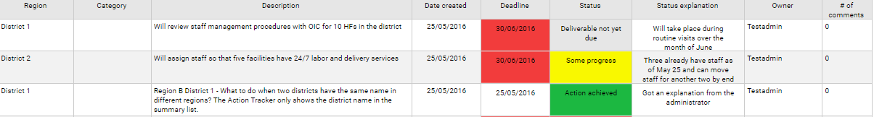
Action Tracker: Actions can be assigned and progress tracked on the scorecard web platform
List of action items, a field showing color-coded implementation status, due date, and owner
Actions can be assigned at all levels
Province 2
M&E
Hire three M&E staff members on temporary basis to clear backlog of HMIS records
15/12/2016
15/12/2016
Action achieved
User 1
1
MPs can see which actions they can support!
District A
M&E
Improve timeliness and quality of data by retraining PHU workers in data management
25/10/2016
25/11/2016
No progress
Training canceled
Admin 3
2
Province 3
Newborn health
Implement excusive breastfeeding for 6 months program at PHUs and conduct community outreach campaign to raise awareness of EBF
30/03/2016
30/09/2016
Some progress
Contacted managers
User 4
0
Missed deadlines are highlighted in red, prompting immediate management attention
Visual indicator of status allows manager to quickly identify which action items are at risk (e.g., yellow = some progress and on track)
Notes:
The scorecard web platform has a management functionality called the Action Tracker, where actions can be assigned and progress of implementation can be tracked. When the scorecard reveals a problem, the action tracker is used by managers to assign to a specific person, an action with a deadline. The web platform automatically sends notifications via email and SMS to the person who is assigned the action, giving them useful reminders that they are responsible for coordinating the implementation of an action. The automatic notifications are sent the day the action is created, 7 days before the deadline, 1 day before the deadline, and every 7 days after the deadline has passed if the action is not marked as complete.
This slide shows a screen shot of the action tracker. As you can see, actions can be assigned at all levels, including at district and even at facility level. The action tracker displays a list of action items, a field showing color-coded implementation status, the due date, and the owner responsible for coordinating the action. Missed deadlines are highlighted in red, prompting immediate management attention. The color-coded visual indicator status allows manager to quickly identify which action items are at risk.
The action tracker, like the other features of the scorecard web platform, is also available on the mobile app which allows programme managers and staff to easily update and monitor progress on action items.

Slide 29
Integrate the scorecard into existing accountability mechanisms
June 2021

Slide 30
Scorecards drive action and accountability
Introduction
Integrating scorecards into ongoing national processes facilitates use and enhances long term sustainability.
The scorecard is intended to support and strengthen existing management mechanisms, such as ministerial, programme or implementation partner meetings and community engagement initiatives.
The scorecard helps focus administrative and political leadership attention on priority areas
The built-in action tracker provides a means to document and monitor actions addressing bottlenecks and challenges
The scorecard also enhances coordination by providing a common tool to track intervention implementation

Slide 31
Integrate scorecard tools into existing accountability mechanisms
Introduction
Identify the key stakeholders who should be engaged for scorecard review
Identify the key accountability fora where the scorecard can be integrated for review and action
Define the quarterly process for populating and analysing the scorecard and documenting and monitoring actions

Slide 32
Who you should share the scorecard with
1. Identify the key stakeholders
Stakeholder | Broad responsibility
Political leaders | Performance transparency Using political power and resources to improve health where it matters most
Programme and Ministry of Health directors | Identifying key gaps in programming Changing policy to foster improvements Re-allocate resources to solve problems requiring funding
Development partners | With Ministry of Health programmes, identifying and providing financial and/or human (such as technical assistance) resources for programme needs Engaging the community around specific bottlenecks
Subnational stakeholders | Supporting implementation Benchmarking performance, data validation Feedback on implementation effectiveness
Community | Validating and supplementing data Joint problem solving to identify bottlenecks and propose community-oriented solutions

Slide 33
Potential fora for the scorecard
2. Identify existing accountability mechanisms
Relevant meetings | What are all of the official, regular government meetings at each level of government that discuss health programmes and outcomes? How frequently do each of these meetings occur?
Stakeholder attendance | Which meetings are attended by technical health staff? Elected officials? Development partners? Local NGOs? Which meetings are attended by stakeholders who run community health engagement programmes?
Discussion topics | What topics are discussed during each meeting? Are community health programmes discussed? Which meetings are focused on presenting updates versus conducting evaluations, setting priorities and reviewing programme progress?
Scorecard integration | Are the scorecard and action tracker already discussed in any meetings? Is there time available during the meeting agenda to discuss the scorecard itself or the action tracker? Would it be useful to discuss current performance and progress on specific health indicators during this meeting? Could the action tracker be used to document follow-up items from meetings?

Slide 34
Opportunities to fully integrate the scorecard into existing management meetings at all levels
Zone / District level
Community level
Central level
NTDs:
Sub-committee of Essential Health Package (EHP)
Programme Review Meetings SCH
Sectorwide Approach
Meeting (SWAP)
NTDs:
Task force meetings
District Executive Committee meetings
DHMT meetings (and extended DHMT)
Health and Environment Committee
Community Health TWG
Community scorecard
Area Development Committee meetings.
Village Development Committee meetings.

Slide 35
Scorecard web platform
June 2021

Slide 36



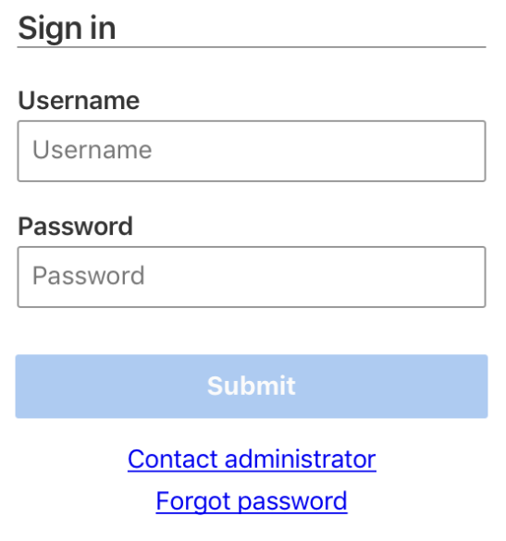
How to login to the scorecard
www.malariascorecard.org
Username: USE YOUR PERSONAL ACCOUNT
Password: USE PERSONAL PASSWORD
or on your mobile and tablet
Download the app “country scorecard”
Android app
iphone app
Instruction | Icon
1. Go to the google play store by clicking on this icon on your mobile or tablet
2. Search for “country scorecard” and download the app
3. Open the app and login using your account credentials
Instruction | Icon
1. Go to the apple store by clicking on this icon on your mobile or tablet
2. Search for “country scorecard” and download the app
3. Open the app and login using your account credentials

Slide 37
Web platform training
June 2021

Slide 38
Action Tracker Training in Demo
new.demoscorecard.org
Username: Malawi Demo
Password: 123456
Exercise:
Create 1 new action with status “deliverable not yet due” (pay attention to how you formulate these actions. They should be SMART)
Update your action status and provide a status explanation

Slide 39
Typical order of Web Platform Training
Add accounts before the training!
General:
How to login (www.RMNCAH.org or app)
Contact Admin (login screen)
Forgot password (login screen)
Structure (categories, national vs subnational)
3 dimensions of each cell (color, data, number)
Indicators
Sort indicators
View indicator definitions
Drill down (how to open the Provinces and Districts)
Top Menu:
Select Province or District
Select type of scorecard (malaria or NTD)
Select quarter
Scorecard button
Subnational view
Indicator View
Charts
PDF download
In the end, it is possible to do a comprehension “test” to make sure they understood

Slide 40
Web Platform
Comprehension Exercise
June 2021

Slide 41
Scorecard Web Platform Comprehension Activity
Go to the action tracker
Go to the scorecard
Select the scorecard for H1 2018, then go to H1 2019
Isolate the scorecard for one Province.
Download a PDF of a Provincial scorecard which also shows the districts
Create a line graph that compares the performance (Percentage of leprosy patients with grade 2 disability identified since 2017 (0% means no reporting) for a Province and 3 districts for the periods H1 2018 – H1 2019
Create a line graph that compares the performance of “Percentage of adults treated for schistosomiasis” or 6 districts, then generate a PDF of that graph. (H1 2018 – H1 2019)

Slide 42
Scorecard Web Platform Comprehension Questions
Generate a subnational view report showing the performance of a district for quarters (H1 2018 – H1 2019. Download a PDF of that report.
Generate a report using the indicator view, which shows the performance for Percentage of adults treated for schistosomiasis” for (H1 2018 – H1 2019)
Go to the action tracker. Add an action in the action tracker.
Then update the status of the action to “Action Achieved” and write a status explanation.
Download an excel of the action tracker.
Add a comment to an action

Slide 43
How to create an analysis and action presentation for existing meetings
June 2021

Slide 44
Analysis and Action Presentation Exercise
CREATE A POWERPOINT PRESENTATION
Slide 1: Insert a screenshot of the Provincial scorecard in a PPT and circle at least 2-3 priorities on the scorecard. This can be an individual cell, multiple cells across an indicator column, or multiple cells across Provinces, Districts, or Facilities. Take a screenshot of the scorecard and insert into the PPT.
Slide 2: create a table with an Executive Summary which highlights the key priorities
For EACH priority:
Generate a report using the “indicator view” function to show the performance of each priority indicator for the periods H1 2018 – H2 2019. Insert the charts into the PowerPoint Presentation.
Generate a line graph for each priority indicator comparing the performance of six Facilities or Districts. Use periods H1 2018 – H2 2019. insert into the PPT.
Create a table with three columns (Priority / Potential Causes / Actions). For each priority, write a list of 1-3 potential causes, and select one action to address the potential causes. Add the table to the PPT. For this exercise, you should communicate with people on the ground to obtain their feedback.
Put the actions in the action tracker and insert a screen shot into the PPT.

Slide 45
EXAMPLE: Scorecard Analysis
Identify three priorities on the scorecard.
Create a slide for each priority: write 3 potential root causes of the issue, develop 1 action for 1 of the identified root causes
Enter the actions into the Scorecard platform action tracker
Priority Issue | Potential Causes | Action

Slide 46
GROUP PRESENTATION

Slide 47
Roles and responsibilities and
Next Steps
June 2021

Slide 48
EXAMLE: Malaria Scorecard Roles and Responsibilities for scorecard (Provinces)
Activity
Responsible
Jan
Feb
Mar
Apr
May
Jun
Jul
Aug
Sep
Oct
Nov
Dec
Jan
H1
H2
Health Information Officers
Data input into DHIS2
NTDs&M&E
Populate the scorecard
Analyse scorecard and propose actions
Provincial and District ntd Focal Points
Actions validated and put into action tracker
Provincial Health Teams and District Health Teams
Action implementation
Province, District teams
Monitoring of actions
NTDs, Province, District teams
H1 Scorecard
H2 Scorecard

Slide 49
Next Steps: NTD
Activity | Responsible | Deadline
To review and complete the missing data into the scorecard | ALL NTD PM | January 2020
To analyse the scorecard and set actions | ALL NTD PM | February 2020
Share the scorecard with authorities | ALL NTD MANAGERS | March 2020
Share the scorecard with stakeholders and districts | ALL NTD MANAGERS | March 2020
The programme managers to send to administrators a list of people that require account to the web platform | ALL NTD MANAGERS | November 2019
Organize a support strengthening meeting for NTD scorecard | ALL NTD Managers ; ALMA | April 2020
Identify opportunities to harmonize with other existing scorecards in country | All NTD Managers | November 2019
Share the existing scorecard (H2 2018) scorecard with all District NTD coordinators | NTD scorecard administrators | November 2019
Create a group email for all NTD Managers and NTD district Coordinators for better information sharing | NTD scorecard administrators | November 2019

Slide 50
Next Steps: NTD
Activity | Responsible | Deadline
Identify opportunities to harmonize with other existing scorecards in country | All NTD Managers | 30 November 2019
Share the existing scorecard (H2 2018) scorecard with all District NTD coordinators | NTD scorecard administrators | 30 November 2019
Create a group email for all NTD Managers and NTD district Coordinators for better information sharing | NTD scorecard administrators | 30 November 2019
The programme managers to send to administrators a list of people that require account to the web platform | ALL NTD MANAGERS | 30 November 2019
To review and complete the missing data into the scorecard | ALL NTD PM | 31 January 2020
To analyze the scorecard and set actions | ALL NTD PM | 28 February 2020
Share the scorecard with authorities | ALL NTD MANAGERS | 30 March 2020
Share the scorecard with stakeholders and districts | ALL NTD MANAGERS | 30 March 2020
Organize a support strengthening meeting for NTD scorecard | ALL NTD Managers ; ALMA | April 2020

