Slide 1








ALMA Youth Advisory Advisoy Council Scorecard Management Tool Training

Slide 2

Workshop Objectives
Gain an understanding of malaria interventions and how National Malaria Programmes conduct monitoring and evaluation of their strategic plans and collect data.
Gain an understanding of what is a scorecard management tool and how countries use the tool to drive action, accountability and advocacy.
Learn about the ALMA Scorecard Hub and how to access scorecard resources including country scorecards, best practices and courses on how to use scorecards.
Learn about the scorecard web platform.
Learn how to use the scorecard for advocacy and communications national to community level.
Agree on next steps

Slide 3

www.scorecardhub.org
ALMA Scorecard Hub
How to continue learning about the scorecard to strengthen implementation

Slide 4

The Hub was launched by HE President Kenyatta to accelerate health digitisation across Africa
About the Scorecard Hub

Slide 5
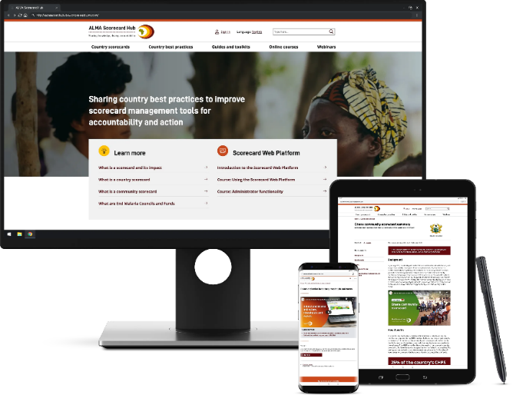
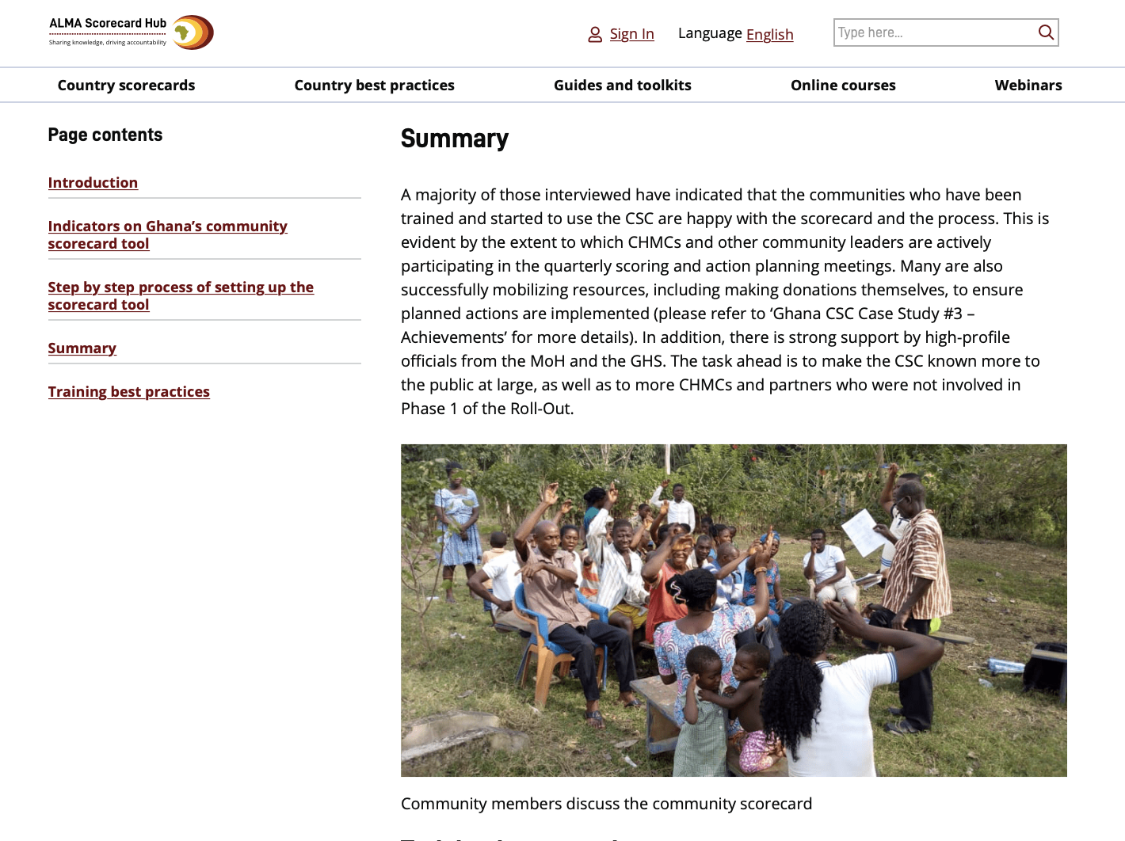
Our Scorecard Hub is the reference portal for countries to share and access knowledge about scorecards
About the Scorecard Hub
What is on the Hub: www.scorecardhub.org
A public directory of scorecards shared by African countries
Country best practices highlighting how countries have used scorecard tools for impact – such as Ethiopia’s community scorecard tool
Guides and toolkits to help countries create, analyse and improve scorecard tools
Online courses for Ministry of Health national and sub-national staff
Events and webinars to encourage users to share experiences of using scorecards
Technical support for ministries of health to request help and guidance with the scorecard management tools
Online training
Blog
Forum

Slide 6
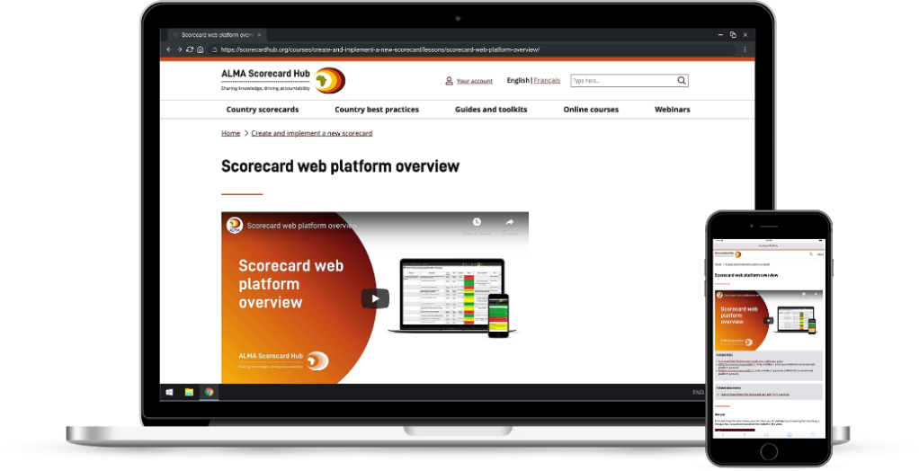
Our online courses are designed to support countries with the decentralisation of the scorecard
Online courses
Guides and toolkits help countries create, analyse and improve scorecard tools
Currently have courses on:
    Create and implement a new scorecard
    Strengthen an existing scorecard
    General web platform training
    Web platform training for administrators
We are working on new courses, such as:
    Create a community scorecard
    Decentralising scorecards
    Using scorecards for advocacy
Are there other course topics that would be helpful to cover?
Based on existing lessons, we can create a custom course for your country

Slide 7

Supporting countries with guides and toolkits
Guides and toolkits
Guides and toolkits help countries create, analyse and improve scorecard tools
Currently have guides about:
    Introduction to country-level scorecards
    Create a new country-level scorecard
    Introduction to community scorecards
    Create a new community scorecard
We are working on new guides to help countries complete common scorecard tasks such as
    How to review a scorecard
    Bottleneck analysis
    Working with data from DHIS2
Are there other guide topics that would be helpful to cover?

Slide 8

Other relevant content for countries
Other content
Our courses are also available to download for offline viewing
View all malaria scorecards published on the hub
View all malaria best practices published on the hub

Slide 9
Website: www.scorecardhub.org
If you have not already created an account, you can use your email as the username and the password: AYAC2021!
Then click on courses
Or use this link to access the AYAC course:
English: https://scorecardhub.org/courses/alma-youth-advisory-council-course/
French: https://scorecardhub.org/fr/courses/formation-du-conseil-consultatif-des-jeunes-de-lalma/

Slide 10
Overview of malaria context and interventions

Slide 11
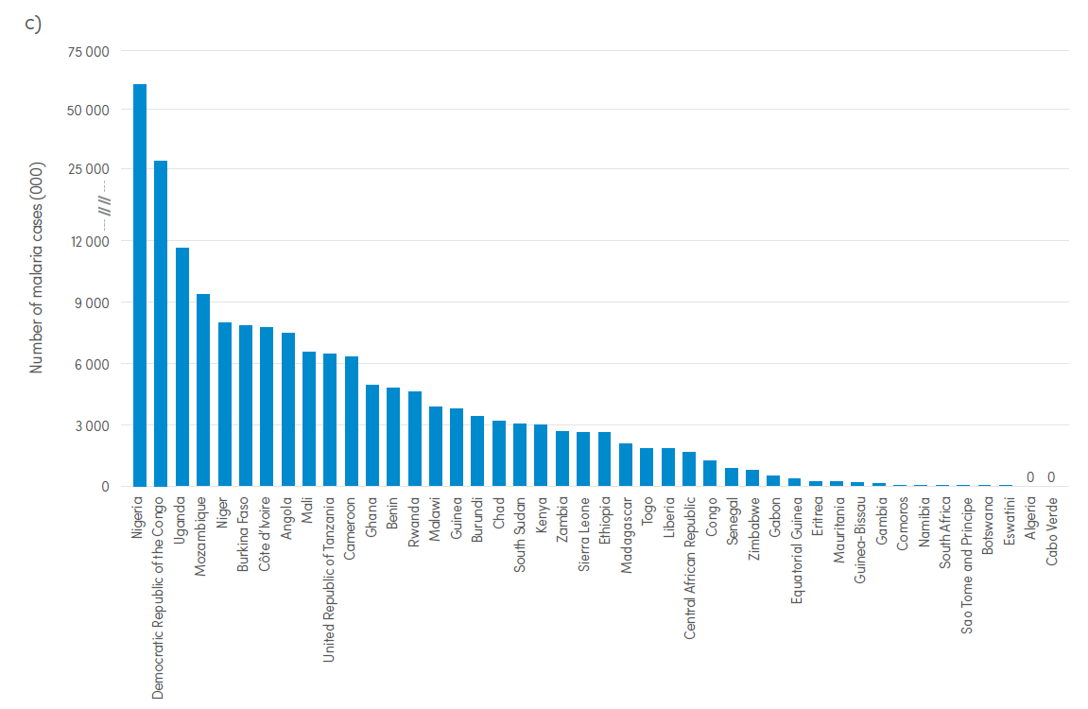
Malaria Context
Each year more than 400,000 people die of malaria – 90% in Africa
Two thirds of deaths are among children under the age of five
229 million new malaria infections in 2019
Progress since 2000: 1.5 billion malaria cases and 7.6 million deaths averted
AU Heads of Sate committed to eliminating malaria in Africa by 2030

Slide 12

Malaria Economic impact Summary:
Work absenteeism
School absenteeism
Less investment
Reduced consumption
Lost tourism
High health sector costs
Up to 1.3% lower GDP growth

Slide 13







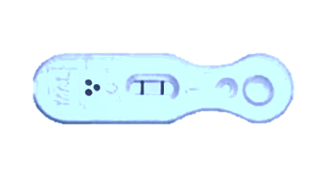




How to prevent malaria deaths and eliminate the disease?
MALARIA INTERVENTIONS
Insecticide treated mosquito nets (Routine and campaign)
Spray houses with
insecticide (IRS)
Larvicide to kill
mosquito larvae
Communication on malaria treatment and prevention
Test all fevers
(Rapid test / blood slide)
Malaria medicine: Mass drug administration (MDA) or treatment to all confirmed cases (ACT)
Target at-risk populations
Surveillance and M&E
New: Vaccines and Gene Drive

Slide 14
Key terms
LLIN – Long-lasting insecticide-treated nets
RDT – Rapid Diagnostic Test
ACT - Artemisinin-based combination therapy
IRS – Indoor residual spraying
IPT - Intermittent preventive treatment of malaria in pregnancy
ANC – Antenatal care
Incidence – new malaria cases
SMC - Seasonal malaria chemoprevention (antimalarial drugs to children aged 3-59 months during peak malaria season)
BCC – Behaviour Change Communication

Slide 15
Challenges in malaria progress
Insecticide resistance (up to 4 classes)
Mobilising and sustaining domestic and external financing
Sustaining interventions in the context of competing priorities like COVID-19
Cross-border collaboration and coordination
Supply-chain management challenges
Local behaviours and attitudes towards prevention and treatment

Slide 16

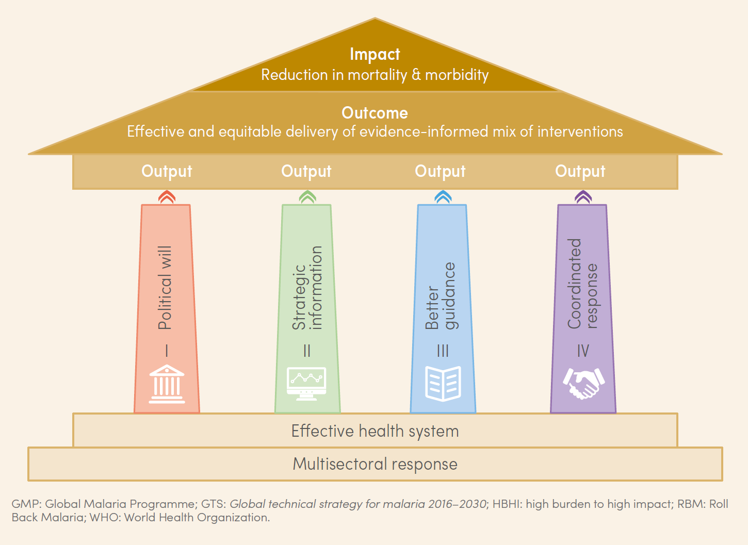
Continent wide initiatives
Pan-African campaign that mobilizes and empowers communities to take ownership over the fight to end malaria.
Aims to drive action from political, private sector and community leaders to accelerate malaria prevention and treatment and save lives.
Implemented by countries and co-led by the African Union Commission and the RBM Partnership to End Malaria
HBHI
(“High Burden High Impact” approach in 10 African countries)
Country-led response catalyzed by WHO and the RBM Partnership – to reignite the pace of progress in the global malaria fight.

Slide 17




Overview of H.E. President Kenyatta’s Legacy Agenda
ALMA Chair
Improve access to malaria data through a digital platform and by using country malaria scorecards so that all citizens are aware and empowered to act
Digitalisation & real-time data
Establish 15 End Malaria Councils and Funds to mobilise additional domestic public and private resources and engage local country leaders across all sectors
End Malaria Councils & Funds
Recruit a new generation of malaria advocates to champion political and resource commitments to support malaria control and elimination
Youth Army
Work with Africa’s Regional Economic Communities and Heads of State and Government to drive progress at the sub-regional level
Sub-regional Coordination

Slide 18
Strategic plans and data collection

Slide 19

What is a National Malaria Strategic Plan?
Guiding 5-year strategy document for National Malaria Programmes
Defines programme objectives and priorities
Yearly planned activities to achieve objectives
M&E framework to establish quantitative targets to measure progress towards objectives
Uses indicators to measure those targets
Example: Tanzania strategic plan

Slide 20
Progress of interventions are measured using indicators
EXAMPLE
Intervention
Indicator
Distribution of mosquito nets to pregnant women attending
antenatal care
% of pregnant women receiving a mosquito net during antenatal care
CALCULATION:
# of pregnant women received net
# of women attended ANC
Each indicator is assigned a target…
Example: At least 85% of pregnant women should receive a net during ANC

Slide 21
Two methods of indicator data collection:
Routine and Survey
 | Routine data (Health Management Information System) | Survey data (DHS, MIS, others)
Method | Health facilities and hospitals report information to a central database (DHIS2) | Studies a sample of the population to understand the country situation
Frequency | Continuous collection, usually reported quarterly | Every 2-5 years (depends on the survey)

Slide 22
Scorecard Management Tools

Slide 23

ALMA: An alliance of Heads of State and Government in Africa
ALMA was launched as a collective, coordinated response
to complement efforts to rid Africa of malaria
  Provides a forum for Heads of State to review progress and address challenges in meeting the malaria targets
  Implements a continental monitoring and accountability system through the ALMA Scorecard for Accountability and Action to track results, identify bottlenecks, and facilitate action
  Supports countries with rollout of national scorecard management tools for malaria, RMNCAH, and NTDs
  Identifies and shares lessons learned for effective implementation of national and regional programmes
  Maintains focus and collective attention on malaria within the AU, international community, UN and regional organizations
Former Chairs of ALMA, H.E. Sirleaf (Liberia) and H.E. Kikwete (Tanzania)

Slide 24
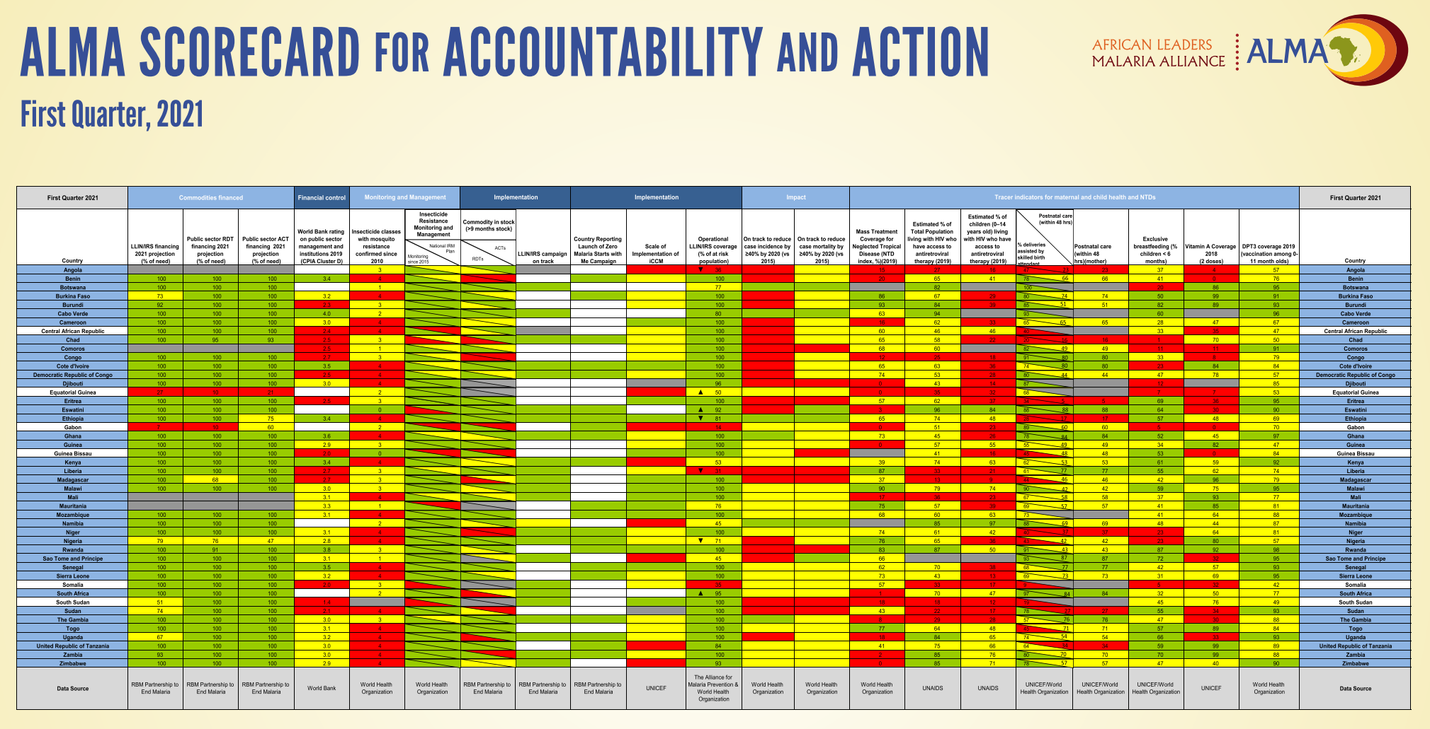
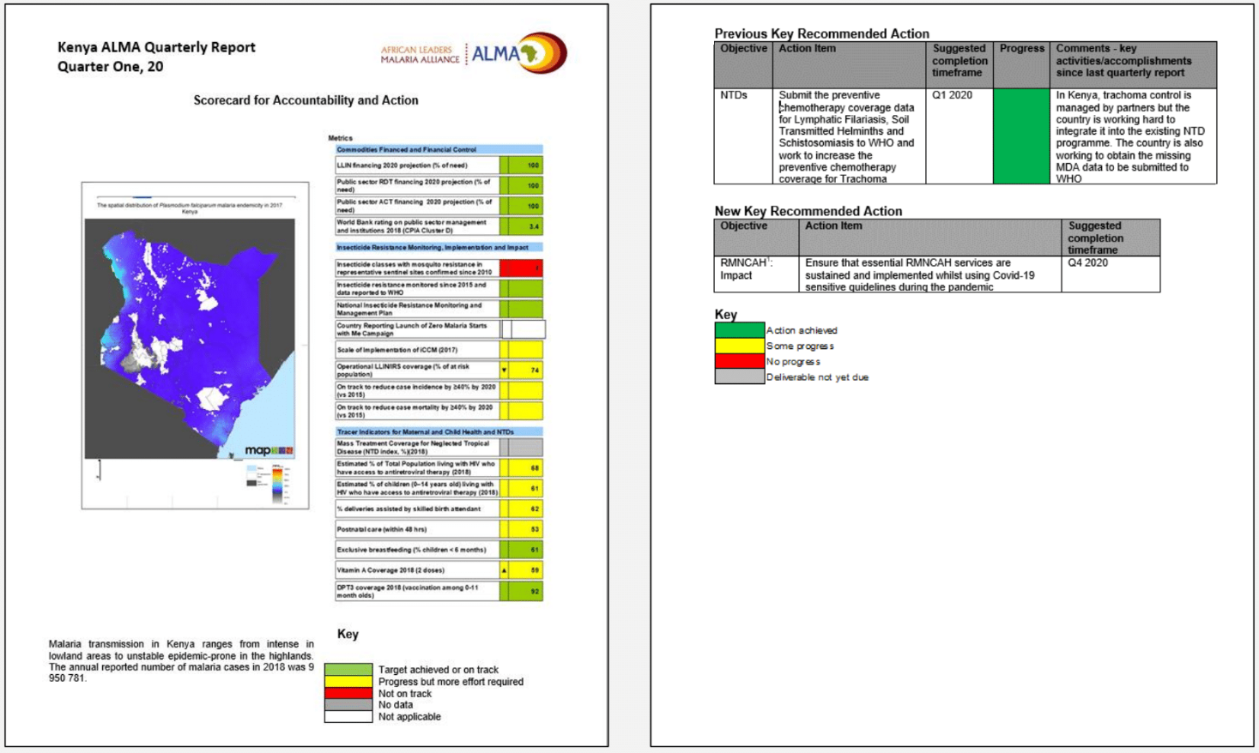
Strengthening accountability and action through the ALMA Scorecard for Accountability and Action…
  Every quarter, the ALMA scorecard and a country-specific report with recommended actions is disseminated to:
  Head of State and Government
  Minister of Health
  Minister of Finance
  Minister of Foreign Affairs
  Ambassadors to the AU and UN
  >80% response rate on due actions each quarter
Access scorecards on www.scorecardhub.org and access quarterly reports on www.alma2030.org

Slide 26
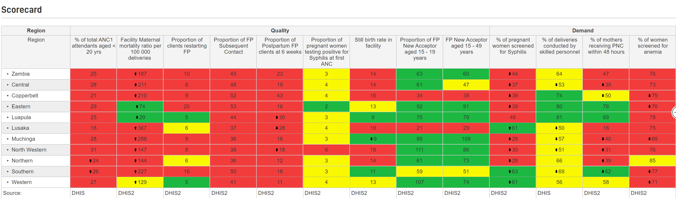
Country Scorecard Management Tools
A colour-coded management tool that helps countries track performance of priority indicators from their strategic plan.
Country-owned and managed.
Uses existing quarterly data from routine sources like DHIS2 and surveys
Integrated into existing management processes.
Used for action, accountability and advocacy at national and subnational levels

Slide 27
ALMA has assisted countries across Africa in the development and strengthening of national Malaria, RMNCAH, and NTD scorecards
  Between 2012 and 2021 ALMA has supported the development of:
    29 RMNCAH Scorecards
    40 malaria Scorecards
    6 NTD Scorecards
    1 country with Malaria-NTD integrated scorecard
    4 Community Scorecards
    2 Nutrition Scorecard (AFDB and TZ)
  Scorecards are updated quarterly and integrated into existing management and decision making processes
  ALMA has continuously supported the implementation and strengthening of country scorecards in order to:
    Strengthen the capacity to ensure sustained use of the tool
    Document best practices
    Provide additional support as needed
Countries with ALMA supported scorecards
Morocco
Tunisia
Objectives
  ALMA Heads of State and Government prioritize malaria control and elimination
  Malaria is maintained high on the political and policy agenda at national level in ALMA member countries & across the region
Sahrawi Arab
Democratic Republic
Algeria
Libya
Egypt
Mauritania
Niger
Senegal
Mali
Sudan
Eritrea
Djibouti
The Gambia
Burkina
Faso
Chad
Guinea-Bissau
Guinea
Benin
Sierra Leone
Côte
d'Ivoire
Togo
Nigeria
Central African
Republic
Ethiopia
Liberia
Ghana
Cameroon
South Sudan
Equatorial Guinea
EG
Uganda
Somalia
Gabon
Congo
Kenya
São Tomé
and Príncipe
DR Congo
R
Rwanda
Angola
B
Burundi
Community
Tanzania
Nutrition
Angola
Comoros
Malaria and RMNCAH
Nigeria
Malawi
Mozambique
RMNCAH
Namibia
Zimbabwe
Madagascar
Botswana
Malaria
ESwatini
NTD
South Africa
No Scorecard
Lesotho

Slide 28
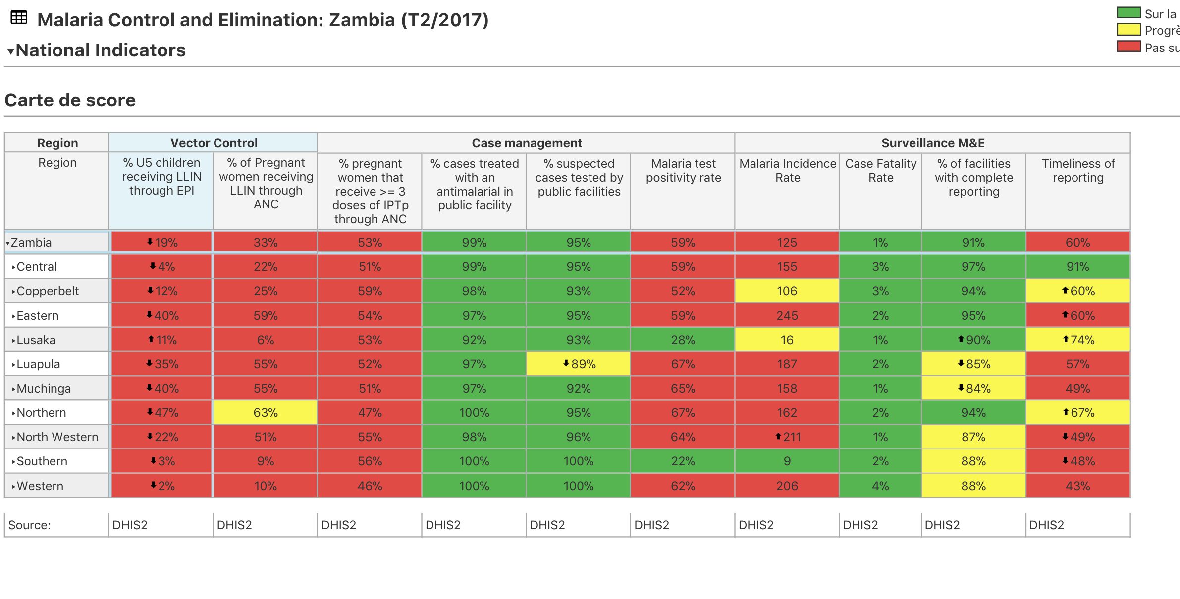
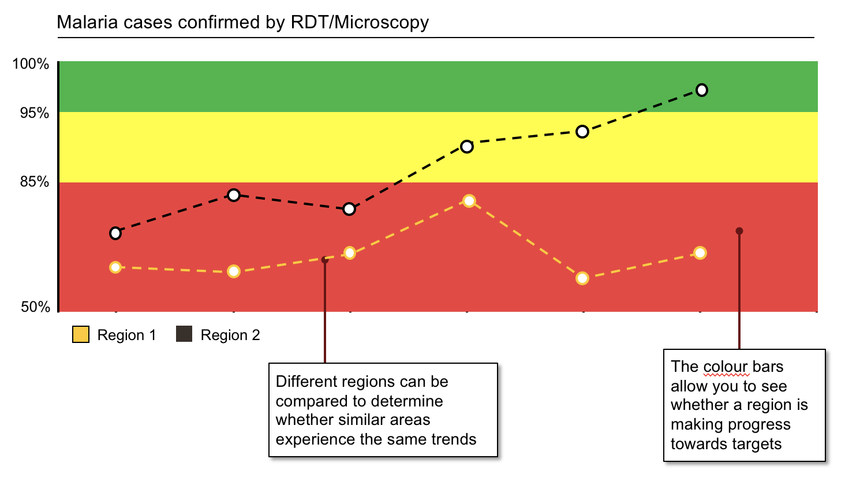
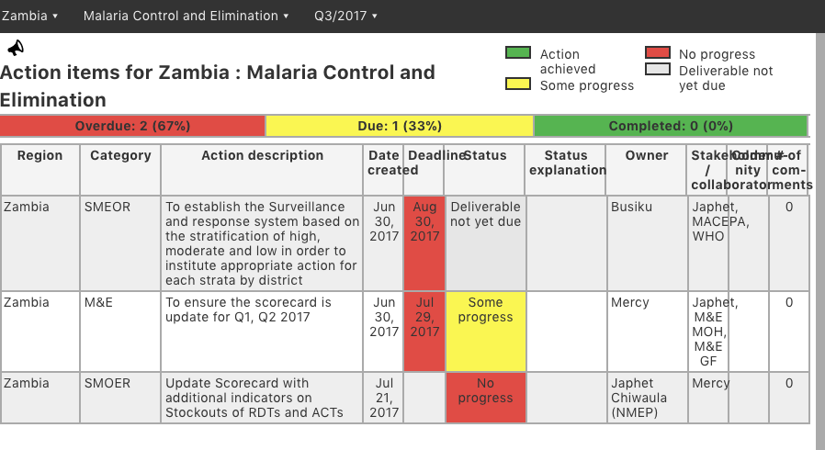
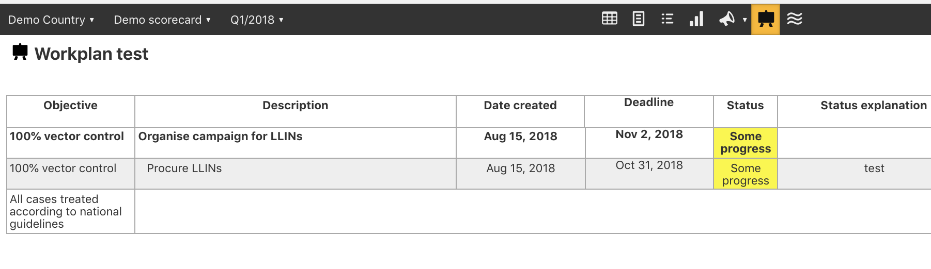

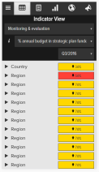
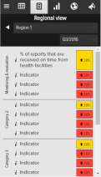
The online scorecard management tool (web platform) includes various data visualization and management functionalities
Scorecard
Action tracker
Charts & Graphs
Action tracker
Workplan manager
Mobile notifications
What It is
What it is
What it is
What it is
What it is
Quarterly performance of priority indicators at national, regional and district level. Some scorecards include facility level data
Charts, maps, and other data visualisation tools provide additional context by showing indicator performance over time
Used to assign actions with deadlines to action “owners”. It includes a progress field showing implementation status and an automated notification system
Tracks implementation of annual workplans, listing key milestones and the progress of action items with clear owners and timelines, and an automated notification system
An automated SMS notification system alerts action owners on outstanding actions and approaching deadlines
Only users with accounts can access scorecards and management tools at www.malariascorecard.org

Slide 29
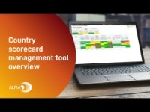
Download video from dropbox here: Country scorecard management tool overview Video

Slide 30
How to access scorecards
ALMA Scorecard Hub: Country Scorecards and ALMA
  www.scorecardhub.org
Scorecard Web Platform (private): Country scorecard
  www.malariascorecard.org / www.rmncah.org
ALMA website: ALMA scorecard and quarterly reports
  www.alma2030.org

Slide 31
How to login to the Scorecard Web Platform
* a national admin can add an account
Access real site if you have an account
www.malariascorecard.org
www.rmncah.org
Access the demo site
new.demoscorecard.org
Username: user 1
Password: 123456

Slide 32
END OF DAY 1

Slide 33
How to analyse a scorecard

Slide 34
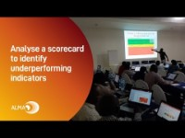
Download video: Analyze a scorecard to identify underperforming indicators Video

Slide 35
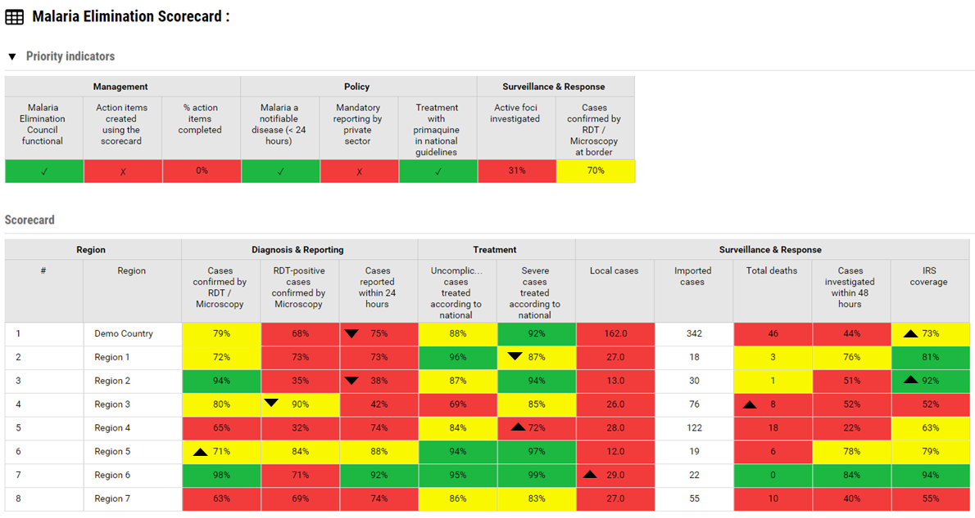
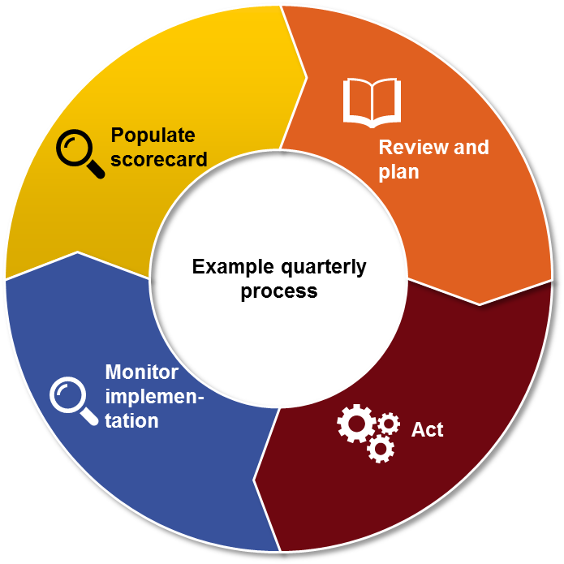
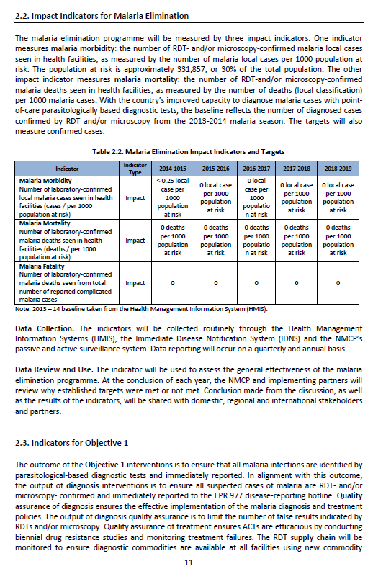
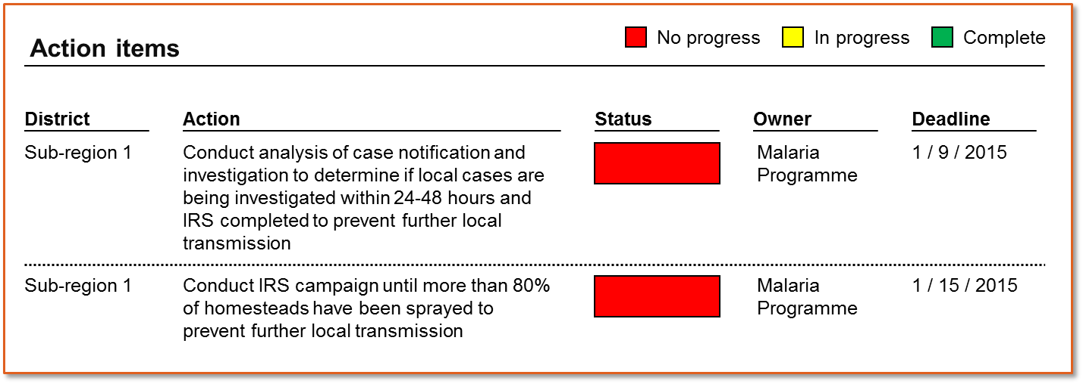

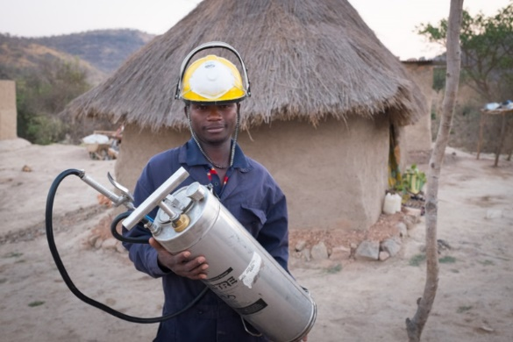
How does the scorecard process work?
1.
Data from existing sources are populated in the scorecard
3.
Existing management processes review the scorecard analysis and document recommended actions in the action tracker.
2.
Analysis
5. .
4.
Management and other existing accountability mechanisms monitor implementation of actions
Programmes and partners implement action items
Notes:
How does the Scorecard Process work?
As a management tool, the emphasis of scorecards should be on how the data is used for action.
Though the process varies depending on the country, many scorecards use the following process
Every quarter, scorecard administrators use data from existing sources like DHIS2 to produce the scorecard.
Technical teams at various levels analyze the scorecard, investigate the root causes of the bottlenecks and propose actions
The scorecard analysis and proposed actions are presented and validated during existing management meetings at all levels. These actions can be entered into the web platform’s action tracker.
Programmes and partners implement the action items; and
Management and other existing accountability mechanisms monitor implementation of actions
If the actions taken had the intended results of addressing the root cause of the issue identified in the scorecard, the data in subsequent scorecards should begin to show improvements.

Slide 36
2. Analyzing the scorecard to create actions…
1
Prioritise
2
Investigate
3
Act
Identify indicators requiring attention
Identify States and LGAs requiring attention
Evaluate whether performance is improving or getting worse
Gather information about root causes of the problem
Determine which factors contribute most to under-performance
Develop actions that address the root causes identified
Input action items into web platform and monitor
Notes:
Analyzing the scorecard to create actions is a three step process: prioritise, investigate, and create actions.
Prioritizing is an important first step because, in a world of limited time and resources, it is usually not possible to resolve of all the problems revealed by the scorecard in one quarter. For that reason, scorecard users usually identify 3-5 priorities to focus on every quarter. Prioritization involves identifying the indicators and locations requiring attention, then evaluating whether the performance is improving or getting worse. A Province or district with poor performance that is getting worse is usually prioritized.
After selecting a few priorities from the scorecard, it is important to investigate by gathering information about the root cause of the problem. It is helpful to determine which factors are contributing the most to the underperformance and whether the performance is likely to persist. Investigating the root cause of the problem often requires communicating with the people on the ground, where the under-perfomance is taking place.
Once the root causes of the problems are known, it is essential to develop actions that address the root causes of the bottleneck identified. Those actions, can then be input into the scorecard web platform which allows managers to monitor the implementation progress of actions. In the next slides, we will dive deeper into how to prioritize, investigate and act.

Slide 37

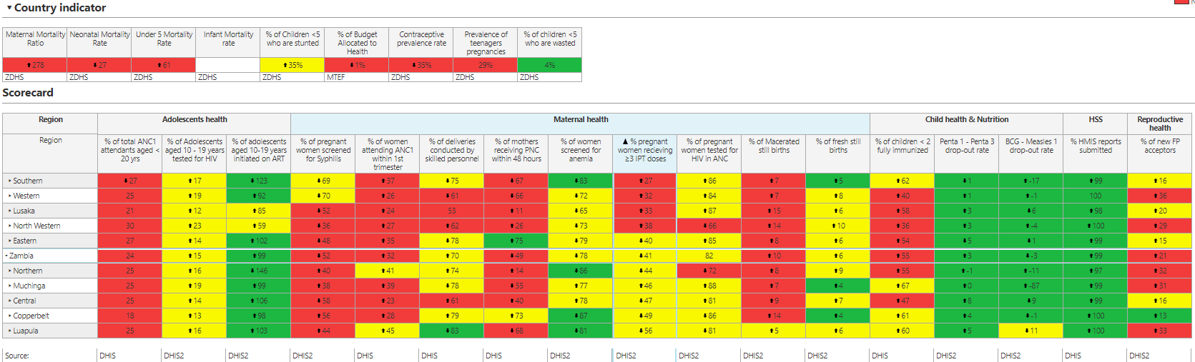
Three dimensions to each cell
3. How to prioritize using scorecard data…
Colour
Arrow
Data value
Notes:
So how can we use the scorecard to prioritize which problems to address?
Each cell on the scorecard has three dimensions to help guide your analysis: a colour, a data value, and sometimes an arrow.
The colour shows whether an indicator is performing well or poorly relative to the national target set by the country. If the indicator is showing red, it means the associated geographic Province is not meeting target. If it is green, it is meeting target, and if yellow, more progress is need to achieve the target. A grey cell means the indicator is not applicable for that geographic location for that period and a white cell means there is no data. An indicator that is performing green may be worth highlighting as a best practice that can be scaled up to other Provinces.
The data values on the scorecard come from various existing local routine data sources. Most scorecard indicators are configured in percentage format, whole number, or decimal, though it is possible to include other formats. In some cases, it is better for the value of an indicator to go up. For example, in the case of Vitamin A coverage, a higher percentage is good and a lower percentage is bad. For other indicators a lower number is considered to be good. For example, in the case of malaria incidence, a lower number is considered to be good.
In addition to the colour and data value, sometimes the scorecard will show an arrow. An arrow will only appear if the performance has changed compared to the previous scorecard or the previous year. For example, if the arrow threshold set by a country is 5%, then an arrow will only show if the percentage increases or decreases by 5 or more points. So if there were a decrease from 50% in Q1 2020 to 45% in Q2 2020, the scorecard in Q2 2020 would show a down arrow, signifying the number has gone down. It is important to note that a green colour indicator with a down arrow may also highlight a priority, since it means the gains are not being sustained and the green may turn to yellow or red eventually.
The colour, the arrow and data value can help to guide the scorecard analysis and prioritization. A red with an arrow showing that the performance is bad and getting worse, is a very high priority.

Slide 38
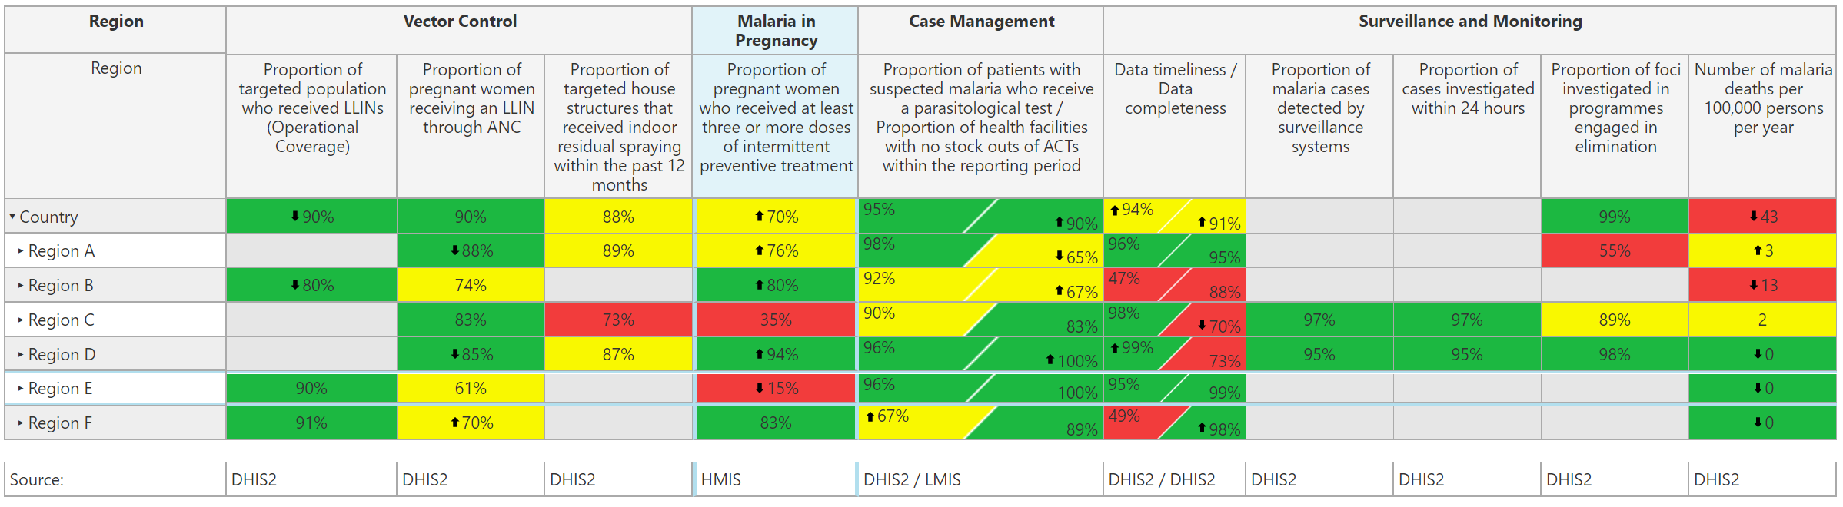
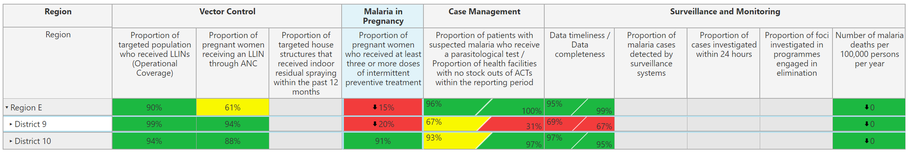
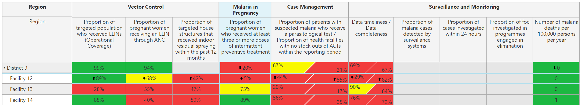
When you identify a problem, open Province to see the performance of the Districts…
“Drill down” by clicking on the arrow next to the name of the Province
Open Province to see which Districts are contributing to the under performance
Open District to see which health facilities are contributing to the under performance
This will help you “find” where the problem is
Open Districts to see the performance of health facilities
Notes:
The scorecard web platform allows users to open sub-Provinces to see the performance of the lower levels, allowing for a more targeted analysis showing where the problem is.
Opening sub-Provinces, or drilling down as it is called, is an important strategy for finding which geographic locations are contributing the most to underperformance.
Take the example in front of you. In the case of the indicator for “Proportion of pregnant women who received at least three or more doses of IPT”, it is clear that Province E is the priority. That indicator in Province E is showing red, at 15%, with a down arrow. It is a bad situation getting worse.
However, to understand the situation better, it is important to open Province E to see how it’s Districts are performing. To see the Districts, in the online web platform, click on the arrow next to the name of the subProvince. In this example, clicking on the arrow next to Province E, will displays two Districts. However, only one of those Districts, “District 9”, is showing poor performance, at 20% with a down arrow. This means it is district 9 that is contributing the most to the underperformance in Province E and District 9 is where the programme should focus its efforts.
Some country scorecards even go down to facility level. In this example, upon opening District 9, it is possible to see that it is actually facility 12 that is mostly contributing to the underperformance. In this way, it is possible to do targeted analysis to create targeted solutions.

Slide 39
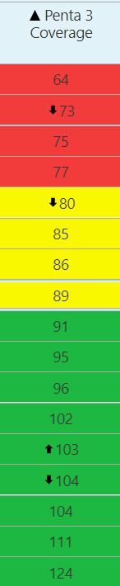

Sorting method
Analyse a scorecard
In the web platform, click on the name of the indicator on the top of the column to quickly sort the values
This shows which places are underperforming
Lowest
Highest

Slide 40
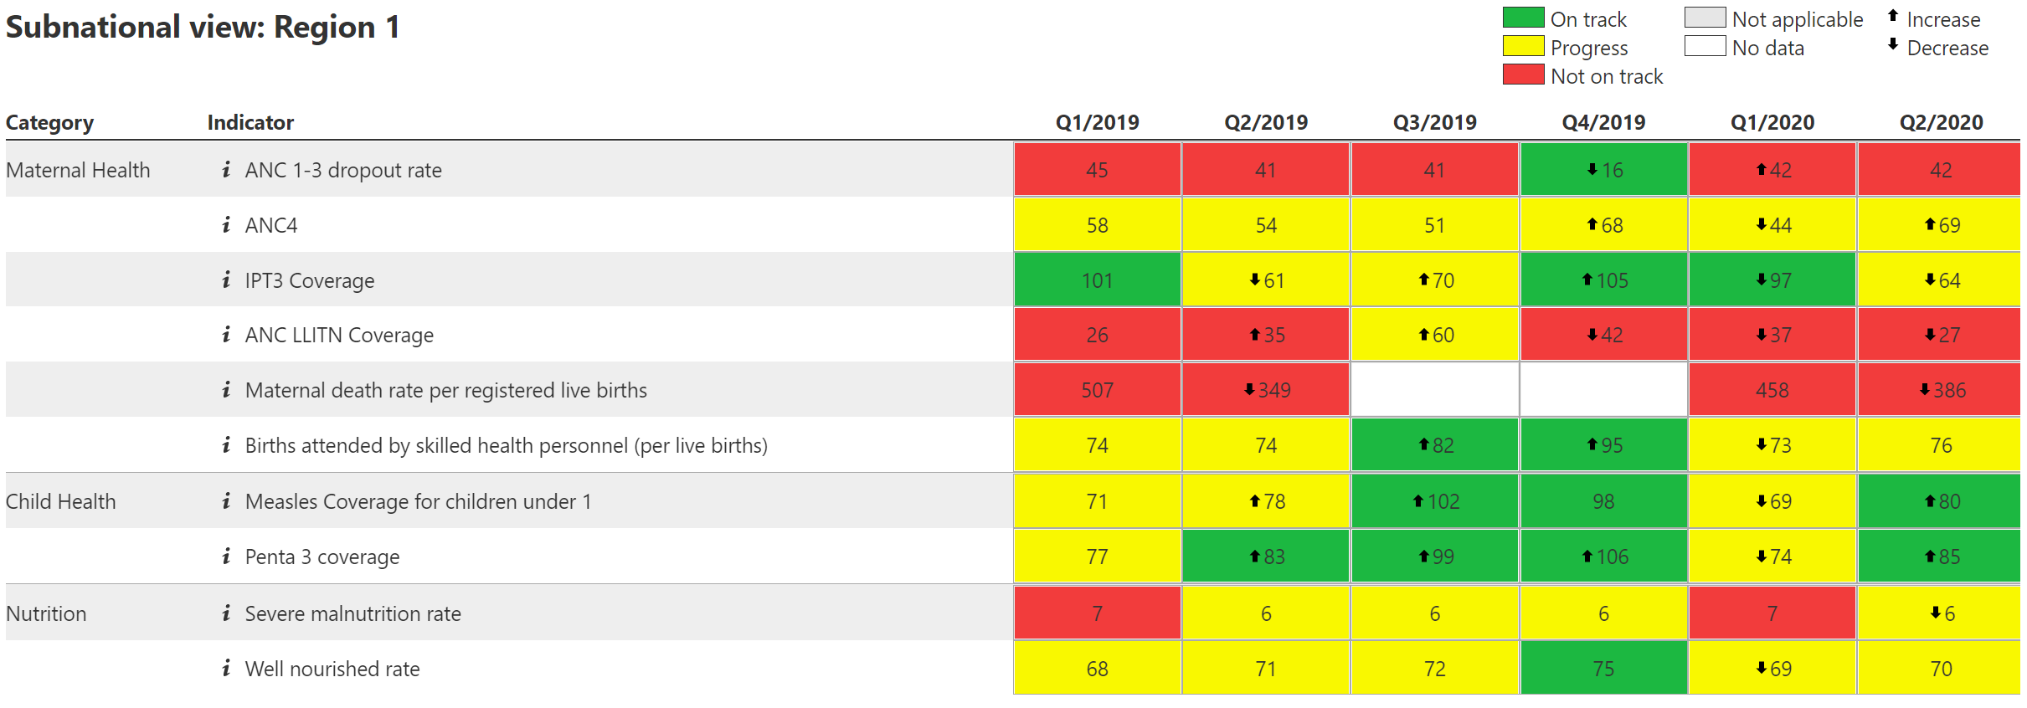
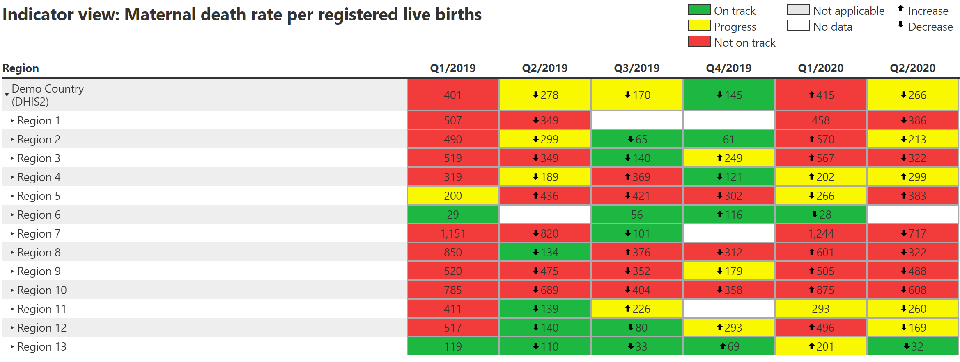
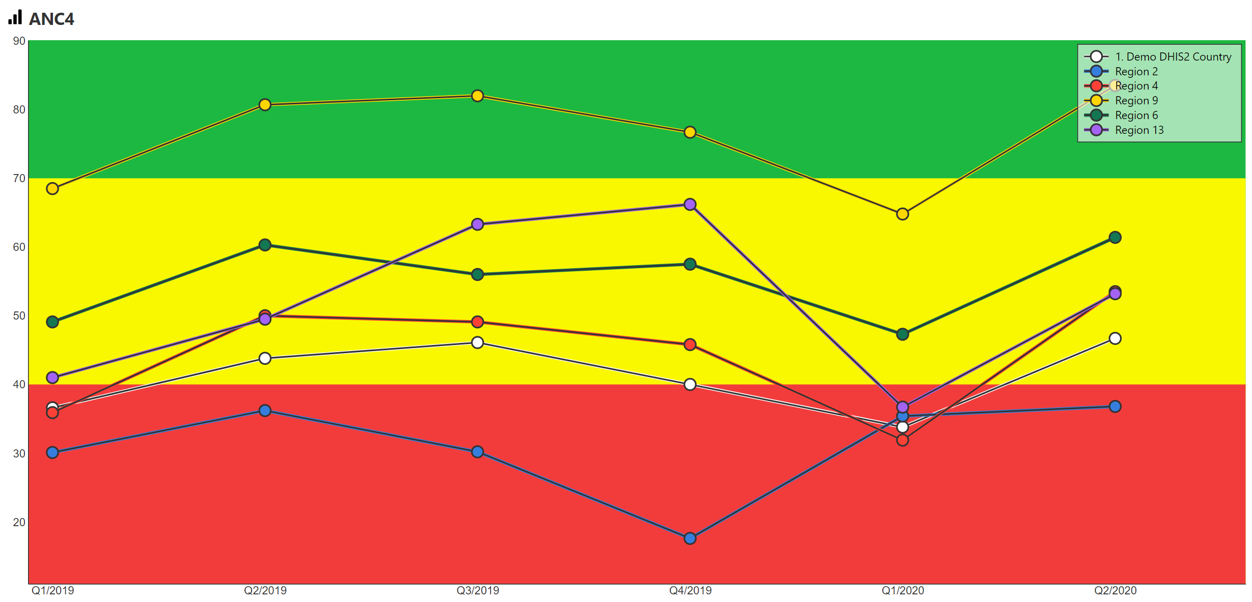
Trend analysis
Analyse a scorecard
Subnational view
View how one particular location is performing across all scorecard indicators.
Indicator view
View how one indicator is performing across all locations, within a selected time range.
Graphs
View how one indicator is performing across multiple locations and across a specified time interval in a line or bar graph.

Slide 41
How to use the scorecard for action

Slide 42

Download video: How to use scorecard data for action Video

Slide 43
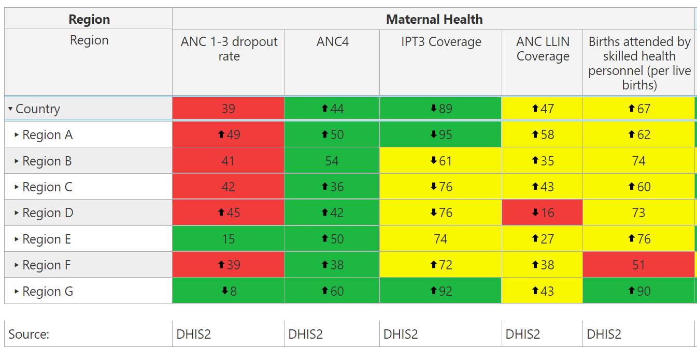
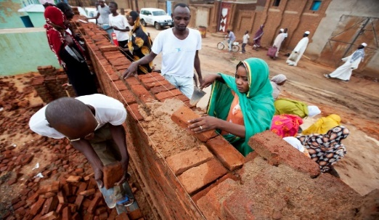
Context
The main objective of scorecards is to use the data to inform actions.
After identifying a problem, it is important to understand the root cause of the bottleneck.
Create SMART actions that directly address the root cause of the problem.

Slide 44
After identifying the problems, investigate deeper to gain an understanding of the situation
Questions to consider
Questions to consider
Example questions
1. Does this need a solution?
  Is this an anomaly? Or is performance likely to remain the same or even worsen?
2. What are the root causes?
  What are the root causes of the poor performance?
  Are there any causes that are specific to this geographic location that is contributing to the underperformance?
  Which causes can be managed or controlled?
3. What interventions exist?
  What interventions are in place or have been tried?
  What interventions have been successful? Which have been unsuccessful?
  Are there lessons learned from neighbors that can be adopted or scaled up?
  Can the community play a role in solving the issue?
Notes:
While the colour-coded scorecard data provides a good starting point for finding the problem, it is important to investigate deeper to understand the situation. Key questions to consider may include:
Does this need a solution? It is important to understand whether the scorecard data truly represents a problem requiring a solution or if it is simply an anomaly or even a data quality issue. Ask yourself, is the performance likely to get worse? If yes, then it is important to take action.
What are the root causes of the problem? Creating an action that will solve the problem requires understanding the root cause of the poor performance. Are there any factors specific to this geographic location that are contributing to the underperformance? Which root causes can be managed or controlled? And finally….
What interventions exist? What interventions are in place and have been tried? Have any been successful? Have any been unsuccessful? Are there lessons learned and success stories from neighbors that can be adopted or scaled up? And can the local community play a role in solving the issue?
The answers to these questions can help to guide the actions required to address the issues identified by the scorecard.

Slide 45
Actions usually fall into these categories
How to create smart actions
Action category | Description
Investigate the root causes | If the problem is unknown, investigate the root cause of the problem to better understand what actions to take
Advocacy for high level policy and strategy change | Changes to national and local policy or strategy to enable more effective implementation and adoption of initiatives
Petition support from partners | Petition support from development partners to implement activities that address underperformance
Manage procurement and supply chain issues | Changes to procurement & supply management of commodities to avoid disruptions, delays, unfulfilled demand, and poor quality
Build capacity | Training of personnel and upgrading of infrastructure to maximize effectiveness of resource utilisation
Address funding | Identification, securing, and disbursement of funding for products, initiatives, and infrastructure and technology upgrades
Improve quality and utilization of data | Improvements in data quality & systems used for monitoring and evaluating that data to track current status and progress
Catalyse community engagement | Working with the community to identify bottlenecks, and deploy necessary interventions
Adopt behavioral change communications | Communications on key messages to the general public to drive adoption of best practices in disease prevention and treatment

Slide 46
The SMART framework can help generate smart action descriptions
How to create smart actions
Criteria
Specific
Actions must be clear and specific. They must include all of the information required for the action owner to coordinate the action, and be specific about what is expected, when and at what level.
Measurable
Actions should quantify the target when possible to define success. They include numbers to indicate how much will be achieved (e.g. how many commodities will be ordered or how many staff will be trained, how many people should be sensitised)
Achievable
Actions must be realistic and achievable by the identified owner who should have the means to implement them.
Results- oriented
The action should address the root cause of the problem in a way that will result in an improvement in the indicator’s performance.
Time-bound
Actions should have a specific deadline which tells the action owner by when it should be implemented. If there are several stages required for the action, each stage can be a separate action, with a defined deadline.

Slide 47
The SMART framework can help generate smart actions
How to create smart actions
BOTTLENECK
stockout of primaquine in Districts X and Y leading to low ACT treatment rate for confirmed cases
SMART ACTION
Regional Medical Store manager to submit an order to the Central Medical Store for 3000 doses of primaquine for region A and deliver 1400 doses to District X and 1600 to District Y by 23 November 2021
Why is this a SMART action?
Specific: who, what, when, where. Describes the process and not the desired end result.
Measurable: 3000 doses, 1400 for District X and 1600 for District Y
Achievable: Medical Store manager is capable to ordering and coordinating delivery of medicine
Results-oriented: ordering and distributing the primaquine will resolve the stockout issue and lead to an improved treatment rate
Time-bound: This action must be implemented by 23 November 2021

Slide 48


Once a problem has been identified on the scorecard, generate clear action items
How to create SMART actions
 | Good example | Bad example
Actions are specific: who, what, when, where | National M&E coordinator should install 3 new computers with DHIS2 software in each regional health office by December 2021. | Improve quality of LMIS data
Should describe the process of “how” to achieve the end objective. Should not be the end objective. | The NMCP programme manager will write a letter to the Global Fund country office petitioning emergency funds for 50,000 LLINs for Regions A, B, C. | Procure 50,000 LLINs to increase coverage from 12% to 80%.
It is clear who is responsible for the action and the person must be able to implement | Director of Maternal & Newborn Health to establish a monthly forum to engage partners, mobilise funds and improve funding allocation to RMNCAH | Increase donor contribution to RMNCAH
You can clearly monitor progress on the action using numbers where possible | District Health Directorate should organize community durbars in all 5 communities of District X, to sensitise them on the upcoming IRS campaign | Ensure communities are sensitized for the upcoming IRS campaign

Slide 49
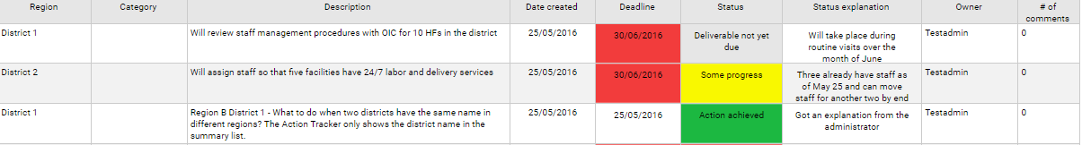
Action Tracker: Actions can be assigned and progress tracked on the scorecard web platform
List of action items, a field showing color-coded implementation status, due date, and owner
Actions can be assigned at all levels
Province 2
M&E
Hire three M&E staff members on temporary basis to clear backlog of HMIS records
15/12/2016
15/12/2016
Action achieved
User 1
1
MPs can see which actions they can support!
District A
M&E
Improve timeliness and quality of data by retraining PHU workers in data management
25/10/2016
25/11/2016
No progress
Training canceled
Admin 3
2
Province 3
Newborn health
Implement excusive breastfeeding for 6 months program at PHUs and conduct community outreach campaign to raise awareness of EBF
30/03/2016
30/09/2016
Some progress
Contacted managers
User 4
0
Missed deadlines are highlighted in red, prompting immediate management attention
Visual indicator of status allows manager to quickly identify which action items are at risk (e.g., yellow = some progress and on track)
Notes:
The scorecard web platform has a management functionality called the Action Tracker, where actions can be assigned and progress of implementation can be tracked. When the scorecard reveals a problem, the action tracker is used by managers to assign to a specific person, an action with a deadline. The web platform automatically sends notifications via email and SMS to the person who is assigned the action, giving them useful reminders that they are responsible for coordinating the implementation of an action. The automatic notifications are sent the day the action is created, 7 days before the deadline, 1 day before the deadline, and every 7 days after the deadline has passed if the action is not marked as complete.
This slide shows a screen shot of the action tracker. As you can see, actions can be assigned at all levels, including at district and even at facility level. The action tracker displays a list of action items, a field showing color-coded implementation status, the due date, and the owner responsible for coordinating the action. Missed deadlines are highlighted in red, prompting immediate management attention. The color-coded visual indicator status allows manager to quickly identify which action items are at risk.
The action tracker, like the other features of the scorecard web platform, is also available on the mobile app which allows programme managers and staff to easily update and monitor progress on action items.

Slide 50
Intergrate the scorecard into existing accountability mechanisms

Slide 51

Download video here: Integrate a scorecard into accountability structures Video

Slide 52
Integrate scorecard tools into existing accountability mechanisms
Introduction
Identify the key stakeholders who should be engaged for scorecard review
Identify the key accountability fora where the scorecard can be integrated for review and action
Define the quarterly process for populating and analysing the scorecard and documenting and monitoring actions

Slide 53
Who you should share the scorecard with
1. Identify the key stakeholders
Stakeholder | Broad responsibility
Political leaders | Performance transparency Using political power and resources to improve health where it matters most
Programme and Ministry of Health directors | Identifying key gaps in programming Changing policy to foster improvements Re-allocate resources to solve problems requiring funding
Development partners | With Ministry of Health programmes, identifying and providing financial and/or human (such as technical assistance) resources for programme needs Engaging the community around specific bottlenecks
Subnational stakeholders | Supporting implementation Benchmarking performance, data validation Feedback on implementation effectiveness
Community | Validating and supplementing data Joint problem solving to identify bottlenecks and propose community-oriented solutions

Slide 54



Scorecard can be reviewed at all levels
2. EXAMPLE: Identify existing accountability mechanisms
National
Regional
District level
Community level
National Cabinet Meetings
National Council on Health
National Technical Working Groups (e.g. RMNCAH+N, Malaria, M&E)
Annual Health Stakeholders Forum
Parliamentarian Committee for Health
End Malaria Councils
Regional Governors Forum
Executive Council
Health Management Committee
Health Data Committee
Health Management Committee
District Management Committee
Village Health Committee
Village Management Committee
Traditional leaders public hearings
Community Town Halls

Slide 55

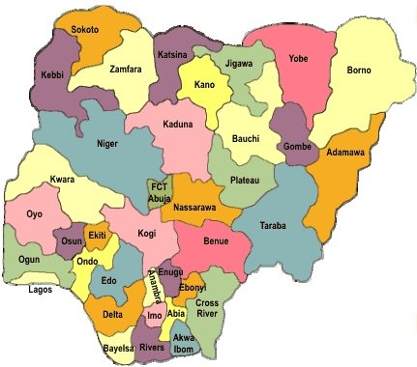
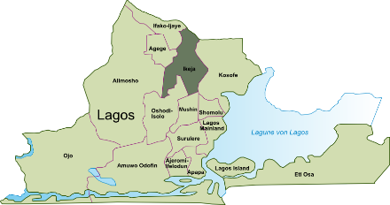
Into what existing management meetings can the scorecard be integrated?
Federal
State
LGA
Community level
Federal Executive Council
National Economic Council
National Council on Health
National Health data governance council
National Health Data Consultative Committee
National MPDSR steering committee
National Emergency Maternal and Child Health Intervention center
National Technical Working Groups (RMNCAH+N and M&E)
National Emergency Routine Immunization Coordination center
Core Technical Committees
Governors Forum
State Executive Council
State Council on Health
State Health Data Consultative Committee
State Health data governance council
State MPDSR steering committee
State Emergency Maternal and Child Health Intervention center
State Core Technical Committees
Association of Local Governments of Nigeria
LGA Emergency Maternal and Child Health Intervention center
LGA Emergency routine immunization coordination center
Ward Development Committee/LG Management Committee
Village Health Committee
Village Development Committee

Slide 56
How to share your scorecard

Slide 57

How to share your scorecard

Slide 58
Accountability and transparency
Why sharing your scorecard is important
Accountability
People and organizations are held responsible for their performance or actions.
Transparency
The extent to which information or data are made available.

Slide 59
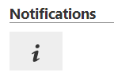
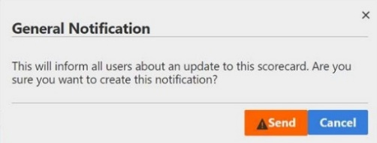



Export from the scorecard web platform
How to share your scorecard
Administrators only
All users
Send email notification to all accounts
Download as
a PDF
To send a notification via email:
Click the notifications
button in the scorecard
web platform
Click Send in the
General Notification
pop-up
To download your scorecard as a PDF onto your computer:
Click the Export
button in the scorecard
web platform from top
navigation bar
Send

Slide 60
Ideas for sharing your scorecard
How to share your scorecard
Present your scorecard analysis at an existing management meeting, have printed copies available for sharing
Download your scorecard as a PDF and share with colleagues and partners
by email
Create a scorecard WhatsApp group and share in the group for a discussion
Publish on the Ministry of Health or another public website
Share in a quarterly health bulletin for all stakeholders including partners
Share on the Knowledge Hub – the one stop shop for scorecard and accountability mechanisms

Slide 61
- How to share the scorecard with high-level decision makers

Slide 62

Video: Using the scorecard for engaging high-level decision makers

Slide 63
Scorecards are useful tools for leaders to drive action and mobilise resources
Introduction
Scorecard management tools are useful for political leaders:
Heads of State and Government can be made aware of progress and gaps and use political power and resources to drive action
Ministers can be made aware of urgent bottlenecks and ensure decisions are made to fast track implementation of key activities
Members of Parliament can follow real time data on the performance of key indicators in their constituency
Local leaders can mobilise resources for the community
International stakeholders such as donors and Partners (such as WHO, UNICEF, UNFPA), Regional Economic Communities, Ambassadors.

Slide 64
Example actions leaders can take
Who can be involved
Login to the scorecard web platform or mobile app to see how the country or a subnational region is performing.
Demand immediate action if there are indicators requiring attention.
Monitor action implementation and mobilise support if necessary.
Mandate subnational health officers to use the scorecard every quarter to develop actions and encourage entry of action into action tracker.
Use the scorecard tool to advocate for financial support for interventions, budget and allocate resources for health and ensure funds are used according to plan.
Disseminate the scorecard to other key stakeholders and encourage scorecard discussions in existing management meetings.

Slide 65
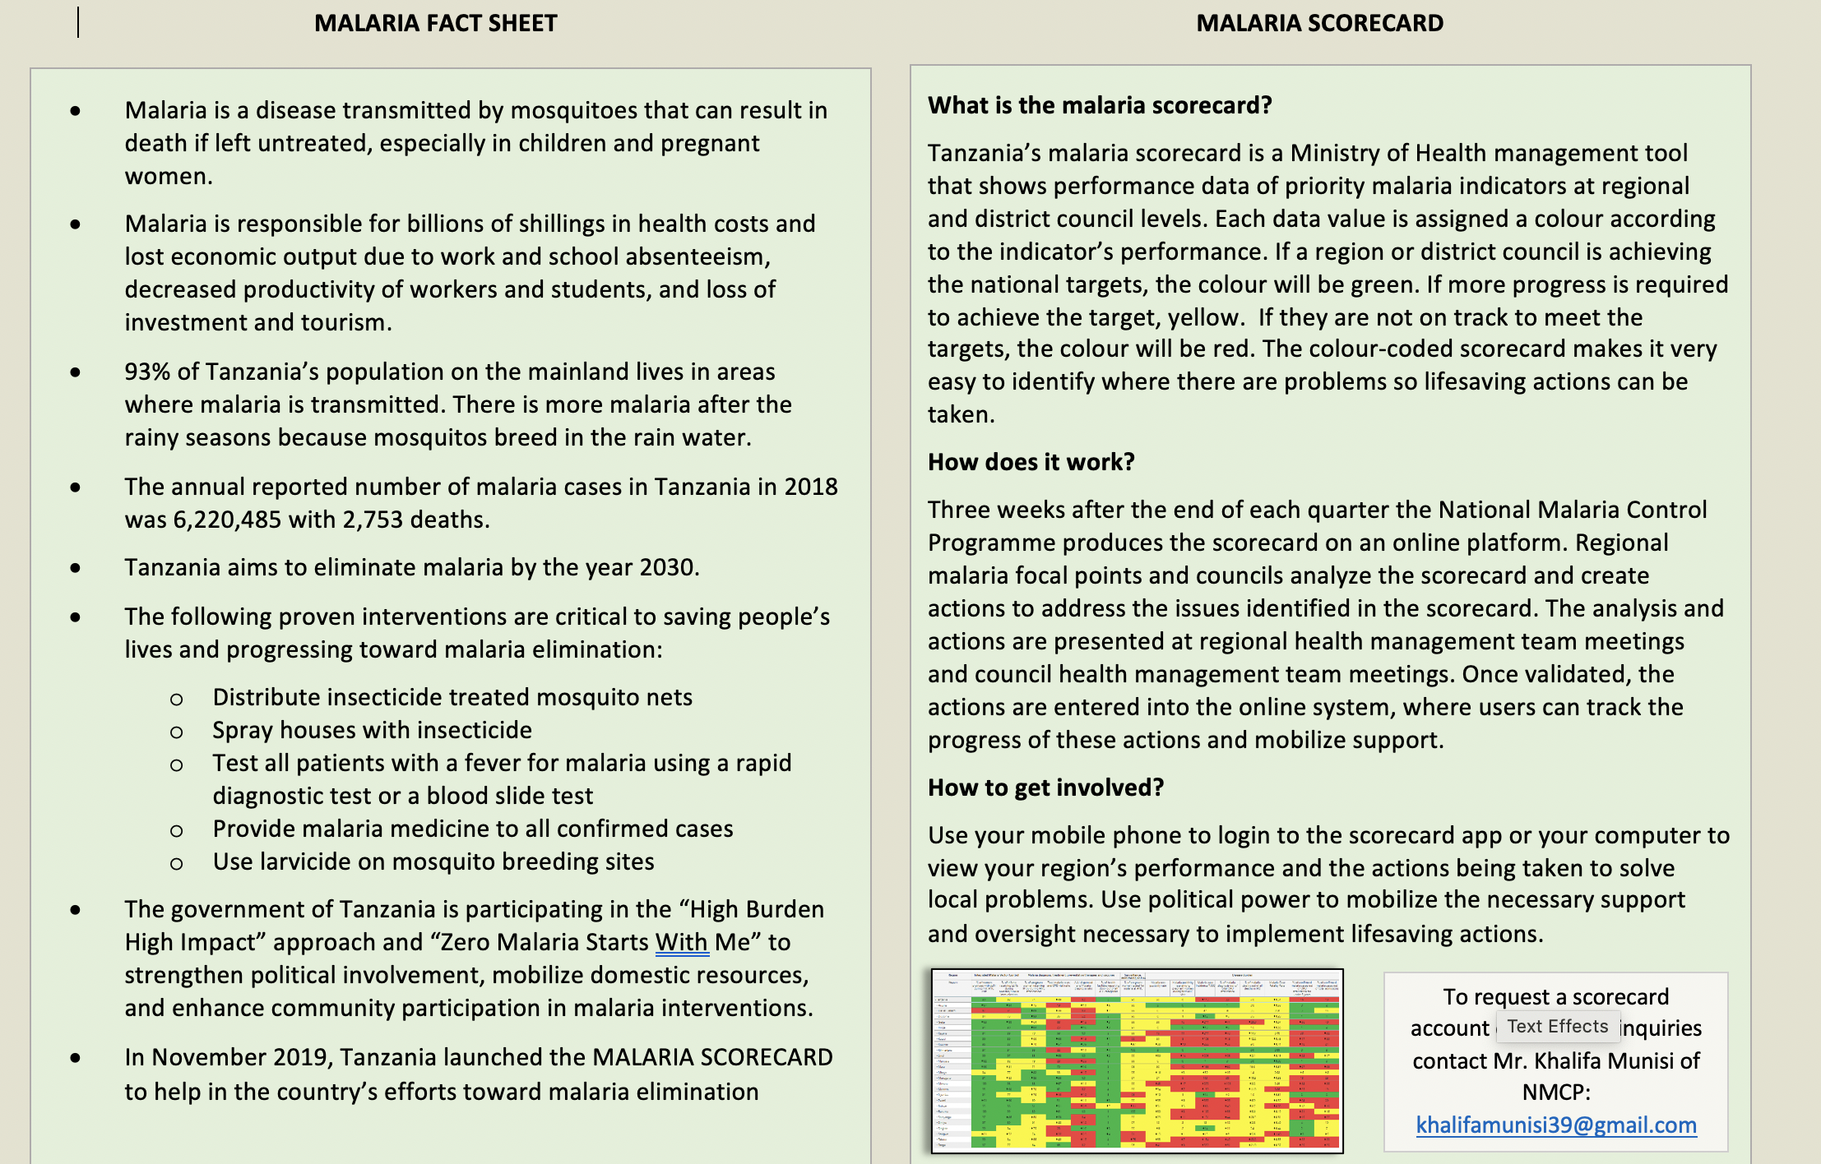
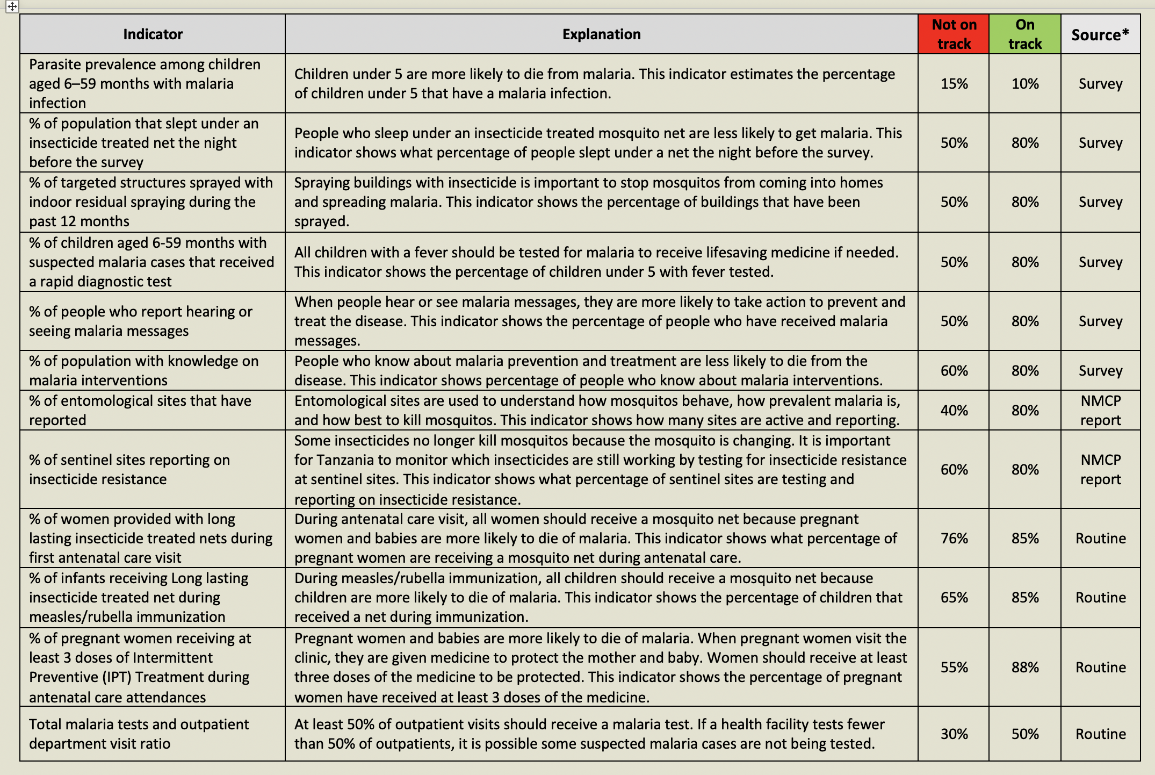
Simplified indicator explanation sheet and advocacy materials
Tools that can be used
Advocacy material to accompany the scorecard can be useful to guide leaders in their reading of the scorecard.
A ‘cheat sheet’ can be designed to explain technical indicators and how to read the scorecard.
An executive summary presentation can also be developed to highlight performance issues and bottlenecks.
Examples of a cheat sheet

Slide 66
How to share the scorecard with
high-level decision makers

Slide 67
How can AYAC members be “Scorecard Champions”
Tools that can be used
Scorecard and knowledge dissemination
    Print the scorecard every quarter and send copies to leaders’ offices with a letter of the priorities and potential actions for the quarter.
    Send a PDF of the scorecard via email to leaders and media.
    Create a WhatsApp group with youth groups and key stakeholders and disseminate the scorecard.
    Train other youth on how to use the scorecard via the scorecard hub.
    Use scorecard in local ZMSWM initiatives.
Action and accountability
    Present the scorecard analysis and proposed actions during community meetings and in meetings with youth. (ALMA scorecard or country scorecard)
    Share with leaders the actions and the budget required to implement the action so they can mobilise support.
    Encourage leaders to monitor the implementation of life-saving actions through scorecards.
    Work with community to promote prevention and treatment seeking behaviours (example: cooperate with the IRS campaign).

Slide 69
EXAMPLE: Scorecard action matrix
Identify three priorities on the scorecard.
Write potential root causes
Create a SMART action to address the root cause(s) of the issue
Priority Issue | Potential Causes | Action
Borno reported 25,709 maternal deaths | Data quality issue | Call the data information officer for Gwoza LGA who reported 2,343,750 Maternal deaths so they can correct the value in DHIS2
Low LLIN coverage for children under 5 in Kebbi, Lagos, and Bayelsa | Stock outs of LLIN Data quality issue | Work with PMI to mobilise 20000 LLINS in Kebbi and 40000 LLINs in Lagos

Slide 70
Next Steps

Slide 71
Next Steps: AYAC Scorecard Champions
Activity | Deadline
Create an account in the Scorecard Hub
Finish the courses and quizzes to earn a certificate of completion
Liaise with ALMA to inquire about gaining access to scorecard on the web platform if it is not available on the scorecard hub
Analyse your country scorecard and identify priorities requiring attention, then share the analysis
Train other youth groups and stakeholders on the use of scorecards using the Scorecard Hub

