Slide 1
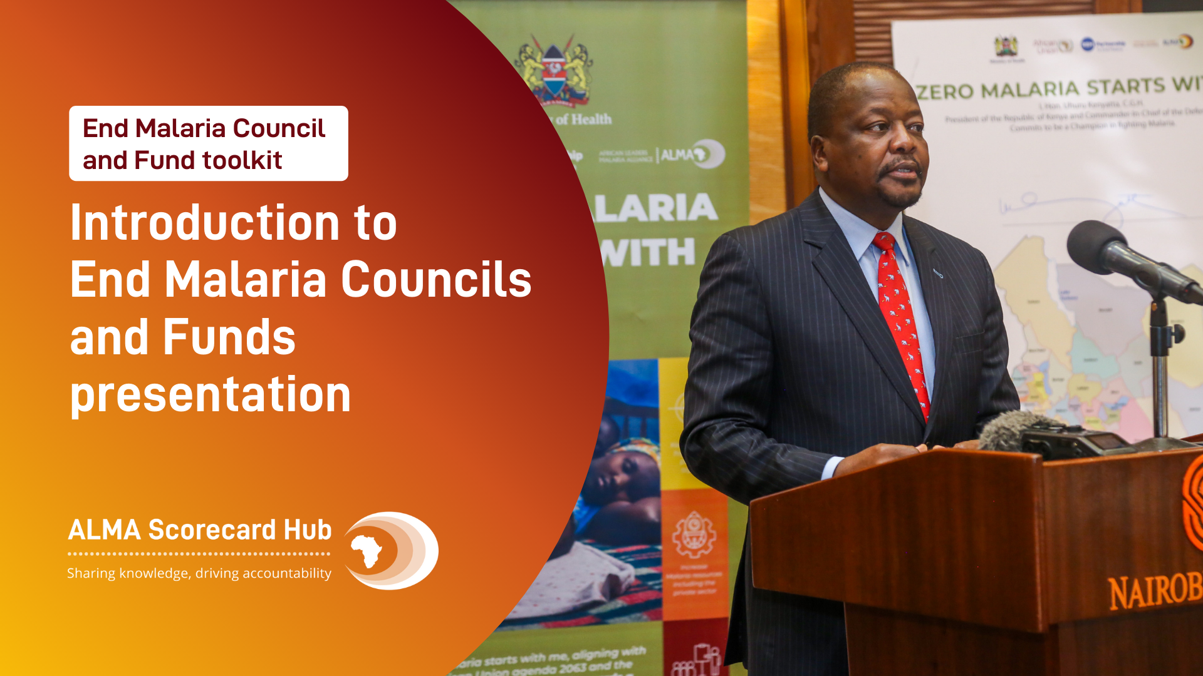

Slide 2
Introduction
END MALARIA COUNCIL TOOLKIT
Significant progress has been made against malaria since 2000. Innovative financing and strong political will led to the rapid distribution of new and more effective malaria commodities and interventions. The results are staggering. From 2010-2018, 650 million cases and 4 million deaths were avoided. The return on investment: 36-to-1 globally and 60-to-1 in Africa. In 2016, the African Union called for the end of malaria on the continent by 2030.
Progress, however, has stagnated. Sustaining political will and mobilising action and resources from all sectors to support national malaria strategic plans (NSP) are critical to getting back on track.
Recent initiatives like Zero Malaria Starts with Me and High Burden to High Impact provide frameworks for driving accountability, advocacy, action, and resources at the regional, national, and community levels. Every person and every sector (government, business, and civil society) have a role to play. Working together will unlock unique skills, capabilities, and resources that will drive innovation, scale and progress.
An End Malaria Council (EMC)¹ is a country-owned and country-led mechanism to drive multisectoral advocacy, action, resource mobilisation, and accountability to achieve the objectives of the NSP. They convene influential leaders from across all sectors to champion malaria and mobilise commitments to address the operational bottlenecks and resource gaps faced by the NMCP and its partners.
This toolkit provides overview on how to design, implement, launch an EMC. However, just as every country is different, so too are EMCs. There is no one-size-fits-all approach. Each must be tailored based on strategic objectives, context, and experience.
Together, we can end malaria.
1. Some countries are having “End Malaria Funds” (e.g., Eswatini End Malaria Fund). This toolkit collectively refers to both councils and funds as “EMCs” because they are synonymous. All are composed of senior leaders; mobilise commitments for advocacy, action, resources, and accountability; work in partnership with the NMCP; and are supported by a lightweight administrative secretariat.

Slide 3



A CALL TO ACTION
World Malaria Report 2020
Progress in the fight against malaria has stagnated
The African Union set a goal of eliminating malaria in Africa by 2030
Progress against malaria has stagnated with more than 220 million cases and 384,000 deaths annually
Malaria burdens public health systems and undermines economic growth and resilience
Increasing insecticide and drug resistance threaten to reduce the effectiveness of malaria commodities and increase costs
Half of the activities in national malaria strategic plans are unfunded preventing the achievement of national targets
Malaria incidence rate
Est. cases per 1.000 persons at risk
-3%
From 2000-2015, malaria incidence in Africa declined by an average of 3% per year
<-1%
The rate has slowed to less than 1% since 2015
SOURCE: WHO, World Malaria Report 2020, Appendix F

Slide 4
An End Malaria Council is a multisectoral forum that mobilises advocacy, action, resources, and accountability to support the national malaria strategy
What is an End Malaria Council?
Head of State
Appoints
End Malaria Council
Public sector
Ministers, Principle Secretaries, Parliamentarians, Governor of National Bank, Head of Revenue Authority, Municipal Leaders
Forum of senior leaders that meets quarterly to review the status of malaria control (including the national malaria scorecard) and then engage their respective sectors to mobilise commitments for advocacy, action and resources to address gaps to support the NMCP
Private sector
CEO of Influential Businesses, President of Trade Organisations, Rotarians
Community
Religious Clergy, Traditional Leaders, other community leaders
NMCP
Administrative Secretariat
Develops and implements the national malaria strategic plan and identifies bottlenecks and resource gaps
2-3 person secretariat that organises quarterly meetings and documents / tracks commitments from the various sectors

Slide 5
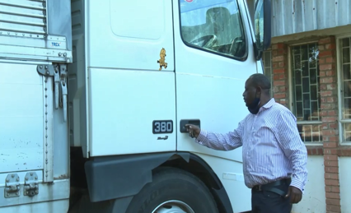
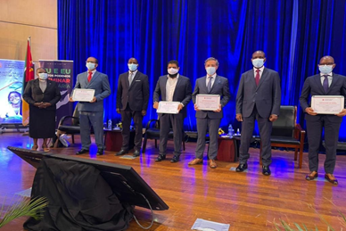
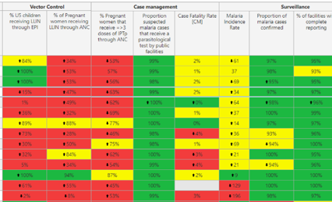

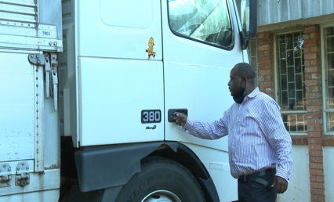
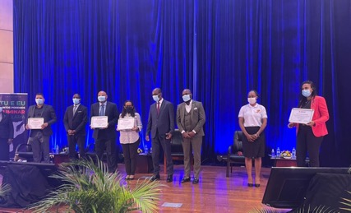
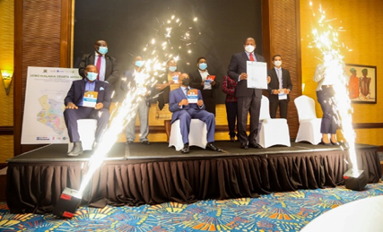
End Malaria Councils mobilise commitments for advocacy, action, resources, and accountability
Activities
Advocacy &
political will
Action
Resource mobilisation
Accountability
Advocate for malaria to remain high on the national development agenda and strategic priorities across all sectors (i.e., public sector, private sector, community)
Drive a coordinated response across all sectors and at all levels (down to the community) to support the national malaria strategic plan
Mobilise resources (financial and in-kind) and capture cost-savings efficiencies to close the gaps in the national malaria strategic plan
Meet regularly to review progress and ensure mutual accountability across sectors for fulfilling commitments and achieving the goals of the national malaria strategic plan
The Cabinet Secretary for Health and Kenya End Malaria Council committing to champion “Zero Malaria Starts with Me”
Transportation of insecticides provided by First Quantum Minerals, a members of the Zambia End Malaria Council
Private sector executives pledging financial and in-kind support for the Fundo da Malaria (Mozambique)
The national malaria scorecard presented by Zambia’s National Malaria Elimination Centre during a meeting of the End Malaria Council

Slide 6
End Malaria Councils mobilise commitments to remove bottlenecks limiting the implementation of the national malaria strategic plan
How they work
EMC members engage their sectors
EMC members engage their sectors to mobilise commitments
NMCP escalates challenges to the EMC
EMC
Sectors
Operational gaps and bottlenecks
Advocacy
Recommended actions for other sectors to take
Action
Recommended policy changes
Resources
NMCP
Itemised budget gaps
Accountability
The NMCP remains primarily responsible for implementing the national strategic plan with the support of commitments mobilised by the EMC

Slide 7
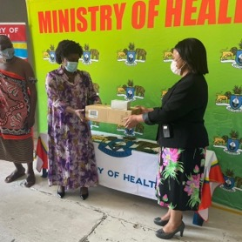
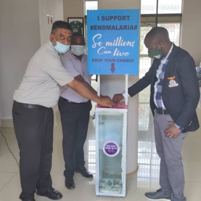
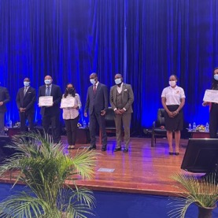
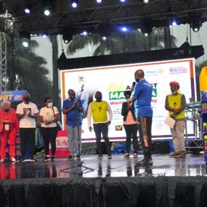
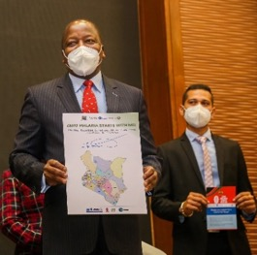
End Malaria Councils have successfully mobilised commitments from across sectors
Example Commitments
Eswatini
Zambia
Mozambique
Uganda
Kenya
Procured antimalarials following a nationwide stockout to avoid disruptions to case management
Funded salaries for Indoor Residual Spray operators during the 2020/21 campaign
Organised a national Youth Celebration featuring Yvonne Chaka Chaka and a private sector Indaba to raise the visibility of malaria
Mobilised $500,000 USD from the private sector to fund mass drug administration in priority districts
Zambia Revenue Authority donated seized trucks to the NMEC
Provided in-kind transportation of insecticide and other malaria commodities to close resource gaps under the NSP
Mobilised commitments of more then $3.5 million USD to close gaps under the national malaria strategic plan
Organised a nationally televised donor conference to raise the visibility of malaria and mark World Malaria Day
Organised a national communications campaign to raise the visibility and awareness of malaria
Held a national bike race on World Malaria Day in partnership with the Ministry of Health and Rotarian Malaria Partners
Conducted trainings with several private sector companies to sensitise them to the objective of ending malaria
Launched a national task force to develop a plan to locally manufacture malaria and other health commodities

Slide 8
Overview of the process for establishing and operating an End Malaria Council
End-to-end process
01
02
03
04
LAUNCH
Design
Advanced planning
Mobilisation
Accountability
Identify the priority gaps under the national malaria strategic plan
Develop a concept note outlining the objectives, structure, and operations of the council
Get high-level political sign-off
Recruit and onboard the founding members
Establish the secretariat and internal processes
Prepare communications materials (e.g., website)
Announce the EMC with a public launch event
Advocate for malaria to be a priority across all sectors
Mobilise and document commitments for advocacy, action, and resources
Identify efficiencies and innovations
Track and report on the fulfilment of commit-ments during quarterly meetings
Measure impact of activities
Publish quarterly and annual reports

