Slide 1




Sierra Leone RMNCAH Scorecard workshop
July 2021

Slide 2

Specific Objectives
General Objective
Strengthen use of data for action using the scorecard management tool.
Understand what the scorecard is and comment on its use for action.
Understand the indicators and thresholds of the RMNCAH scorecard.
Learn how to access and use the scorecard web platform.
Learn how to access the Knowledge Center to use other learning and training materials.
Create the Q1 / 2021 scorecard analysis and define recommended actions (actions).
Presentation of analysis and recommended actions..

Slide 3
Introduction to ALMA and Country Scorecards for accountability and action

Slide 4

Our work
About ALMA
Keeping malaria high on policy and political agenda and promoting collective action on policy priorities
ALMA Scorecard for Accountability and Action (quarterly), 2030 Scorecard towards Malaria Elimination (annually)
Supporting countries in the development and use of country scorecard management tools (malaria, RMNCAH, NTDs, nutrition and community)
Identifying and sharing lessons for effective implementation of national programmes
End Malaria Councils and End Malaria Funds

Slide 5







ALMA Chairs
About ALMA
Previous chairs
Tanzania - 2009 to 2012
H.E. Jakaya Kikwete
Liberia - 2012 to 2013
H.E. Ellen Johnson Sirleaf
Mozambique - 2013 to 2014
H.E. Armando Guebuza
Ethiopia - 2014 to 2016
H.E. Hailemariam Desalegn
Chad - 2016 to 2017
H.E. Idriss Déby
Current Chair (since February 2020)
His Excellency Uhuru Kenyatta
Kenya
Eswatini - 2017 to 2020
H.M. King Mswati III

Slide 6

Download video from dropbox here: Country scorecard management tool overview Video

Slide 7
ALMA has assisted countries across Africa in the development and strengthening of national Malaria, RMNCAH, and NTD scorecards
  Between 2012 and 2021 ALMA has supported the development of:
    29 RMNCAH Scorecards
    40 malaria Scorecards
    6 NTD Scorecards
    1 country with Malaria-NTD integrated scorecard
    4 Community Scorecards
    2 Nutrition Scorecard (Kenya and Tanzania – and now one in Ghana)
  Scorecards are updated quarterly and integrated into existing management and decision making processes
  ALMA has continuously supported the implementation and strengthening of country scorecards in order to:
    Strengthen the capacity to ensure sustained use of the tool
    Document best practices
    Provide additional support as needed
Countries with ALMA supported scorecards
Morocco
Tunisia
Objectives
  ALMA Heads of Region and Government prioritize malaria control and elimination
  Malaria is maintained high on the political and policy agenda at national level in ALMA member countries & across the region
Sahrawi Arab
Democratic Republic
Algeria
Libya
Egypt
Mauritania
Niger
Senegal
Mali
Sudan
Eritrea
Djibouti
The Gambia
Burkina
Faso
Chad
Guinea-Bissau
Guinea
Benin
Sierra Leone
Côte
d'Ivoire
Togo
Nigeria
Central African
Republic
Ethiopia
Liberia
Ghana
Cameroon
South Sudan
Equatorial Guinea
EG
Uganda
Somalia
Gabon
Congo
Kenya
São Tomé
and Príncipe
DR Congo
R
Rwanda
Angola
B
Burundi
Community
Tanzania
Nutrition
Angola
Comoros
Malaria and RMNCAH
Nigeria
Malawi
Mozambique
RMNCAH
Namibia
Zimbabwe
Madagascar
Botswana
Malaria
ESwatini
NTD
South Africa
No Scorecard
Lesotho

Slide 8
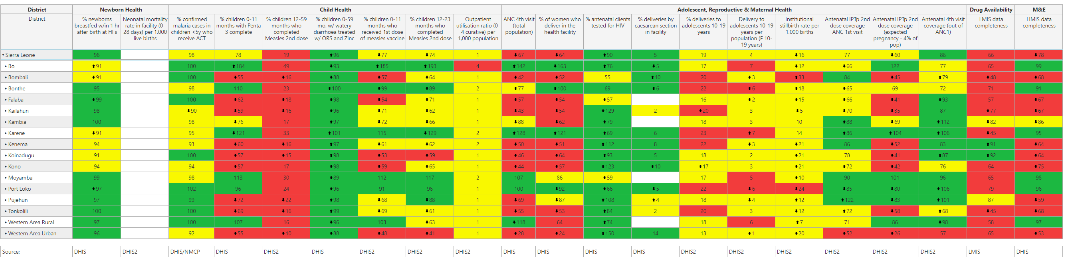
Scorecard Management Tools
A colour-coded management tool that helps Sierra Leone track performance of priority indicators from the national strategic plan.
Country-owned and managed.
Uses existing quarterly data from routine sources like DHIS2 and integrated into existing management processes.
Used for action, accountability and advocacy at national and subnational levels through data visualization and management functionalities

Slide 9
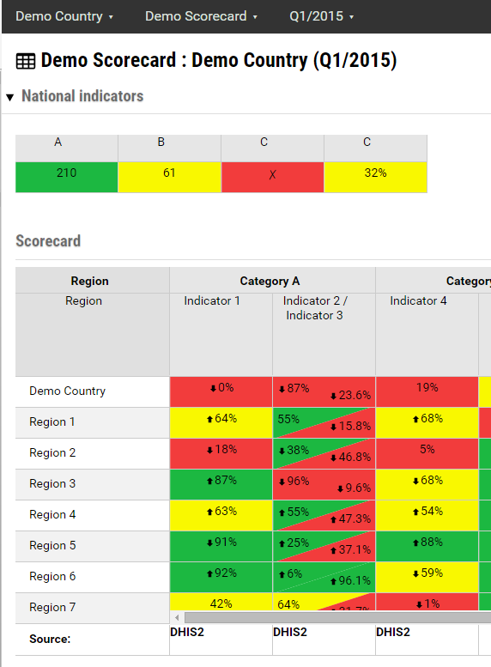
The scorecard shows the performance of selected RMNCAH
indicators at national, subnational, and community levels
The scorecard aggregates data on 3-6 key national priority indicators that:
  Measure outcomes or impact (e.g., maternal mortality rate)
  Don’t change quarterly (e.g., health expenditure as % of total)
  Arrows show performance against the previous comparable period
  The scorecard aggregates data on 15-20 subnational indicators selected by the country
  Traffic-light colours indicate how performance measures against pre-defined targets

Slide 10
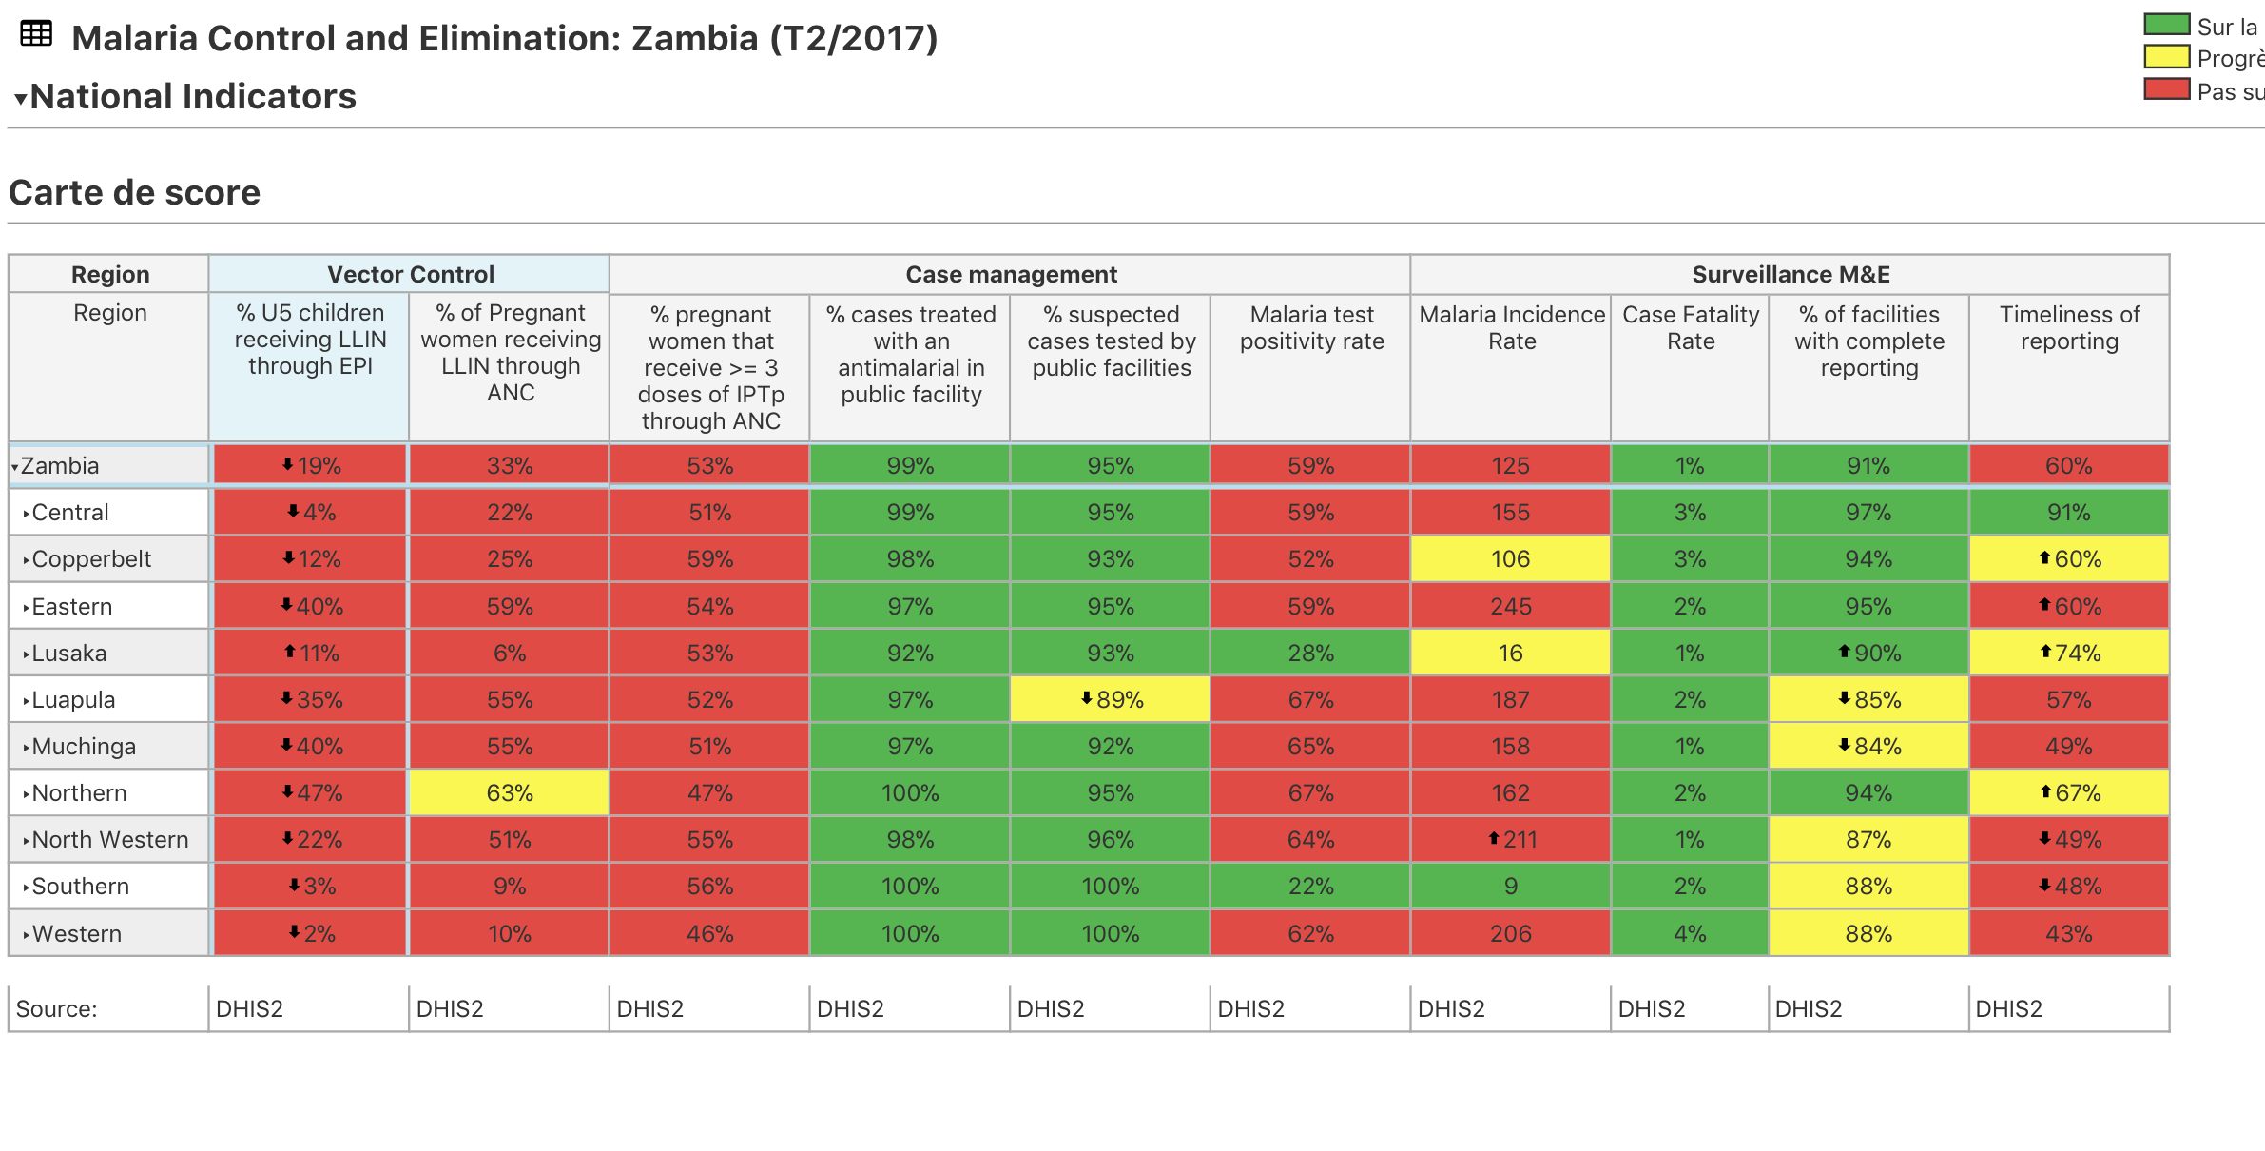
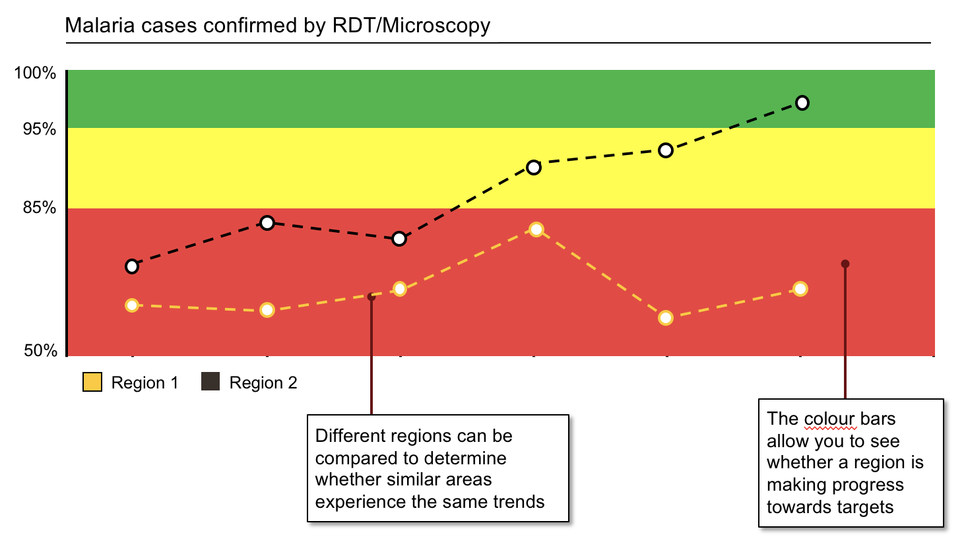
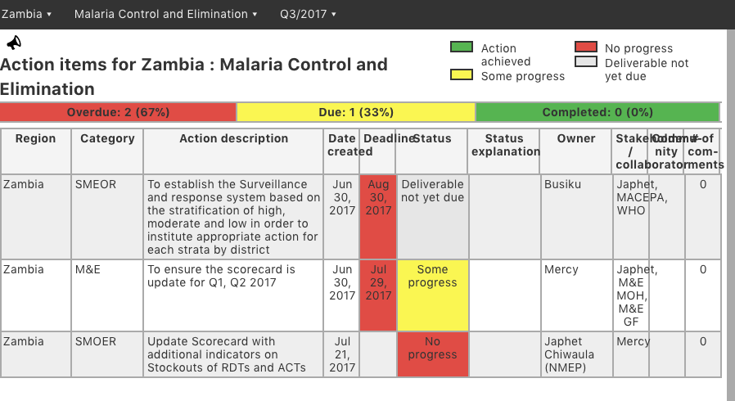
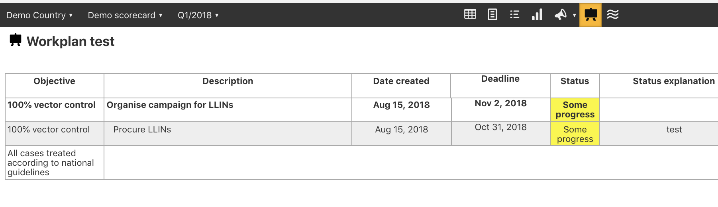

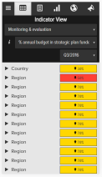
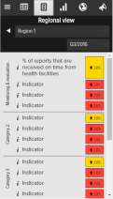
The online scorecard management tool (web platform) includes various data visualization and management functionalities
Scorecard
Action tracker
Charts & Graphs
Action tracker
Workplan manager
Mobile notifications
What It is
What it is
What it is
What it is
What it is
Quarterly performance of priority indicators at national, regional and district level. Some scorecards include facility level data
Charts, maps, and other data visualisation tools provide additional context by showing indicator performance over time
Used to assign actions with deadlines to action “owners”. It includes a progress field showing implementation status and an automated notification system
Tracks implementation of annual workplans, listing key milestones and the progress of action items with clear owners and timelines, and an automated notification system
An automated SMS notification system alerts action owners on outstanding actions and approaching deadlines
Only users with accounts can access scorecards and management tools at www.malariascorecard.org

Slide 11
Key lessons learned to date from existing RMNCAH scorecards
  1
Integrating scorecards into ongoing national processes reduces costs, facilitates use, and enhances long term sustainability
Wide dissemination to a broad range of stakeholders and high-level political engagement enhances transparency and ownership and helps to facilitate action
Publishing the scorecard quarterly stimulates discussion and transparency around health, progress against indicators and bottlenecks
Decentralising the scorecards sub-nationally and engaging communities enhances the ability to identify bottlenecks, make recommendations and track action
The scorecard supports bottleneck analysis and identification of key actions to respond to underperformance
Use of the action tracker facilitates improved quality and efficiency of management meeting discussions and serves as an accessible system to track implementation of agreed actions linked to indicator under-performance
The scorecard can drive improvements in data quality, and has helped to facilitate additional data collection and corrections to indicator calculations in DHIS2.
Scorecards have identified under-resourced interventions and areas and have supported effective resource mobilisation and resource allocations
  2
  3
  4
  5
  6
  7
  8

Slide 12
Background on Sierra Leone’s RMNCAH Scorecard use experience
INSERT PPT BY SLMOH
July 2021

Slide 13
Overview and guidelines for indicator selection

Slide 14


Slide 15
Select indicators
The selection of the indicators is guided by the following criteria:
Is it a priority indicator?
    Is it a priority in the strategic plan?
    Does it measure success of an intervention to improve outcomes?
Long list of
indicators
M&E plan
Is it an actionable indicator?
    Does the country have a clear target?
    Can under-performance trigger an action at the national or sub-national level?
    Should be a %, rate, or per 1000 or 100,000 (not a total number – numbers cannot have thresholds)
Strategic plans
Are data available?
    Are data available to measure the progress of the indicator? (if yes, wave 1 indicator).
    Will it be available in the medium term or long the long term? (if yes, place indicator in wave 2 and 3 respectively).

Slide 16
Step 3. Sort into waves
Indicator selection and revision for the scorecard tool
If a priority indicator does not have data, it can be added to future waves. The indicator will not be displayed in the scorecard until the data is available.
Wave
3
(Data available in the longer-term)
Wave
2
(Data available in the short-term term)
Wave
1
(Data available today)
Indicator is:
Priority
Actionable
Intervention is not being implemented yet but will be in the long-term (see example next slide)
Indicator is:
Priority
Data will be available in the future (long-term)
Intervention is not being implemented yet but will be in the short-term (see example next slide)
Indicator is:
Priority
Actionable
Data available

Slide 17
Set thresholds
Indicator selection and revision for the scorecard tool
Each indicator should have defined thresholds to indicate whether or not performance is on track.
Red
Not on track
Thresholds are specific to each indicator and may change over time.
Best practices:
    Green is usually aligned with the final target of the strategic plan
    Red is usually the baseline
Red-yellow threshold
Yellow
Progress, but more effort required
Yellow-green threshold
Green
Target achieved or on track

Slide 18
- Presentation and discussion on Sierra Leone’s revised RMNCAH scorecard indicators www.rmncah.org

Slide 19
Overview of Web Platform

Slide 20

Overview of Web Platform

Slide 21
Scorecard web platform

Slide 22
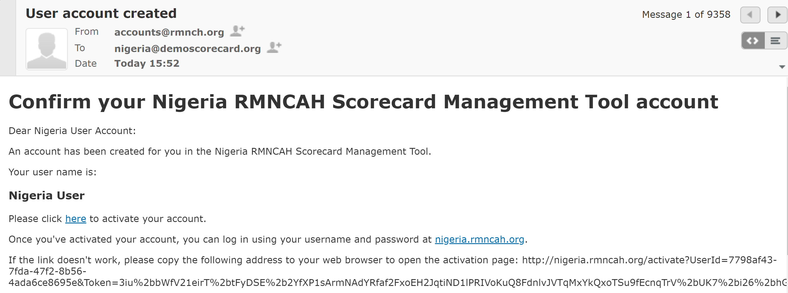
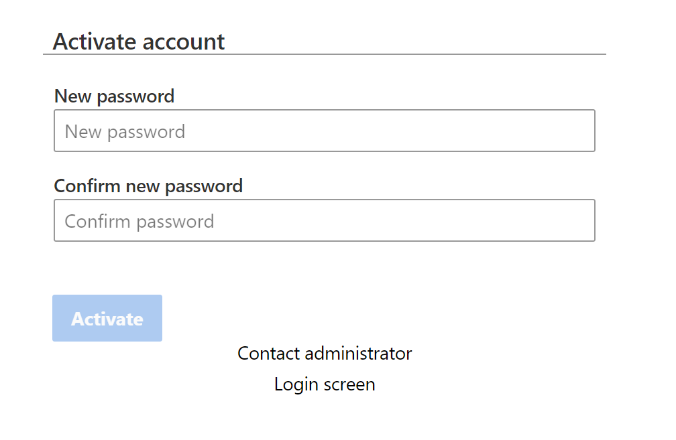
Activate your account from your email
Go to your email inbox and search for email with subject “User account created” from accounts@rmnch.org
If you cannot find the email, check your spam inbox
Click on the link where it says “Please click here to activate you account”
Ghana
Ghana

Slide 23



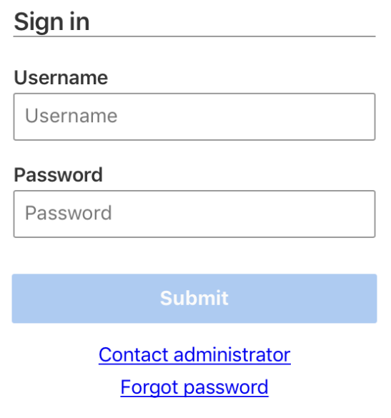
How to login to the scorecard
www.rmncah.org
Username: Use your personal account
Password: Use personal account
or on your mobile and tablet
Download the app “country scorecard”
Android app
iphone app
Instruction | Icon
1. Go to the google play store by clicking on this icon on your mobile or tablet
2. Search for “country scorecard” and download the app
3. Open the app and login using your account credentials
Instruction | Icon
1. Go to the apple store by clicking on this icon on your mobile or tablet
2. Search for “country scorecard” and download the app
3. Open the app and login using your account credentials

Slide 24
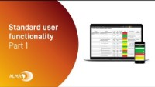
Users part 1
Download video: Web platform Part 1 video

Slide 25

Users part 2
Download video: Web Plaform Part 2 Video

Slide 26

www.scorecardhub.org
ALMA Scorecard Hub
How to continue learning about the scorecard to strengthen implementation

Slide 27

The Hub was launched by HE President Kenyatta to accelerate health digitisation across Africa
About the Scorecard Hub

Slide 28

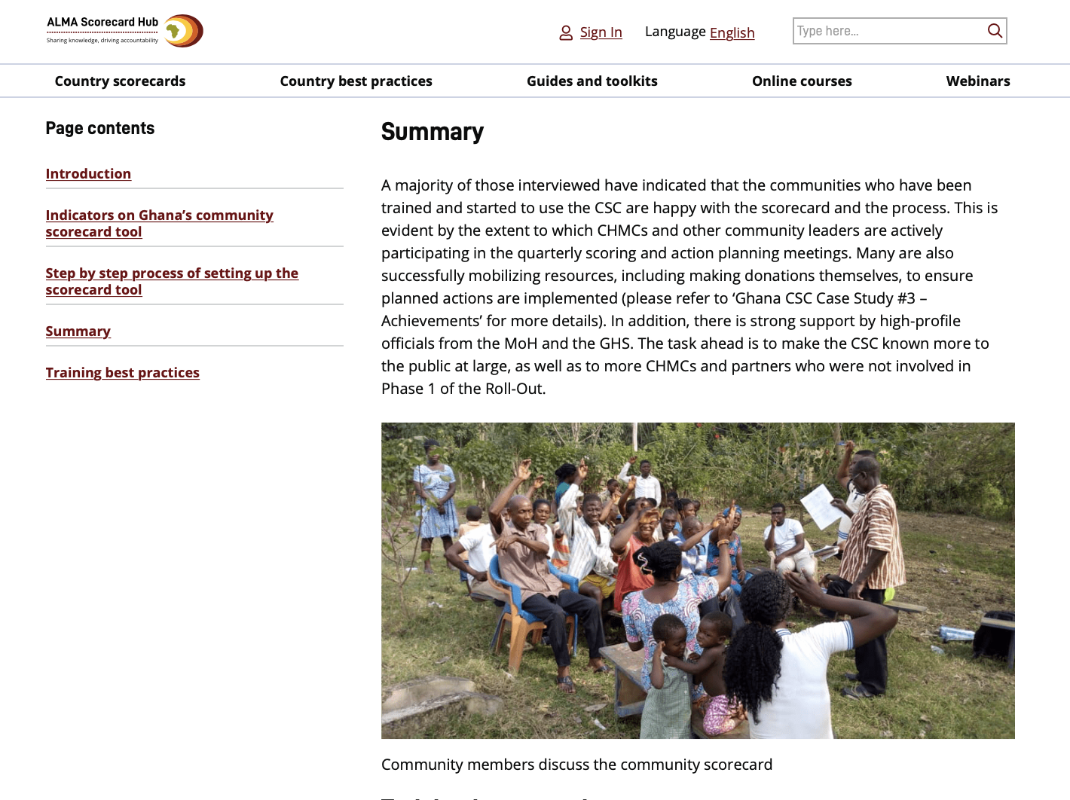
Our Scorecard Hub is the reference portal for countries to share and access knowledge about scorecards
About the Scorecard Hub
What is on the Hub: www.scorecardhub.org
A public directory of scorecards shared by African countries
Country best practices highlighting how countries have used scorecard tools for impact – such as Ethiopia’s community scorecard tool
Guides and toolkits to help countries create, analyse and improve scorecard tools
Online courses for Ministry of Health national and sub-national staff
Events and webinars to encourage users to share experiences of using scorecards
Technical support for ministries of health to request help and guidance with the scorecard management tools
Online training
Blog
Forum

Slide 29
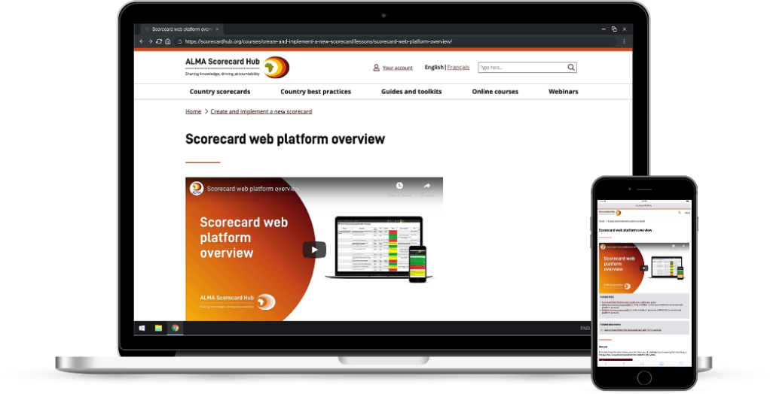
Our online courses are designed to support countries with the decentralisation of the scorecard
Online courses
Guides and toolkits help countries create, analyse and improve scorecard tools
Currently have courses on:
    Create and implement a new scorecard
    Strengthen an existing scorecard
    General web platform training
    Web platform training for administrators
We are working on new courses, such as:
    Create a community scorecard
    Decentralising scorecards
    Using scorecards for advocacy
Are there other course topics that would be helpful to cover?
Based on existing lessons, we can create a custom course for your country

Slide 30

Supporting countries with guides and toolkits
Guides and toolkits
Guides and toolkits help countries create, analyse and improve scorecard tools
Currently have guides about:
    Introduction to country-level scorecards
    Create a new country-level scorecard
    Introduction to community scorecards
    Create a new community scorecard
We are working on new guides to help countries complete common scorecard tasks such as
    How to review a scorecard
    Bottleneck analysis
    Working with data from DHIS2
Are there other guide topics that would be helpful to cover?

Slide 31

Other relevant content for countries
Other content
Our courses are also available to download for offline viewing
View all malaria scorecards published on the hub
View all malaria best practices published on the hub

Slide 32
Website: www.scorecardhub.org
Create an account by using this link https://scorecardhub.org/member-register/
Then click on courses
Or use this link: https://scorecardhub.org/courses/sierra-leone-rmncah-scorecard-training/

Slide 33
End of Day 1

Slide 34
Start of Day 2

Slide 35
Recap of scorecard web platform

Slide 36
www.scorecardhub.org
Hub Quiz: Web Platform part 1

Slide 37
www.scorecardhub.org
Hub Quiz: Web Platform part 2

Slide 38
How to analyse a scorecard

Slide 39

Download video: Analyze a scorecard to identify underperforming indicators Video

Slide 40
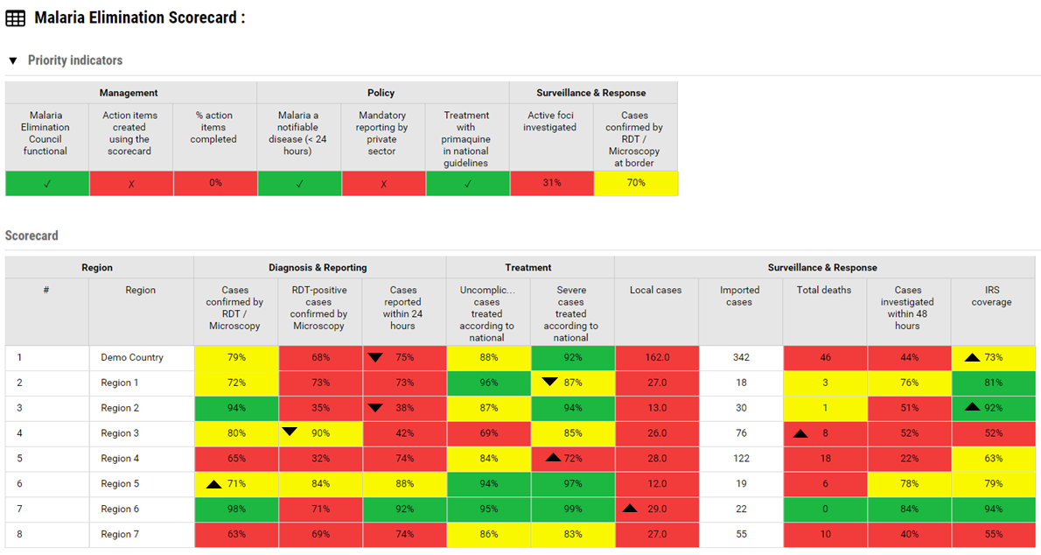
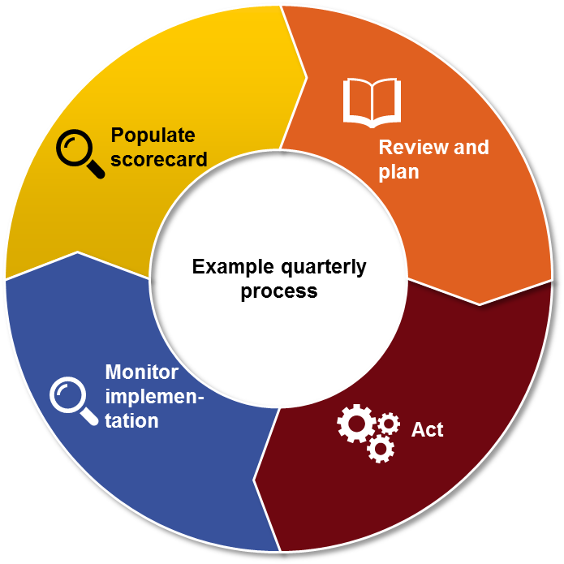
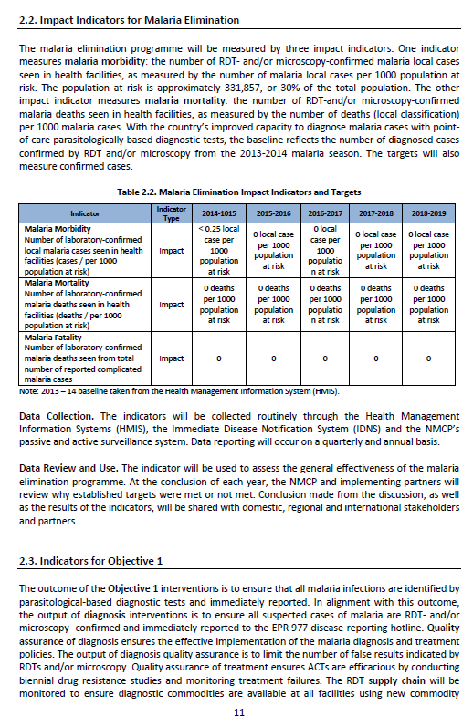
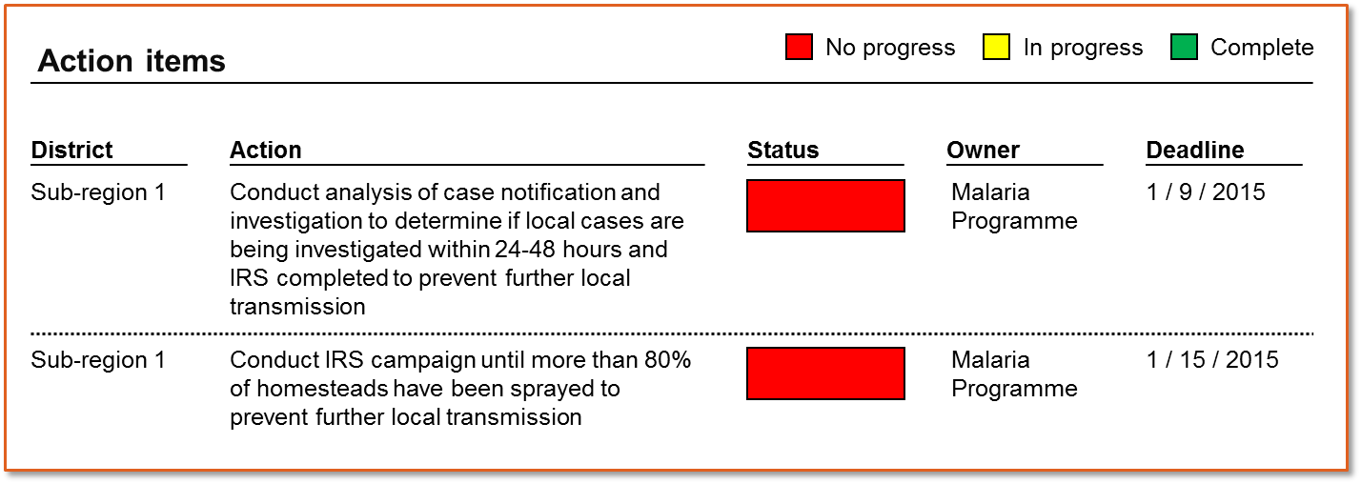

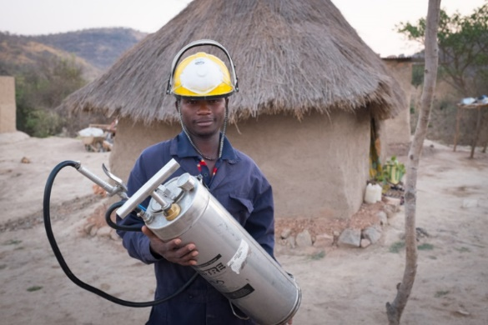
How does the scorecard process work?
1.
Data from existing sources are populated in the scorecard
3.
Existing management processes review the scorecard analysis and document recommended actions in the action tracker.
2.
Analysis
5. .
4.
Management and other existing accountability mechanisms monitor implementation of actions
Programmes and partners implement action items
Notes:
How does the Scorecard Process work?
As a management tool, the emphasis of scorecards should be on how the data is used for action.
Though the process varies depending on the country, many scorecards use the following process
Every quarter, scorecard administrators use data from existing sources like DHIS2 to produce the scorecard.
Technical teams at various levels analyze the scorecard, investigate the root causes of the bottlenecks and propose actions
The scorecard analysis and proposed actions are presented and validated during existing management meetings at all levels. These actions can be entered into the web platform’s action tracker.
Programmes and partners implement the action items; and
Management and other existing accountability mechanisms monitor implementation of actions
If the actions taken had the intended results of addressing the root cause of the issue identified in the scorecard, the data in subsequent scorecards should begin to show improvements.

Slide 41
2. Analyzing the scorecard to create actions…
1
Prioritise
2
Investigate
3
Act
Identify indicators requiring attention
Identify Regions and Districts requiring attention
Evaluate whether performance is improving or getting worse
Gather information about root causes of the problem
Determine which factors contribute most to under-performance
Develop actions that address the root causes identified
Input action items into web platform and monitor
Notes:
Analyzing the scorecard to create actions is a three step process: prioritise, investigate, and create actions.
Prioritizing is an important first step because, in a world of limited time and resources, it is usually not possible to resolve of all the problems revealed by the scorecard in one quarter. For that reason, scorecard users usually identify 3-5 priorities to focus on every quarter. Prioritization involves identifying the indicators and locations requiring attention, then evaluating whether the performance is improving or getting worse. A Province or district with poor performance that is getting worse is usually prioritized.
After selecting a few priorities from the scorecard, it is important to investigate by gathering information about the root cause of the problem. It is helpful to determine which factors are contributing the most to the underperformance and whether the performance is likely to persist. Investigating the root cause of the problem often requires communicating with the people on the ground, where the under-perfomance is taking place.
Once the root causes of the problems are known, it is essential to develop actions that address the root causes of the bottleneck identified. Those actions, can then be input into the scorecard web platform which allows managers to monitor the implementation progress of actions. In the next slides, we will dive deeper into how to prioritize, investigate and act.

Slide 42

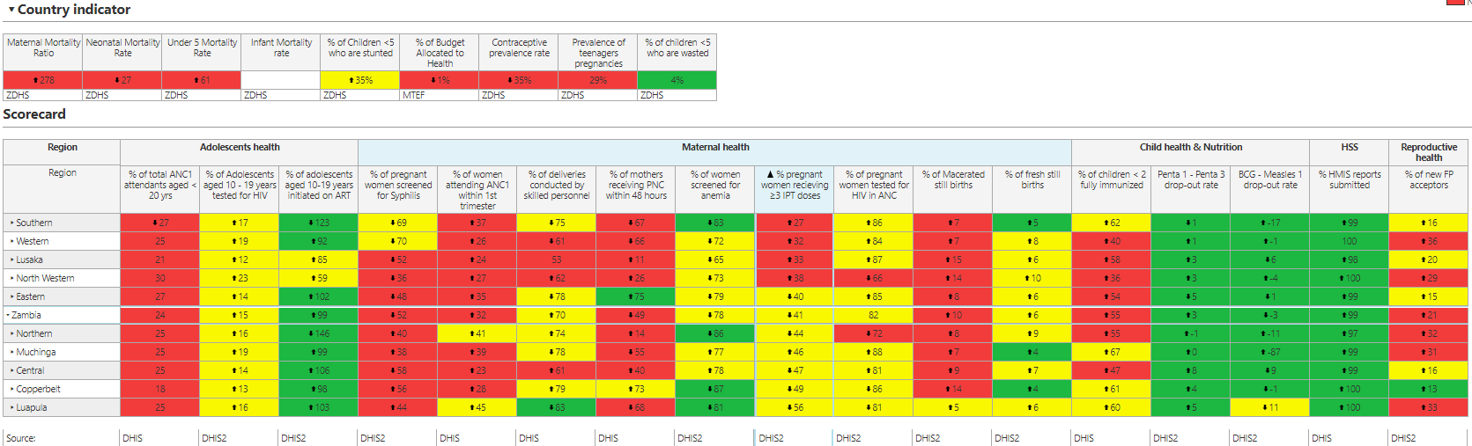
Three dimensions to each cell
3. How to prioritize using scorecard data…
Colour
Arrow
Data value
Notes:
So how can we use the scorecard to prioritize which problems to address?
Each cell on the scorecard has three dimensions to help guide your analysis: a colour, a data value, and sometimes an arrow.
The colour shows whether an indicator is performing well or poorly relative to the national target set by the country. If the indicator is showing red, it means the associated geographic Province is not meeting target. If it is green, it is meeting target, and if yellow, more progress is need to achieve the target. A grey cell means the indicator is not applicable for that geographic location for that period and a white cell means there is no data. An indicator that is performing green may be worth highlighting as a best practice that can be scaled up to other Provinces.
The data values on the scorecard come from various existing local routine data sources. Most scorecard indicators are configured in percentage format, whole number, or decimal, though it is possible to include other formats. In some cases, it is better for the value of an indicator to go up. For example, in the case of Vitamin A coverage, a higher percentage is good and a lower percentage is bad. For other indicators a lower number is considered to be good. For example, in the case of malaria incidence, a lower number is considered to be good.
In addition to the colour and data value, sometimes the scorecard will show an arrow. An arrow will only appear if the performance has changed compared to the previous scorecard or the previous year. For example, if the arrow threshold set by a country is 5%, then an arrow will only show if the percentage increases or decreases by 5 or more points. So if there were a decrease from 50% in Q1 2020 to 45% in Q2 2020, the scorecard in Q2 2020 would show a down arrow, signifying the number has gone down. It is important to note that a green colour indicator with a down arrow may also highlight a priority, since it means the gains are not being sustained and the green may turn to yellow or red eventually.
The colour, the arrow and data value can help to guide the scorecard analysis and prioritization. A red with an arrow showing that the performance is bad and getting worse, is a very high priority.

Slide 43
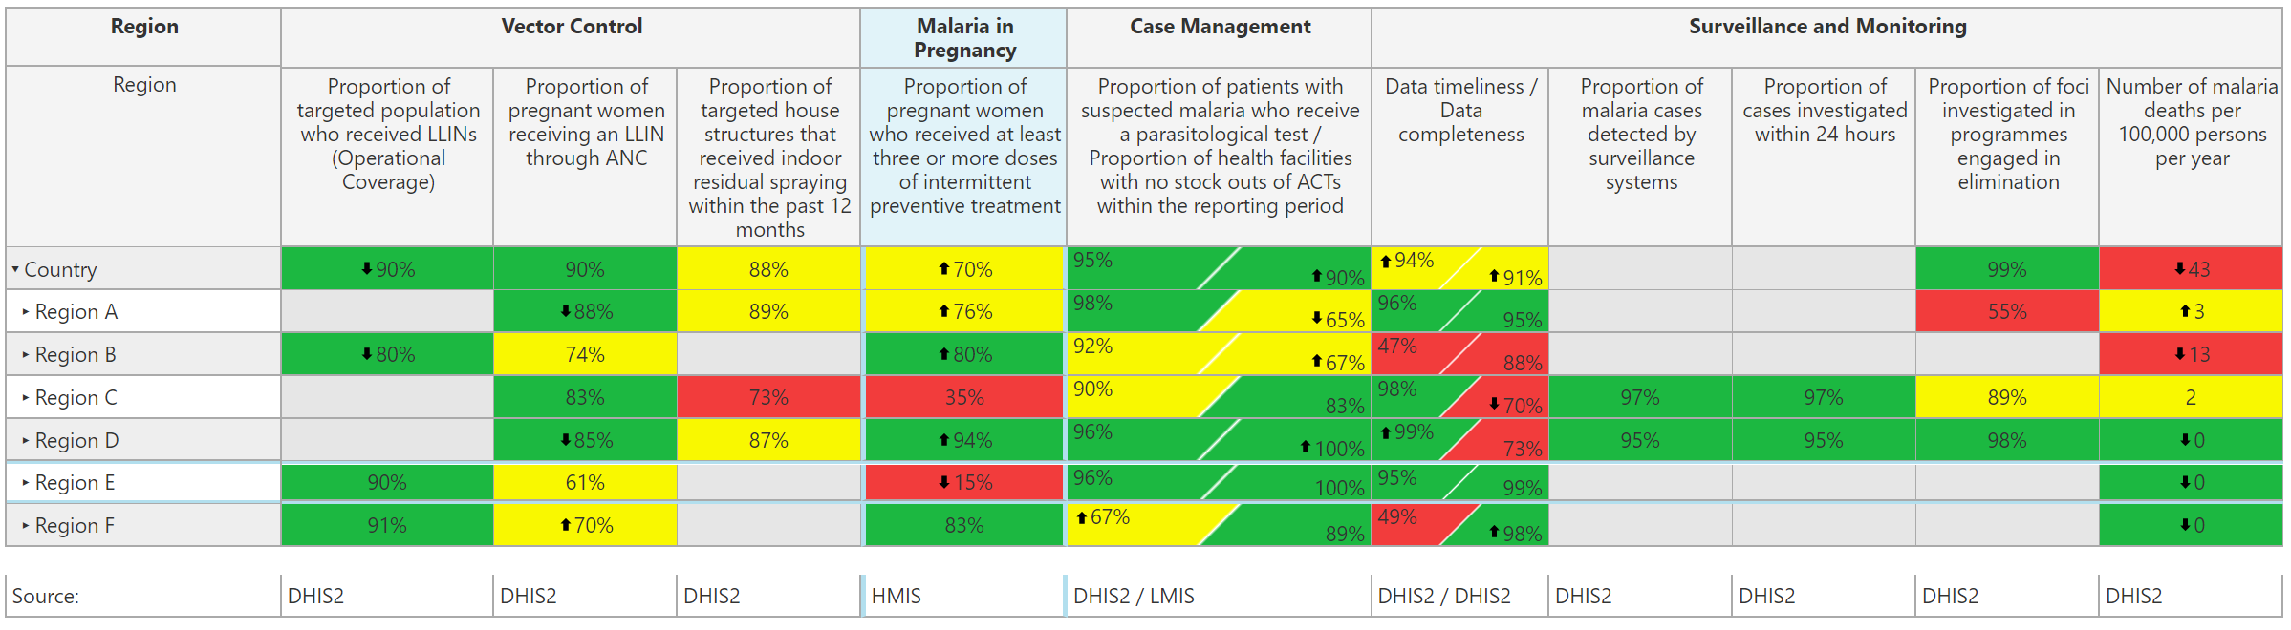
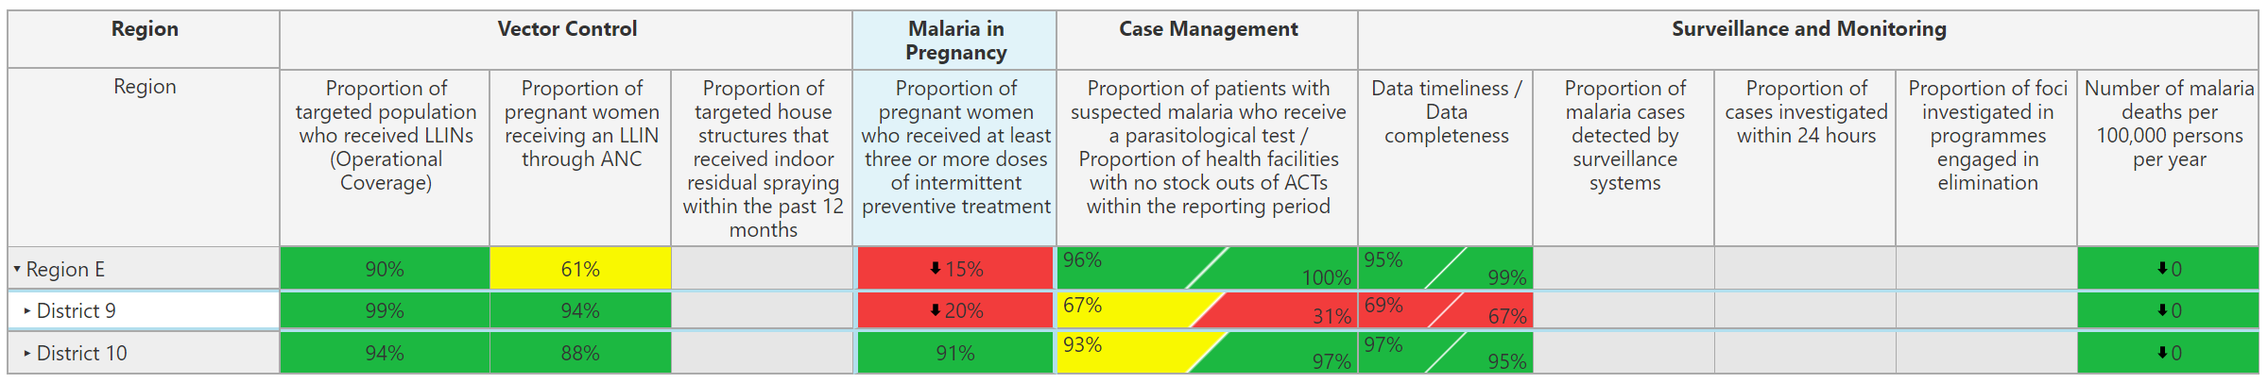
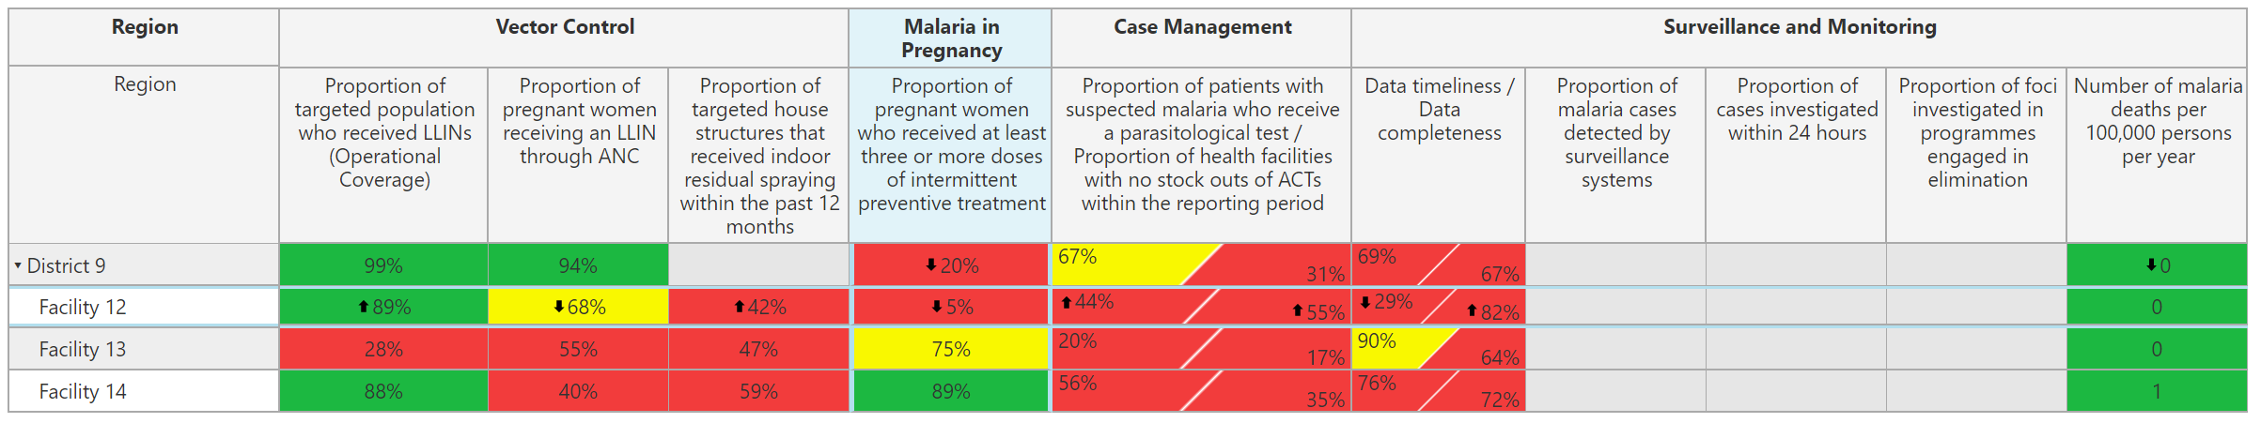
When you identify a problem, open Province to see the performance of the Districts…
“Drill down” by clicking on the arrow next to the name of the Province
Open Province to see which Districts are contributing to the under performance
Open District to see which health facilities are contributing to the under performance
This will help you “find” where the problem is
Open Districts to see the performance of health facilities
Notes:
The scorecard web platform allows users to open sub-Provinces to see the performance of the lower levels, allowing for a more targeted analysis showing where the problem is.
Opening sub-Provinces, or drilling down as it is called, is an important strategy for finding which geographic locations are contributing the most to underperformance.
Take the example in front of you. In the case of the indicator for “Proportion of pregnant women who received at least three or more doses of IPT”, it is clear that Province E is the priority. That indicator in Province E is showing red, at 15%, with a down arrow. It is a bad situation getting worse.
However, to understand the situation better, it is important to open Province E to see how it’s Districts are performing. To see the Districts, in the online web platform, click on the arrow next to the name of the subProvince. In this example, clicking on the arrow next to Province E, will displays two Districts. However, only one of those Districts, “District 9”, is showing poor performance, at 20% with a down arrow. This means it is district 9 that is contributing the most to the underperformance in Province E and District 9 is where the programme should focus its efforts.
Some country scorecards even go down to facility level. In this example, upon opening District 9, it is possible to see that it is actually facility 12 that is mostly contributing to the underperformance. In this way, it is possible to do targeted analysis to create targeted solutions.

Slide 44
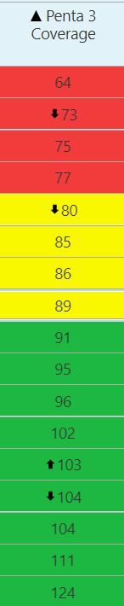

Sorting method
Analyse a scorecard
In the web platform, click on the name of the indicator on the top of the column to quickly sort the values
This shows which places are underperforming
Lowest
Highest

Slide 45
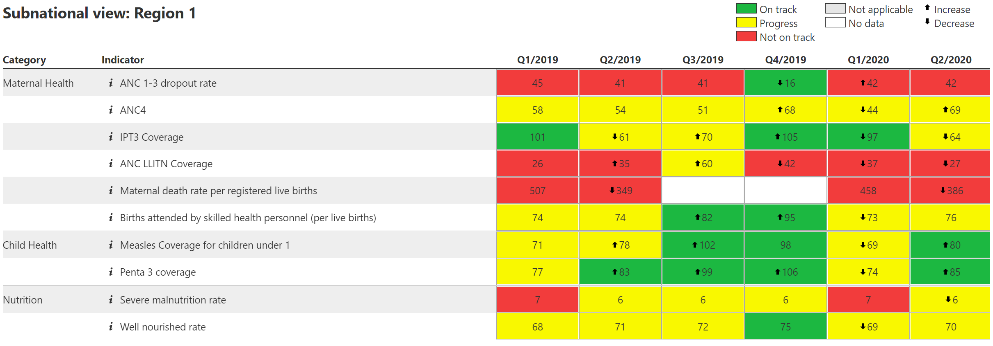
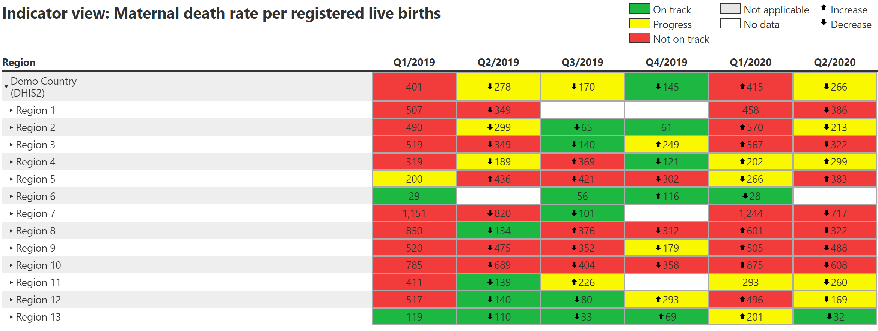
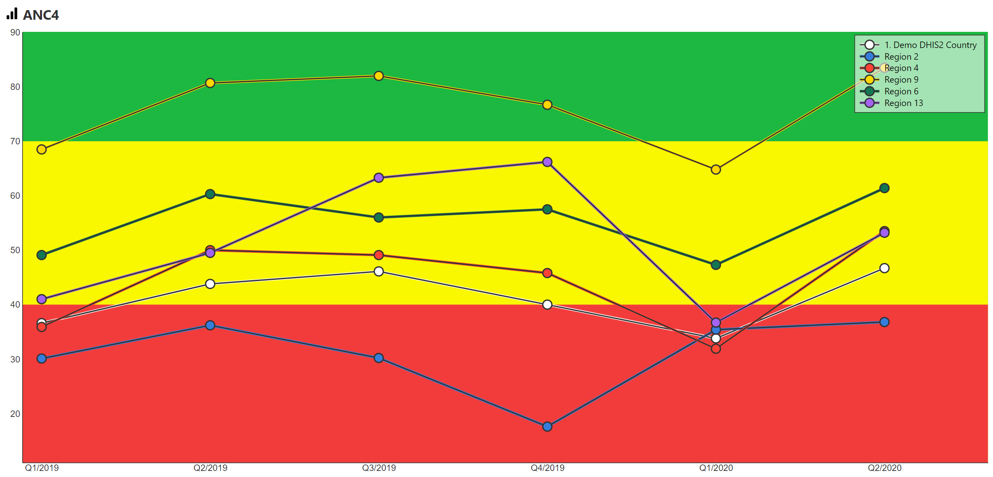
Trend analysis
Analyse a scorecard
Subnational view
View how one particular location is performing across all scorecard indicators.
Indicator view
View how one indicator is performing across all locations, within a selected time range.
Graphs
View how one indicator is performing across multiple locations and across a specified time interval in a line or bar graph.

Slide 46
www.scorecardhub.org
Hub Quiz: Scorecard Analysis

Slide 47
End of Day 1

Slide 48
How to use the scorecard for action

Slide 49

Download video: How to use scorecard data for action Video

Slide 50
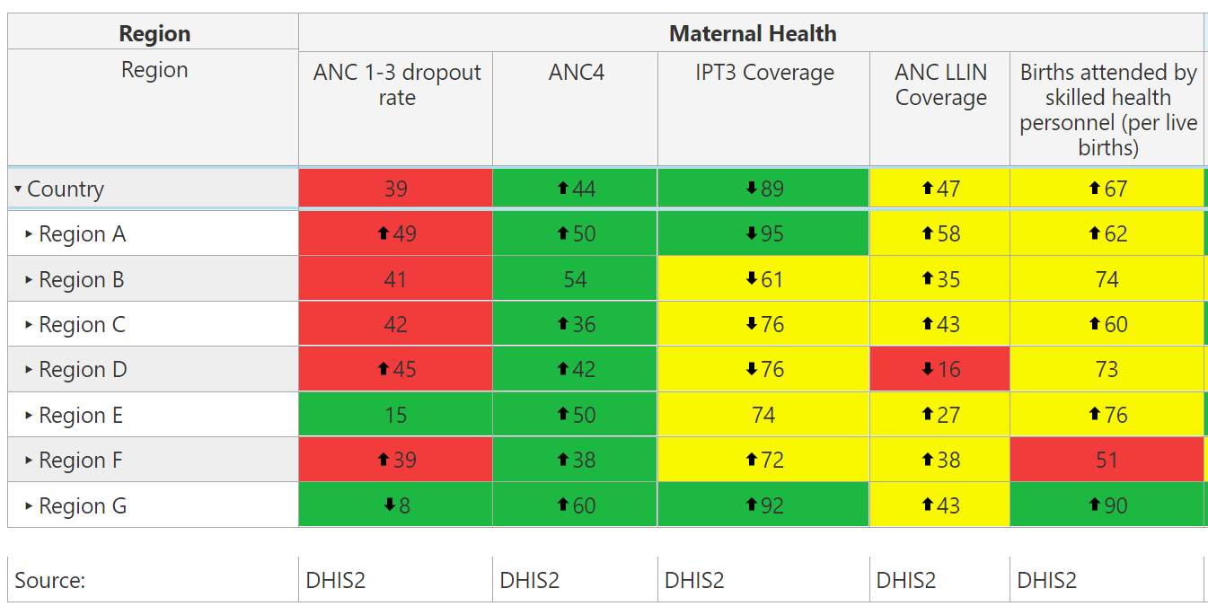
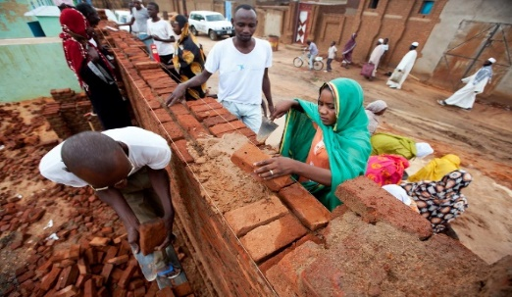
Context
The main objective of scorecards is to use the data to inform actions.
After identifying a problem, it is important to understand the root cause of the bottleneck.
Create SMART actions that directly address the root cause of the problem.

Slide 51
After identifying the problems, investigate deeper to gain an understanding of the situation
Questions to consider
Questions to consider
Example questions
1. Does this need a solution?
  Is this an anomaly? Or is performance likely to remain the same or even worsen?
2. What are the root causes?
  What are the root causes of the poor performance?
  Are there any causes that are specific to this geographic location that is contributing to the underperformance?
  Which causes can be managed or controlled?
3. What interventions exist?
  What interventions are in place or have been tried?
  What interventions have been successful? Which have been unsuccessful?
  Are there lessons learned from neighbors that can be adopted or scaled up?
  Can the community play a role in solving the issue?
Notes:
While the colour-coded scorecard data provides a good starting point for finding the problem, it is important to investigate deeper to understand the situation. Key questions to consider may include:
Does this need a solution? It is important to understand whether the scorecard data truly represents a problem requiring a solution or if it is simply an anomaly or even a data quality issue. Ask yourself, is the performance likely to get worse? If yes, then it is important to take action.
What are the root causes of the problem? Creating an action that will solve the problem requires understanding the root cause of the poor performance. Are there any factors specific to this geographic location that are contributing to the underperformance? Which root causes can be managed or controlled? And finally….
What interventions exist? What interventions are in place and have been tried? Have any been successful? Have any been unsuccessful? Are there lessons learned and success stories from neighbors that can be adopted or scaled up? And can the local community play a role in solving the issue?
The answers to these questions can help to guide the actions required to address the issues identified by the scorecard.

Slide 52
Actions usually fall into these categories
How to create smart actions
Action category | Description
Investigate the root causes | If the problem is unknown, investigate the root cause of the problem to better understand what actions to take
Advocacy for high level policy and strategy change | Changes to national and local policy or strategy to enable more effective implementation and adoption of initiatives
Petition support from partners | Petition support from development partners to implement activities that address underperformance
Manage procurement and supply chain issues | Changes to procurement & supply management of commodities to avoid disruptions, delays, unfulfilled demand, and poor quality
Build capacity | Training of personnel and upgrading of infrastructure to maximize effectiveness of resource utilisation
Address funding | Identification, securing, and disbursement of funding for products, initiatives, and infrastructure and technology upgrades
Improve quality and utilization of data | Improvements in data quality & systems used for monitoring and evaluating that data to track current status and progress
Catalyse community engagement | Working with the community to identify bottlenecks, and deploy necessary interventions
Adopt behavioral change communications | Communications on key messages to the general public to drive adoption of best practices in disease prevention and treatment

Slide 53
The SMART framework can help generate smart action descriptions
How to create smart actions
Criteria
Specific
Actions must be clear and specific. They must include all of the information required for the action owner to coordinate the action, and be specific about what is expected, when and at what level.
Measurable
Actions should quantify the target when possible to define success. They include numbers to indicate how much will be achieved (e.g. how many commodities will be ordered or how many staff will be trained, how many people should be sensitised)
Achievable
Actions must be realistic and achievable by the identified owner who should have the means to implement them.
Results- oriented
The action should address the root cause of the problem in a way that will result in an improvement in the indicator’s performance.
Time-bound
Actions should have a specific deadline which tells the action owner by when it should be implemented. If there are several stages required for the action, each stage can be a separate action, with a defined deadline.

Slide 54
The SMART framework can help generate smart actions
How to create smart actions
BOTTLENECK
stockout of primaquine in Districts X and Y leading to low ACT treatment rate for confirmed cases
SMART ACTION
Regional Medical Store manager to submit an order to the Central Medical Store for 3000 doses of primaquine for region A and deliver 1400 doses to District X and 1600 to District Y by 23 November 2021
Why is this a SMART action?
Specific: who, what, when, where. Describes the process and not the desired end result.
Measurable: 3000 doses, 1400 for District X and 1600 for District Y
Achievable: Medical Store manager is capable to ordering and coordinating delivery of medicine
Results-oriented: ordering and distributing the primaquine will resolve the stockout issue and lead to an improved treatment rate
Time-bound: This action must be implemented by 23 November 2021

Slide 55


Once a problem has been identified on the scorecard, generate clear action items
How to create SMART actions
 | Good example | Bad example
Actions are specific: who, what, when, where | National M&E coordinator should install 3 new computers with DHIS2 software in each regional health office by December 2021. | Improve quality of LMIS data
Should describe the process of “how” to achieve the end objective. Should not be the end objective. | The NMCP programme manager will write a letter to the Global Fund country office petitioning emergency funds for 50,000 LLINs for Regions A, B, C. | Procure 50,000 LLINs to increase coverage from 12% to 80%.
It is clear who is responsible for the action and the person must be able to implement | Director of Maternal & Newborn Health to establish a monthly forum to engage partners, mobilise funds and improve funding allocation to RMNCAH | Increase donor contribution to RMNCAH
You can clearly monitor progress on the action using numbers where possible | District Health Directorate should organize community durbars in all 5 communities of District X, to sensitise them on the upcoming IRS campaign | Ensure communities are sensitized for the upcoming IRS campaign

Slide 56
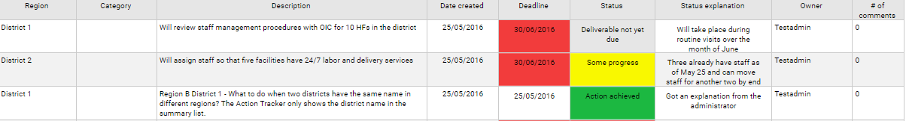
Action Tracker: Actions can be assigned and progress tracked on the scorecard web platform
List of action items, a field showing color-coded implementation status, due date, and owner
Actions can be assigned at all levels
Province 2
M&E
Hire three M&E staff members on temporary basis to clear backlog of HMIS records
15/12/2016
15/12/2016
Action achieved
User 1
1
MPs can see which actions they can support!
District A
M&E
Improve timeliness and quality of data by retraining PHU workers in data management
25/10/2016
25/11/2016
No progress
Training canceled
Admin 3
2
Province 3
Newborn health
Implement excusive breastfeeding for 6 months program at PHUs and conduct community outreach campaign to raise awareness of EBF
30/03/2016
30/09/2016
Some progress
Contacted managers
User 4
0
Missed deadlines are highlighted in red, prompting immediate management attention
Visual indicator of status allows manager to quickly identify which action items are at risk (e.g., yellow = some progress and on track)
Notes:
The scorecard web platform has a management functionality called the Action Tracker, where actions can be assigned and progress of implementation can be tracked. When the scorecard reveals a problem, the action tracker is used by managers to assign to a specific person, an action with a deadline. The web platform automatically sends notifications via email and SMS to the person who is assigned the action, giving them useful reminders that they are responsible for coordinating the implementation of an action. The automatic notifications are sent the day the action is created, 7 days before the deadline, 1 day before the deadline, and every 7 days after the deadline has passed if the action is not marked as complete.
This slide shows a screen shot of the action tracker. As you can see, actions can be assigned at all levels, including at district and even at facility level. The action tracker displays a list of action items, a field showing color-coded implementation status, the due date, and the owner responsible for coordinating the action. Missed deadlines are highlighted in red, prompting immediate management attention. The color-coded visual indicator status allows manager to quickly identify which action items are at risk.
The action tracker, like the other features of the scorecard web platform, is also available on the mobile app which allows programme managers and staff to easily update and monitor progress on action items.

Slide 57
www.scorecardhub.org
Hub Quiz: How to use the scorecard for action

Slide 58
Intergrate the scorecard into existing accountability mechanisms

Slide 59

Download video here: Integrate a scorecard into accountability structures Video

Slide 60
Integrate scorecard tools into existing accountability mechanisms
Introduction
Identify the key stakeholders who should be engaged for scorecard review
Identify the key accountability fora where the scorecard can be integrated for review and action
Define the quarterly process for populating and analysing the scorecard and documenting and monitoring actions

Slide 61
Who you should share the scorecard with
1. Identify the key stakeholders
Stakeholder | Broad responsibility
Political leaders | Performance transparency Using political power and resources to improve health where it matters most
Programme and Ministry of Health directors | Identifying key gaps in programming Changing policy to foster improvements Re-allocate resources to solve problems requiring funding
Development partners | With Ministry of Health programmes, identifying and providing financial and/or human (such as technical assistance) resources for programme needs Engaging the community around specific bottlenecks
Subnational stakeholders | Supporting implementation Benchmarking performance, data validation Feedback on implementation effectiveness
Community | Validating and supplementing data Joint problem solving to identify bottlenecks and propose community-oriented solutions

Slide 62
How does the scorecard process work?
1.
Data from existing sources are populated in the scorecard
3.
Existing management processes review the scorecard analysis and document recommended actions in the action tracker.
2.
Analysis
5. .
4.
Management and other existing accountability mechanisms monitor implementation of actions
Programmes and partners implement action items
Notes:
How does the Scorecard Process work?
As a management tool, the emphasis of scorecards should be on how the data is used for action.
Though the process varies depending on the country, many scorecards use the following process
Every quarter, scorecard administrators use data from existing sources like DHIS2 to produce the scorecard.
Technical teams at various levels analyze the scorecard, investigate the root causes of the bottlenecks and propose actions
The scorecard analysis and proposed actions are presented and validated during existing management meetings at all levels. These actions can be entered into the web platform’s action tracker.
Programmes and partners implement the action items; and
Management and other existing accountability mechanisms monitor implementation of actions
If the actions taken had the intended results of addressing the root cause of the issue identified in the scorecard, the data in subsequent scorecards should begin to show improvements.

Slide 63

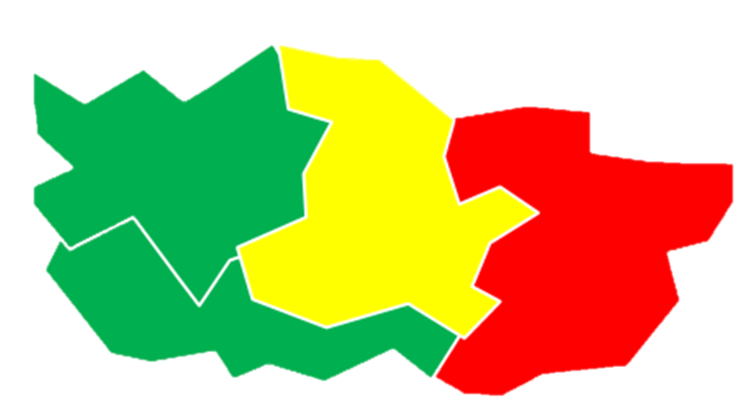

Scorecard can be reviewed at all levels
2. EXAMPLE: Identify existing accountability mechanisms
National
Regional
District level
Community level
National Cabinet Meetings
National Council on Health
National Technical Working Groups (e.g. RMNCAH+N, Malaria, M&E)
Annual Health Stakeholders Forum
Parliamentarian Committee for Health
End Malaria Councils
Regional Governors Forum
Executive Council
Health Management Committee
Health Data Committee
Health Management Committee
District Management Committee
Village Health Committee
Village Management Committee
Traditional leaders public hearings
Community Town Halls

Slide 64

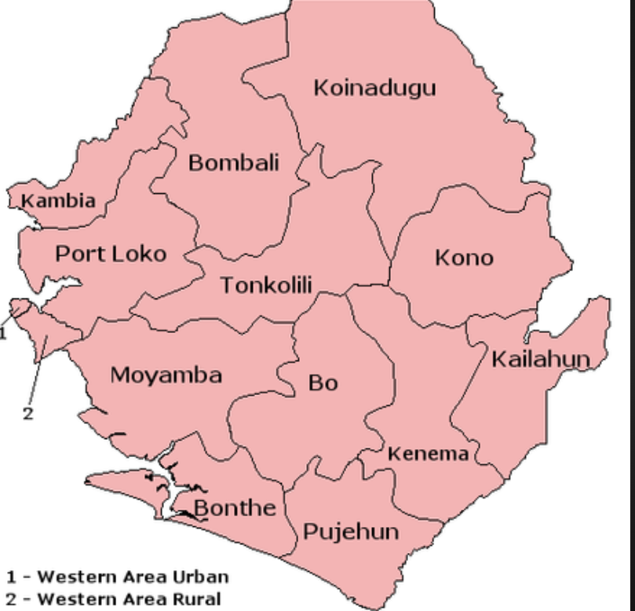
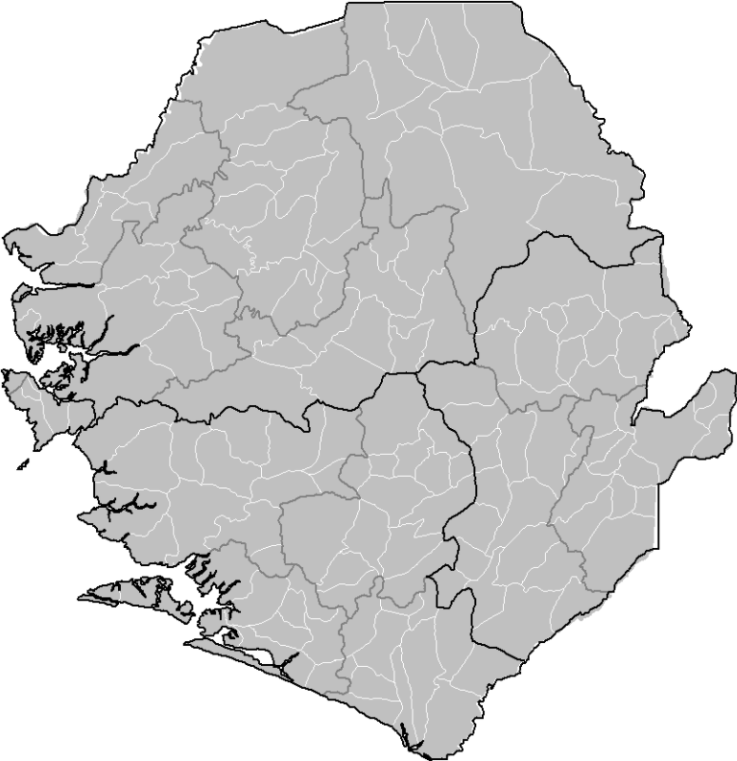
In what meetings can the scorecards be discussed and presented to decide on actions?
Central
District
Chiefdoms
Community
RCH Technical Committee
RCH Annual review meeting
Multi-sectoral technical committee
Interagency Coordination Committee (ICC)
DHMT meetings
Inter-sectoral meetings
Facility Management Committee meetings
?

Slide 65
Example: Roles and Responsibilities for scorecard (Regions)
Activity
Responsible
Jan
Feb
Mar
Apr
May
Jun
Jul
Aug
Sep
Oct
Nov
Dec
Jan
Q1
Q2
Q3
Q4
Health Information Officers
Data input into DHIS2
PPME
Populate the scorecard
Analyse scorecard and propose actions
Regional and District health teams
Actions validated and put into action tracker
NMCP, FD, PPME, RHMTs and DHMTs
Action implementation
Relevant stakeholder
Monitoring of actions
NMCP, FD, PPME, RHMTs and DHMTs,
Q4 Scorecard
Q1 Scorecard
Q2 Scorecard
Q3 Scorecard

Slide 66
www.scorecardhub.org
Hub Quiz: Accountability Mechanisms

Slide 67
Web Platform continued: Action Tracker

Slide 68
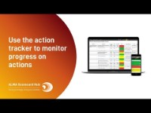
Action Tracker Overview

Slide 69
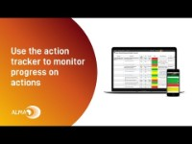
Users Part 3: Action Tracker
Download video: Web Platform Action Tracker

Slide 70
www.scorecardhub.org
Hub Quiz: Action Tracker

Slide 71
Web Platform comprehension exercise

Slide 72
Scorecard Web Platform Comprehension Activity
Go to the action tracker
Go to the scorecard
Select the scorecard for Q1 2018, then go to Q1 2021
Isolate the scorecard for one State.
Download a PDF of a district scorecard which also shows the chiefdoms
Create a line graph that compares the performance of the indicator ANC 4 for a Distrcit and 3 Chiefdoms for the periods Q4 2020 – Q1 2021
Create a line graph that compares the performance of “% children 0-11 months who received 1st dose of measles vaccine” for 6 LGAs, then generate a PDF of that graph. (Q4 2020 – Q1 2021)

Slide 73
Scorecard Web Platform Comprehension Questions
Generate a subnational view report showing the performance of a district for quarters Q4 2020 – Q1 2021. Download a PDF of that report.
Generate a report using the indicator view, which shows the performance for Penta 3 for Q4 2020 – Q1 2021.
Go to the action tracker. Add an action in the action tracker.
Then update the status of the action to “Action Achieved” and write a status explanation.
Download an excel of the action tracker.
Add a comment to an action

Slide 74
How to create an analysis and action presentation for existing meetings

Slide 75
Analysis and Action Presentation Exercise
CREATE A POWERPOINT PRESENTATION
Slide 1: Insert a screenshot of the Region scorecard in a PPT and circle at least 3 priorities on the scorecard. This can be an individual cell, multiple cells across an indicator column, or multiple cells across Sate or Districts. Take a screenshot of the scorecard and insert into the PPT.
For EACH priority:
Generate a report using the “indicator view” function to show the performance of each priority indicator for the periods Q1 2020 – Q1 2021. Insert the charts into the PowerPoint Presentation. Circle the priorities.
Generate a line graph for each priority indicator comparing the performance of six Facilities or Districts. Use periods Q1 2020 – Q1 2021. insert into the PPT. Circle the priorities.
Create a table with three columns (Priority / Potential Causes / Actions). For each priority, write a list of 1-3 potential causes, and select one action to address the potential causes. Add the table to the PPT. For this exercise, you should communicate with people on the ground to obtain their feedback.
Put the actions in the action tracker and insert a screen shot into the PPT.

Slide 76

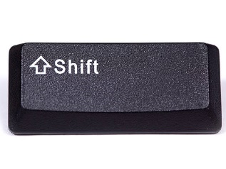

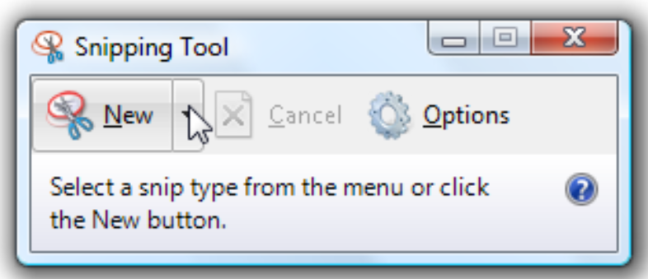
To insert an image of the scorecard, tables and graphs into a PPT presentation you can use…
S
Screen Capture: + +
Then copy into a PPT presentation
Or use« snipping tool »
Search for snipping tool in your computer.
Select and open snipping tool
Make sure you can see in your screen the image that you would like to take a screenshot of.
Click on "New” on the tool
Use the cursor to select what you want to capture.
Copy and paste the image into the PPT or relevant document.

Slide 77
EXMAMPLE: Analysis of Sierra Leone’s Q1 2021 RMNCAH Scorecard

Slide 78
Which regions are showing underperformance?
Considerations: Where are the reds with the arrows showing declining performance? What indicators are proxies for the main drivers of maternal and child death? Is there data suggesting this is a long-term systemic problem that requires intervention?

Slide 79
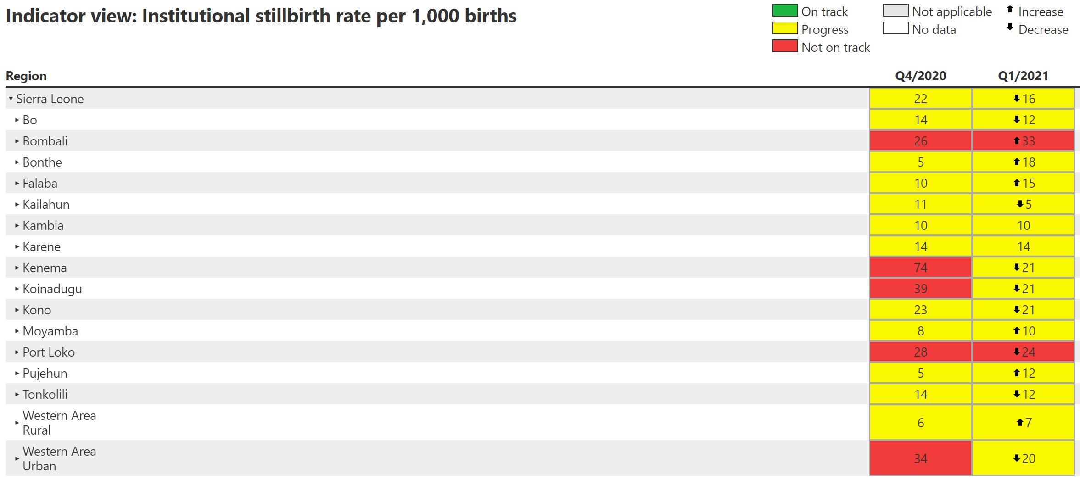

Slide 80
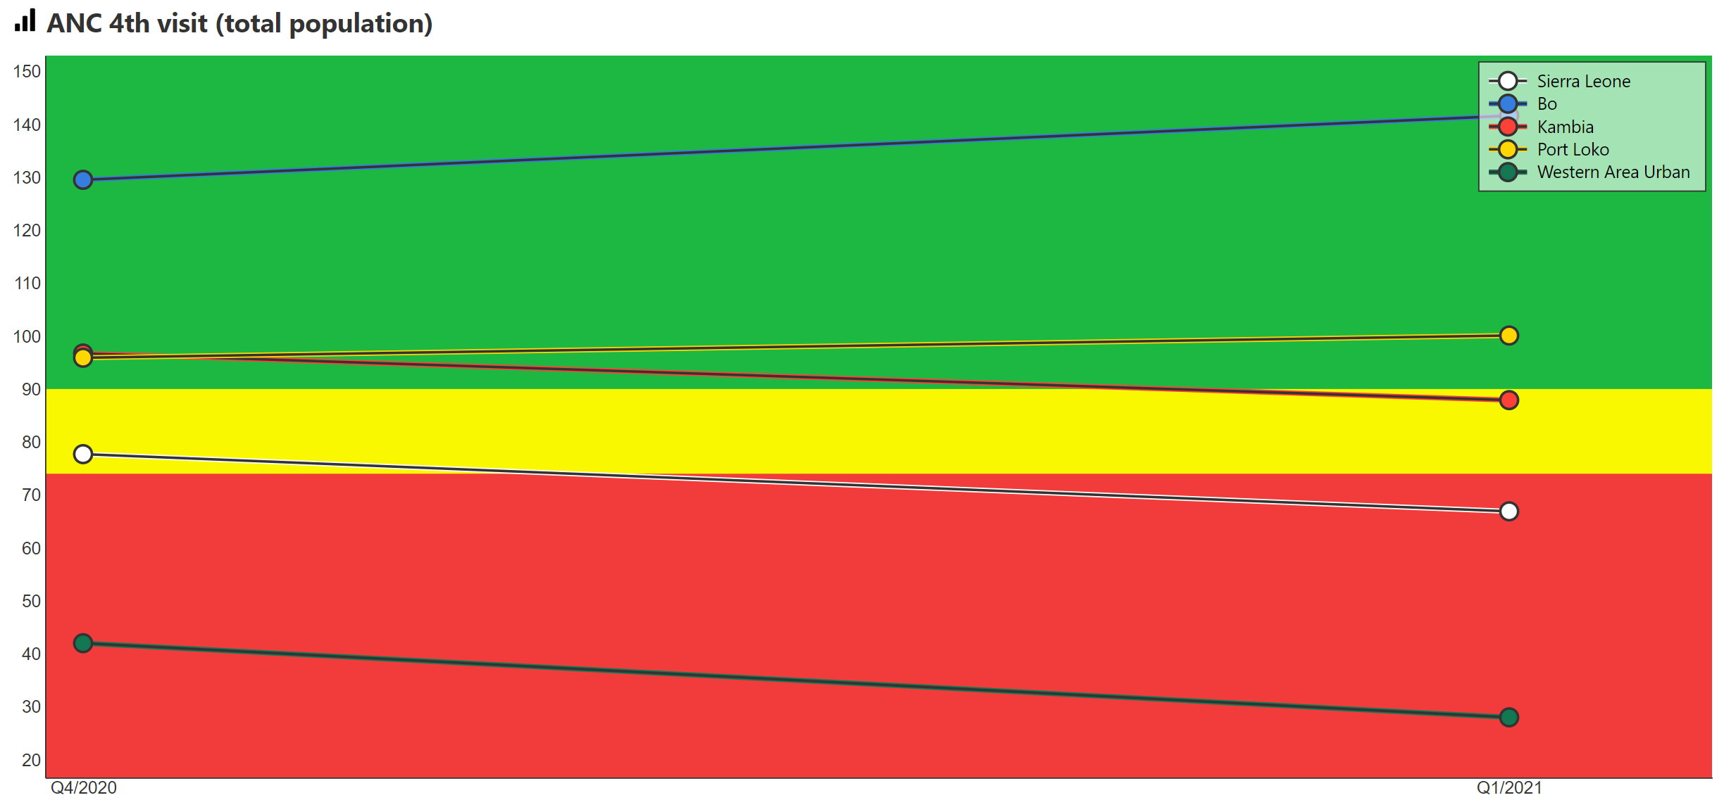

Slide 81
Actions to improve indicator performance
Priority Issue and location | Potential Causes | Action

Slide 82
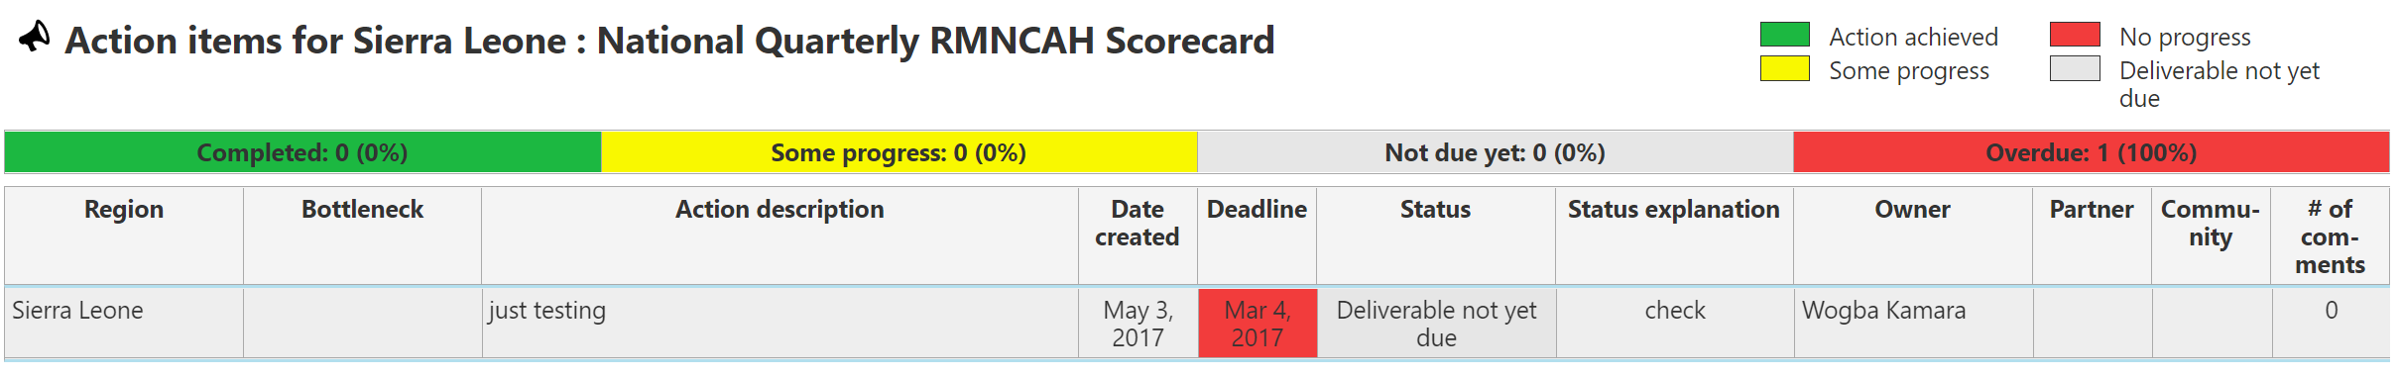
Example of action tracker

Slide 83
Group Presentations

Slide 84
Roles and Responsibilities and Coordination Mechanisms

Slide 85
How does the scorecard process work?
1.
Data from existing sources are populated in the scorecard
3.
Existing management processes review the scorecard analysis and document recommended actions in the action tracker.
2.
Analysis
5. .
4.
Management and other existing accountability mechanisms monitor implementation of actions
Programmes and partners implement action items
Notes:
How does the Scorecard Process work?
As a management tool, the emphasis of scorecards should be on how the data is used for action.
Though the process varies depending on the country, many scorecards use the following process
Every quarter, scorecard administrators use data from existing sources like DHIS2 to produce the scorecard.
Technical teams at various levels analyze the scorecard, investigate the root causes of the bottlenecks and propose actions
The scorecard analysis and proposed actions are presented and validated during existing management meetings at all levels. These actions can be entered into the web platform’s action tracker.
Programmes and partners implement the action items; and
Management and other existing accountability mechanisms monitor implementation of actions
If the actions taken had the intended results of addressing the root cause of the issue identified in the scorecard, the data in subsequent scorecards should begin to show improvements.

Slide 86
Sierra Leone: Roles and Responsibilities for scorecard
Activity
Responsible
Jan
Feb
Mar
Apr
May
Jun
Jul
Aug
Sep
Oct
Nov
Dec
Jan
Q1
Q2
Q3
Q4
Data input into DHIS2
Populate the scorecard
Analyse scorecard and propose actions
Actions validated and put into action tracker
Action implementation
Monitoring of actions
Q4 Scorecard
Q1 Scorecard
Q2 Scorecard
Q3 Scorecard

Slide 87
Next Steps

Slide 88
Next Steps: Nutrition Scorecard
Activity | Responsible | Deadline

Slide 89

Ghana Community Scorecard Video

Slide 90

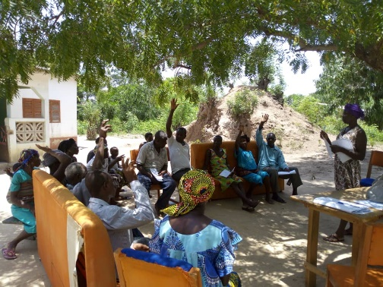
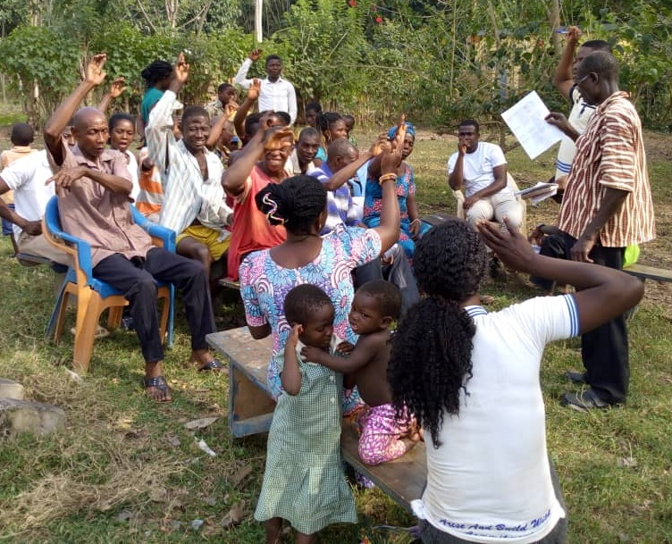
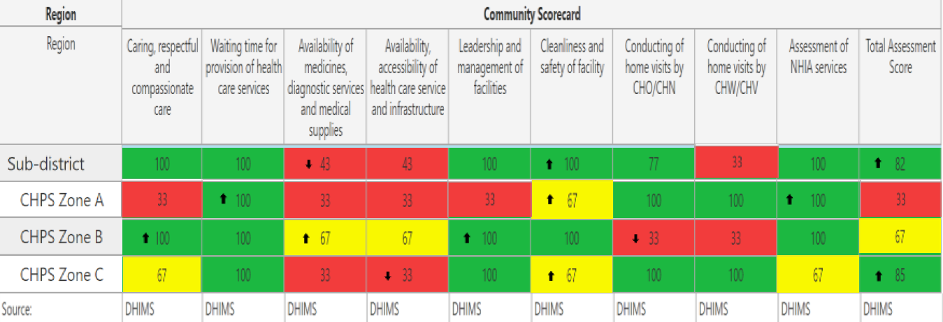
Community Scorecards
Rolled out in 2018 with support from the African Leaders Malaria Alliance (ALMA).
Community scorecards (CSC) are implemented through a community-led process that convenes community members, primary health facility staff, and local government structures, to promote social accountability and responsiveness to community needs in the health system.
The CSC process involves two components:
Scoring session
Action planning
In every community in Ghana, Community Health Management Committees (CHMCs) provide oversight to health service delivery. CHMC membership is comprised of community leaders.
CHMCs convene communities every quarter to discuss and score 9 indicators related to the quality of care and create actions plans.

Slide 91
Communities use the community scorecard for accountability and action
Ghana
1 = Bad / 2 = Average / 3 = Good
Each qualitative indicator is assigned a value from 1-3, where 1 is bad and 3 is good. The score that receives a majority vote from community members is recorded to produce a Community Scorecard (CSC).
The communities develop a Community Health Action Plan based on the identified gaps. At least 3 actions per quarter are recorded.
The 9-primary quality of care indicators:
Caring, Respective & Compassionate Care
Waiting time for service provision at time of entry.
Availability of medicines, diagnostics services and supplies.
Availability, Accessibility and Quality of health services and infrastructure.
Cleanness and safety of facility.
Leadership and management of facility
Conduct of home visit by health staff (CHO or CHN or Midwife).
Conduct of home visit by the Community Health Volunteer
Assessment of NHIA services
This CSC process has led to communities across Ghana to:
  Acquire land for new health facilities
  Build new health facilities
  Finance improvements of existing health facilities
  Resolve water supply issues
  Create community health insurance schemes
  Volunteer cleaning time at health facilities and others

Slide 92

Community Scorecard quarterly process
Continuous
Government and partners can use the RMNCAH and malaria scorecards to track outcome and coverage indicators, then use the community scorecard to understand bottlenecks based on community feedback. This community feedback can be used to inform action
Bottom-Up Interaction
Step 5
Enter scores and action plans into the scorecard web platform to produce colour-coded scorecards and provide online access to many stakeholders
Step 4
Inter-face meeting held between CHMC and facility in-charge to present result and the steps outlined to resolve the gaps within a period of 3-months
Step 3
Develop community health action plan (CHAP) to address problems identified in the scoring session. Progress of action plans from the previous quarter are also reviewed.
Step 2
Conduct scoring session by voting on each indicator. The score that receives the majority votes is recorded in the scorecard.
Step 1
CHMC conducts tour of health facility to understand the condition of the infrastructure, commodity availability, and equipment

Slide 93
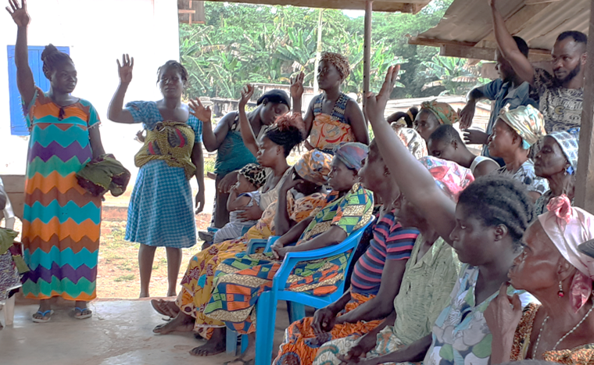
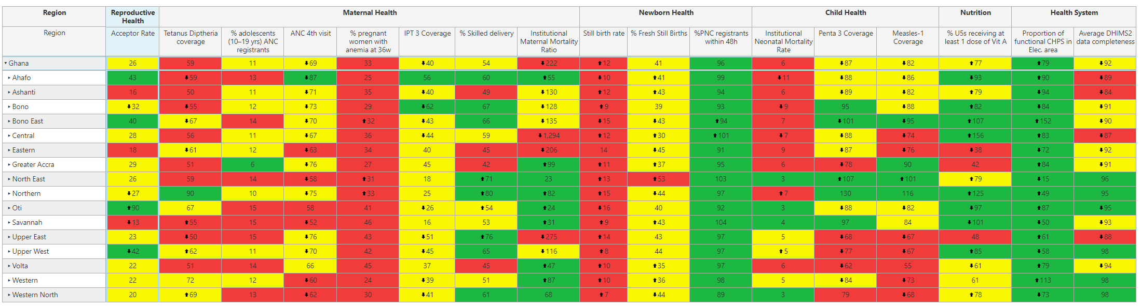
Positive outcomes in malaria using the CSC approach
In the Kparekpare Community (Oti Region’s Karachi East District), the CSC process identified low antenatal care (ANC) attendance as a problem leading to low IPTp coverage.
The CHMC conducted intensified community education during community meetings (durbars) to discuss dangers of non-attendance of ANC.
Within a year (Q42018/Q4 2019), ANC increased from 41% to 63% and IPT3 coverage from 41% to 79%.
Separate Malaria and RMNCAH scorecards track the performance of the output and coverage indicators

